Slide 1
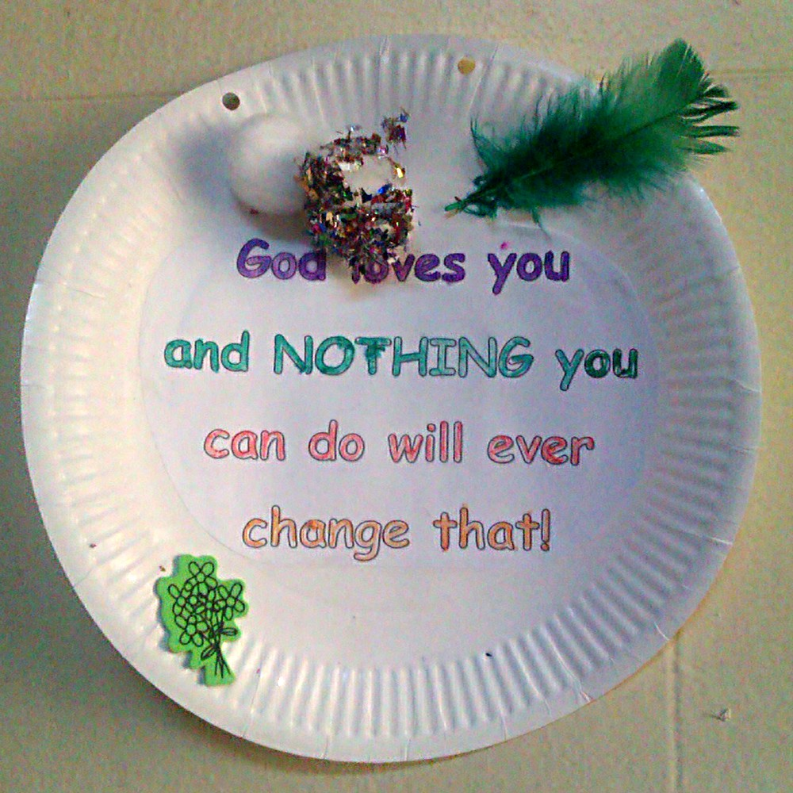

Slide 2
What then shall we say to these things? If God is for us, who can be against us? He who did not spare his own Son but gave him up for us all, how will he not also with him graciously give us all things? Who shall bring any charge against God’s elect? It is God who justifies. Who is to condemn? Christ Jesus is the one who died—more than that, who was raised—who is at the right hand of God, who indeed is interceding for us.
Romans 8:31-34 (ESV)

Slide 3
Who shall separate us from the love of Christ? Shall tribulation, or distress, or persecution, or famine, or nakedness, or danger, or sword? As it is written,
“For your sake we are being killed all the day long; we are regarded as sheep to be slaughtered.”
Romans 8:35-36 (ESV)

Slide 4
No, in all these things we are more than conquerors through him who loved us. For I am sure that neither death nor life, nor angels nor rulers, nor things present nor things to come, nor powers, nor height nor depth, nor anything else in all creation, will be able to separate us from the love of God in Christ Jesus our Lord.
Romans 8:37-39 (ESV)

Slide 5
What then shall we say to these things? (v31)
“These things”: Romans = the Himalayas of the NT
Chapter 8 = Everest
There is no condemnation for those who are in Christ Jesus (v1)
You did not receive a spirit that makes you a slave again to fear, but … the Spirit of sonship (v15)
In all things God works for the good of those who love him (v28)

Slide 6
Four questions:
If God is for us, who can be against us? (v31)
Nobody!
(or: maybe quite a few people but none can prevail against God)
He who did not spare his own Son but gave him up for us all, how will he not also with him graciously give us all things? (v32)

Slide 7
Four questions:
Who shall bring any charge against God’s elect? (v33a)
Nobody!
(or: maybe quite a few people but none can sustain their allegations)
It is God who justifies. (v33b)

Slide 8
Four questions:
Who is to condemn? (v34a)
Nobody!
(or: many may try but all will fail)
Christ Jesus is the one who died—more than that, who was raised—who is at the right hand of God, who indeed is interceding for us. (v34b)

Slide 9
Four questions:
Who shall separate us from the love of Christ? (v35a)
Nobody!
Shall tribulation, or distress, or persecution,
or famine, or nakedness,
or danger, or sword? (v35b)
or … ?

Slide 10
As it is written,
“For your sake we are being killed all the day long; we are regarded as sheep to be slaughtered.” (v36 )
quoting Psalm 44:22 (traditionally applied to martyrs)
No, in all these things we are more than conquerors through him who loved us. (v37)

Slide 11
For I am sure that:
neither death nor life,
nor angels nor rulers,
nor things present nor things to come,
nor powers,
nor height nor depth,
nor anything else in all creation,
will be able to separate us from the love of God
in Christ Jesus our Lord. (v38-39)

Slide 12
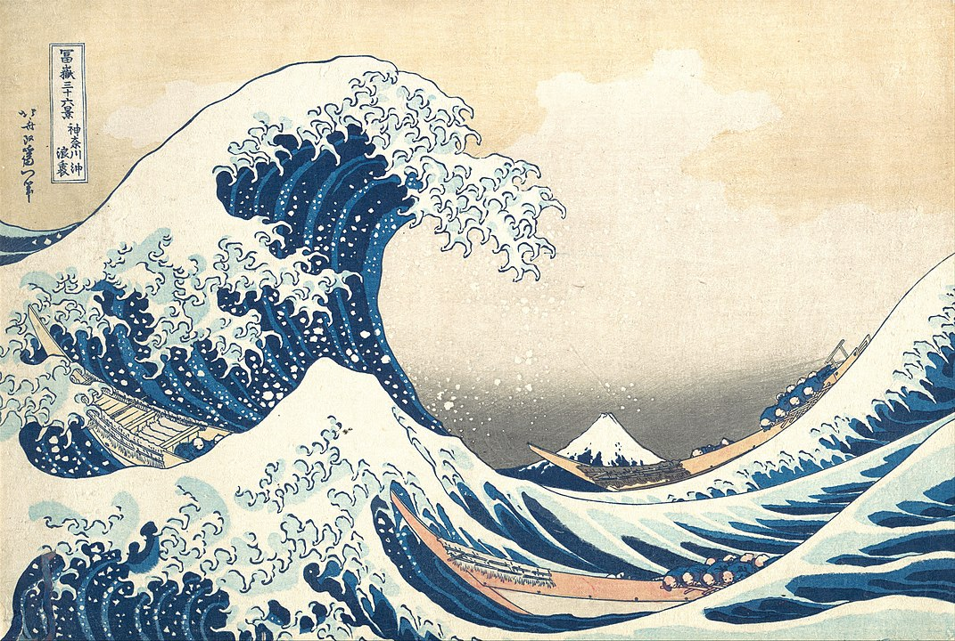
Notes:
“Ash Wednesday reminds us of our constant need to acknowledge and confess our fallen humanity, to repent of the past and throw ourselves on the loving mercy of God. For we have been assured that nothing can separate us from the love of God in Christ Jesus our Lord (Romans 8:38-39)”
[Sister Wendy Beckett; “The Art of Lent” – Day 1]
Picture: The Great Wave by Katsushika Hokusai (1831; Public Domain)

Slide 13
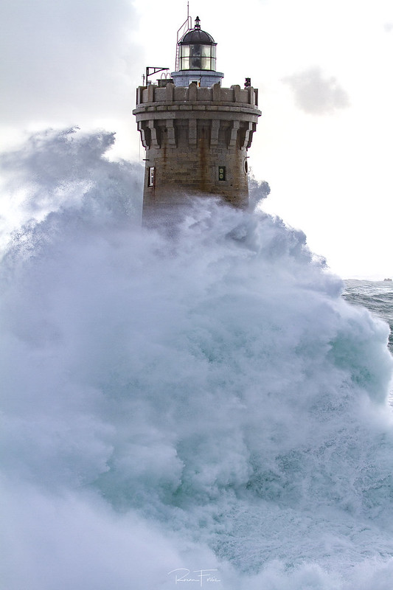
Notes:
“Phare du FOUR” by Ronan Follic, on Flickr (downloaded 2020/02/28 under a Creative Commons Attribution Non-Commercial licence)

