Slide 1
But as for you, continue in what you have learned and have become convinced of, because you know those from whom you learned it, and how from infancy you have known the Holy Scriptures, which are able to make you wise for salvation through faith in Christ Jesus. All Scripture is God-breathed and is useful for teaching, rebuking, correcting and training in righteousness, so that the servant of God may be thoroughly equipped for every good work.’ (2Tim.3:14-17)

Slide 2
The Evangelical Alliance Statement of Faith

Slide 3
The divine inspiration and supreme authority of the Old and New Testament Scriptures, which are the written Word of God - fully trustworthy for faith and conduct

Slide 4
“Do not think that I have come to abolish the Law or the Prophets; I have not come to abolish them but to fulfil them. For truly I tell you, until heaven and earth disappear, not the smallest letter, not the least stroke of a pen, will by any means disappear from the Law until everything is accomplished. Therefore anyone who sets aside one of the least of these commands and teaches others accordingly will be called least in the kingdom of heaven, but whoever practises and teaches these commands will be called great in the kingdom of heaven. For I tell you that unless your righteousness surpasses that of the Pharisees and the teachers of the law, you will certainly not enter the kingdom of heaven.” (Mt.5:17-20)

Slide 5
‘The Law, the Prophets and the Writings’,
the TaNaCh (Torah, Nevi’im, Chetuvim),
what we now call the Old Testament

Slide 6
It is written: ‘Man shall not live on bread alone, but on every word that comes from the mouth of God.’
It is also written: ‘Do not put the Lord your God to the test.’
Away from me, Satan! For it is written: ‘Worship the Lord your God, and serve him only.’ (Mt.4:4-10)

Slide 7
If you had known what these words mean, ‘I desire mercy, not sacrifice,’you would not have condemned the innocent. For the Son of Man is Lord of the Sabbath. (Mt.12:7,8)

Slide 8
Jesus called the crowd to him and said, “Listen to me, everyone, and understand this. Nothing outside a person can defile them by going into them. Rather, it is what comes out of a person that defiles them.” After he had left the crowd and entered the house, his disciples asked him about this parable. “Are you so dull?” he asked. “Don’t you see that nothing that enters a person from the outside can defile them? For it doesn’t go into their heart but into their stomach, and then out of the body.” (In saying this, Jesus declared all foods clean.) Mark7:14-19

Slide 9
“Haven’t you read,” Jesus replied, “that at the beginning the Creator ‘made them male and female,’ [quoting Genesis 1:27] and said, ‘For this reason a man will leave his father and mother and be united to his wife, and the two will become one flesh’? [quoting Genesis 2:24] So they are no longer two, but one flesh. Therefore what God has joined together, let no one separate.” (Mt.19:4-6)

Slide 10
“But about that day or hour no one knows, not even the angels in heaven, nor the Son, but only the Father. As it was in the days of Noah, so it will be at the coming of the Son of Man. For in the days before the flood, people were eating and drinking, marrying and giving in marriage, up to the day Noah entered the ark; and they knew nothing about what would happen until the flood came and took them all away. That is how it will be at the coming of the Son of Man.” (Mt.24:36-39)

Slide 11
Therefore, sin entered the world through one man, and death through sin, and in this way death came to all people, because all sinned. Death reigned from the time of Adam to the time of Moses, even over those who did not sin by breaking a command, as did Adam, who is a pattern of the one to come. (Rom.5:12,14)

Slide 12
All Scripture is God-breathed and is useful for teaching, rebuking, correcting and training in righteousness, so that the man of God may be thoroughly equipped for every good work.
^{(2 Tim.3:16,17)}

Slide 13
Myth: a powerful story
with a significant meaning

Slide 14
The seventh time around, when the priests sounded the trumpet blast, Joshua commanded the army, “Shout! For the Lord has given you the city! The city and all that is in it are to be devoted to the Lord.”…When the trumpets sounded, the army shouted, and at the sound of the trumpet, when the men gave a loud shout, the wall collapsed; so everyone charged straight in, and they took the city. They devoted the city to the Lord and destroyed with the sword every living thing in it—men and women, young and old, cattle, sheep and donkeys.
(Josh.6:16-21)

Slide 15
‘O Daughter of Babylon, doomed to destruction, happy is the one who repays you according to what you have done to us. Happy is the one who seizes your infants and dashes them against the rocks.’ (Psalm 137:8,9)

Slide 16
The Counsellor, the Holy Spirit, whom the Father will send in my name, will teach you all things and will remind you of everything I have said to you. (Jn.14:26)

Slide 17
Bear in mind that our Lord’s patience means salvation, just as our dear brother Paul also wrote you with the wisdom that God gave him. He writes the same way in all his letters, speaking in them of these matters. His letters contain some things that are hard to understand, which ignorant and unstable people distort, as they do the other Scriptures, to their own destruction. (2 Peter 3:15,16)

Slide 18
But I want you to realize that the head of every man is Christ, and the head of the woman is man, and the head of Christ is God. Every man who prays or prophesies with his head covered dishonours his head. But every woman who prays or prophesies with her head uncovered dishonours her head—it is the same as having her head shaved. For if a woman does not cover her head, she might as well have her hair cut off; but if it is a disgrace for a woman to have her hair cut off or her head shaved, then she should cover her head. A man ought not to cover his head, since he is the image and glory of God; but woman is the glory of man. …Judge for yourselves: Is it proper for a woman to pray to God with her head uncovered? Does not the very nature of things teach you that if a man has long hair, it is a disgrace to him, but that if a woman has long hair, it is her glory? For long hair is given to her as a covering. ^{(1 Cor.11:3-15)}

Slide 19
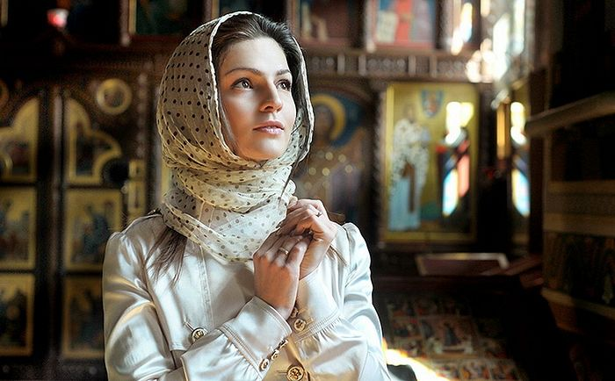

Slide 20
Therefore God gave them over in the sinful desires of their hearts to sexual impurity for the degrading of their bodies with one another. They exchanged the truth about God for a lie, and worshipped and served created things rather than the Creator—who is forever praised. Amen.
Because of this, God gave them over to shameful lusts. Even their women exchanged natural sexual relations for unnatural ones. In the same way the men also abandoned natural relations with women and were inflamed with lust for one another. Men committed shameful acts with other men, and received in themselves the due penalty for their error. (Rom.1:24-27)

Slide 21
The Counsellor, the Holy Spirit, whom the Father will send in my name, will teach you all things and will remind you of everything I have said to you. (Jn.14:26)

