Slide 1
He said to them, “How foolish you are, and how slow to believe all that the prophets have spoken! Did not the Messiah have to suffer these things and then enter his glory?”
And beginning with Moses and all the Prophets, he explained to them what was said in all the Scriptures concerning himself. (vv.25-27)

Slide 2
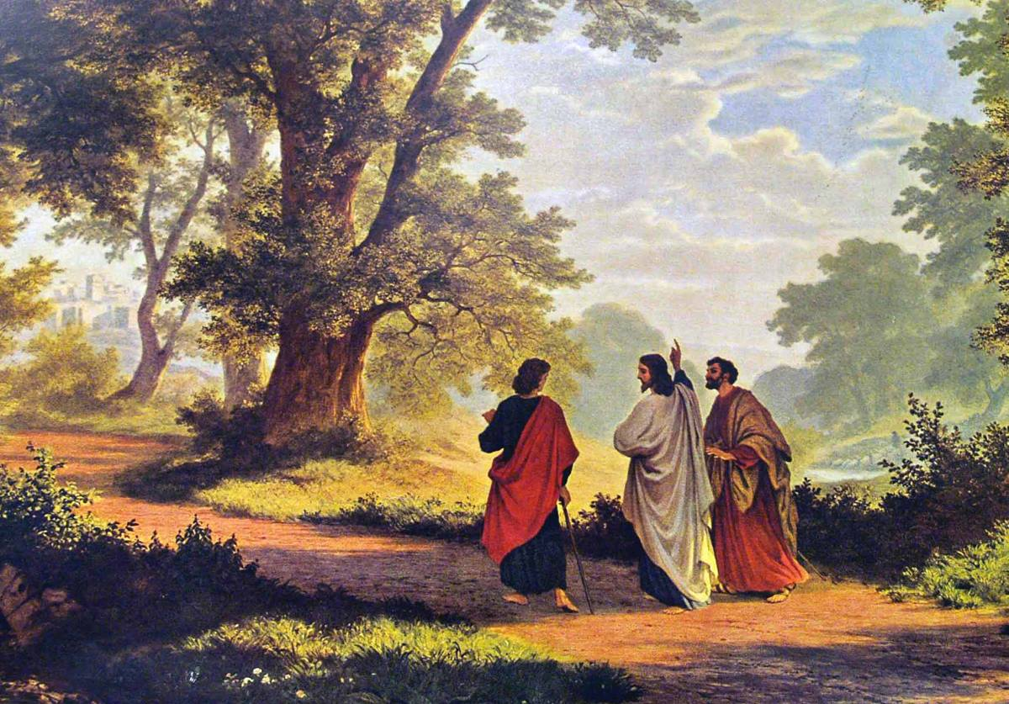

Slide 3
The Torah, the Books of Moses
Gen3:15 'I will put enmity between you and the woman, and between your offspring and hers; he will crush your head, and you will strike his heel.’ (The Protevangelion)
Num.21:9 'Moses made a bronze snake and put it up on a pole. Then when anyone was bitten by a snake and looked at the bronze snake, he lived.'

Slide 4
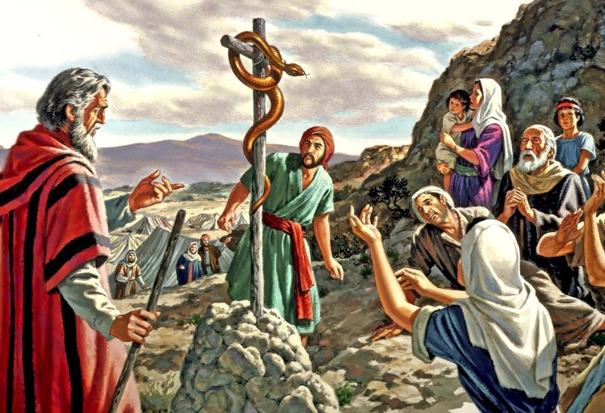

Slide 5
More from the Books of Moses
Dt.18:15 'The LORD your God will raise up for you a prophet like me from among your own brothers. You must listen to him.'

Slide 6
The Prophets
Is.7:14 'The virgin will be with child and will give birth to a son, and will call him Immanuel.'
Is.9:6 'For to us a child is born...'
Is.42:1-4 'Here is my servant, whom I uphold, my chosen one in whom I delight; I will put my Spirit on him...'
Is.53:6 'We all like sheep have gone astray, each of us has turned to his own way; and the LORD has laid on him the iniquity of us all.’
Is.61:1 ‘The Spirit of the Sovereign Lord is on me, because he has anointed me to preach good news to the poor.’

Slide 7
‘Anointed’ is Mashiach in Hebrew
In Greek it is Christos
A king is anointed with oil at his coronation
A priest is anointed at his ordination

Slide 8
More from the Prophets
Ezek.34:23 'I will place over them one shepherd, my servant David, and he will tend them; he will tend them and be their shepherd.’
Dan.9:24 'Seventy 'sevens' are decreed for your people and your holy city to finish transgression, to put an end to sin, to atone for wickedness, to bring in everlasting righteousness, to seal up vision and prophecy and to anoint the most holy.'

Slide 9
More from the Prophets
Mic.7:18-20 'Who is a God like you who pardons sin and forgives the transgression of the remnant of his inheritance?
...You will tread our sins underfoot...’
Mal.3:1 'See, I will send my messenger, who will prepare the way before me. Then suddenly the Lord you are seeking will come to his temple...'

Slide 10
Psalms
2:7,8 'He said to me, "You are my Son; today I have become your Father. Ask of me, and I will make the nations your inheritance..'
16:8-11 '..You will not abandon me to the grave..'
22:1,16-18 'My God, my God, why have you forsaken me?'
72:8-11 'He will rule from sea to sea.'
110:1 'The LORD says to my Lord: "Sit at my right hand until I make your enemies a footstool for your feet." '
118:22,23 'The stone the builders rejected has become the capstone; the LORD has done this, and it is marvellous in our eyes.'

Slide 11
When he was at the table with them, he took bread, gave thanks, broke it and began to give it to them. Then their eyes were opened and they recognized him, and he disappeared from their sight. (vv.30,31)

Slide 12
