Slide 1
The book of the genealogy of Jesus Christ, the son of David, the son of Abraham.
Abraham was the father of Isaac, and Isaac the father of Jacob, and Jacob the father of Judah and his brothers, and Judah the father of Perez and Zerah by Tamar, and Perez the father of Hezron, and Hezron the father of Ram, and Ram the father of Amminadab, and Amminadab the father of Nahshon, and Nahshon the father of Salmon, and Salmon the father of Boaz by Rahab, and Boaz the father of Obed by Ruth, and Obed the father of Jesse, and Jesse the father of David the king.

Slide 2
And David was the father of Solomon by the wife of Uriah, and Solomon the father of Rehoboam, and Rehoboam the father of Abijah, and Abijah the father of Asaph, and Asaph the father of Jehoshaphat, and Jehoshaphat the father of Joram, and Joram the father of Uzziah, and Uzziah the father of Jotham, and Jotham the father of Ahaz, and Ahaz the father of Hezekiah, and Hezekiah the father of Manasseh, and Manasseh the father of Amos, and Amos the father of Josiah, and Josiah the father of Jechoniah and his brothers, at the time of the deportation to Babylon.

Slide 3
And after the deportation to Babylon: Jechoniah was the father of Shealtiel, and Shealtiel the father of Zerubbabel, and Zerubbabel the father of Abiud, and Abiud the father of Eliakim, and Eliakim the father of Azor, and Azor the father of Zadok, and Zadok the father of Achim, and Achim the father of Eliud, and Eliud the father of Eleazar, and Eleazar the father of Matthan, and Matthan the father of Jacob, and Jacob the father of Joseph the husband of Mary, of whom Jesus was born, who is called Christ.

Slide 4
So all the generations from Abraham to David were fourteen generations, and from David to the deportation to Babylon fourteen generations, and from the deportation to Babylon to the Christ fourteen generations.
Matthew 1:1-17 (ESV)
All Scripture is God-breathed and is useful for teaching, rebuking, correcting and training in righteousness, so that the servant of God may be thoroughly equipped for every good work.
2 Timothy 3:16-17 (NIV)

Slide 5
In the beginning was the Word, and the Word was with God and the Word was God.
John 1:1 (ESV)
In the beginning, God created the heavens and the earth.
Genesis 1:1 (ESV)
The book of the genealogy [genesis] of Jesus Christ, the son of David, the son of Abraham.
Matthew 1:1 (ESV)
This is the book of the generations [genesis]of Adam.
Genesis 5:1 (ESV)

Slide 6
Jesus’ credentials are established by the genealogy

Slide 7
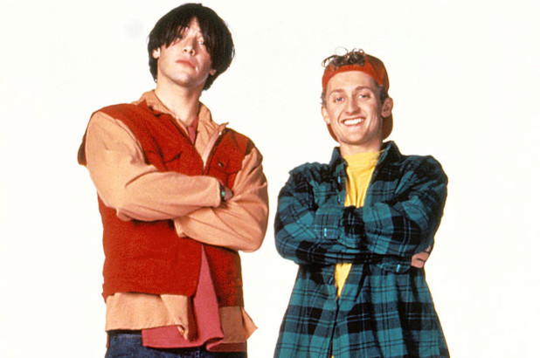

Slide 8
Always remember:
God is the hero of every Bible story

Slide 9
Jesus’ credentials are established by the genealogy
Jesus completes the OT story

Slide 10
[Jesus] unrolled the scroll and found the place where it was written,
“The Spirit of the Lord is upon me, because he has anointed me to proclaim good news to the poor. He has sent me to proclaim liberty to the captives and recovering of sight to the blind, to set at liberty those who are oppressed, to proclaim the year of the Lord's favour.”
… And he began to say to them, “Today this Scripture has been fulfilled in your hearing.”
Luke 4:17b-21 (ESV)

Slide 11
“Do not think that I have come to abolish the Law or the Prophets; I have not come to abolish them but to fulfil them.”
Matthew 5:17 (ESV)

Slide 12
But when Christ appeared as a high priest … he entered once for all into the holy places, not by means of the blood of goats and calves but by means of his own blood, thus securing an eternal redemption.
Hebrews 9:11-12 (ESV)

Slide 13
“When your days are fulfilled and you lie down with your fathers, I will raise up your offspring after you, who shall come from your body, and I will establish his kingdom. He shall build a house for my name, and I will establish the throne of his kingdom for ever. I will be to him a father, and he shall be to me a son.”
2 Samuel 7:12-14a (ESV)

Slide 14
Now the Lord said to Abram, “Go from your country and your kindred and your father’s house to the land that I will show you. And I will make of you a great nation, and I will bless you and make your name great, so that you will be a blessing.”
Genesis 12:1-2 (ESV)

Slide 15
Now the Lord said to Abram, “Go … and I will make of you a great nation, and I will bless you and make your name great, so that you will be a blessing. I will bless those who bless you, and him who dishonours you I will curse, and in you all the families of the earth shall be blessed.”
Genesis 12:1-3 (ESV)

Slide 16
Jesus’ credentials are established by the genealogy
Jesus completes the OT story
Jesus’ care extends to all nations

