Slide 1
HEBREWS עברית
The ‘Hall of Faith’
Hebrews Chapter 11

Slide 2
Righteous Living – by faith
Hebrews 10: ³⁸”My righteous ones will live by [from my] faith. But if fear holds them back, my soul is not content with them!”
³⁹But we are certainly not those who are held back by fear and perish [go to waste]; we are among those who have faith and experience true life!”
Hebrews 11: ⁶And without faith living within us it would be impossible to please God.
[From: The Passion Translation]

Slide 3
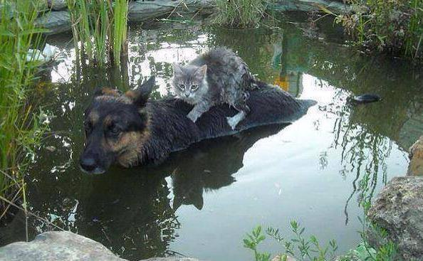

Slide 4
Recap:
Jesus Christ – a greater person
Jesus Christ – a greater priest
Jesus Christ – a perfect sacrifice
Jesus Christ – a greater tabernacle/temple

Slide 5
What Faith is not:
Blind optimism
Manufactured ‘hope so’ feeling
Intellectual agreement with a doctrine
Believing in the unknown in spite of evidence = superstition
Asking for frivolities…

Slide 6
Faith in Action
Heb 11: ¹Now faith is confidence in what we hope for and assurance about what we do not see. ² This is what the ancients were commended for.
³ By faith we understand that the universe was formed at God’s command, so that what is seen was not made out of what was visible.
“True Bible faith is confident obedience to God’s Word in spite of circumstances and consequences”
[Warren Wiersbe, Hebrews, Be Confident]

Slide 7
What Faith is:
Based on hearing God’s Word (Romans 10:17)
A firm foundation (KJV translates ’confidence’ as ‘substance’)
Being sure of the unseen (as opposed to the unknown)
Things that have not yet happened (things hoped for)
Things that cannot be seen (no-one has ever seen God – 1 John 4:12)
Caught, not taught
Like a muscle, needs exercising

Slide 8
Faith Exercised through Worship
Hebrews 11 ⁴Faith moved Abel to choose a more acceptable sacrifice to offer than his brother Cain, and God declared him righteous because of his offering. By his faith, Abel still speaks instruction to us today, even though he is long dead.

Slide 9
Faith Exercised through Walking
Hebrews 11 ⁵Faith translated Enoch from this life and he was taken up into heaven! He never had to experience death; he just disappeared from this world because God promoted him. For before he was translated into the heavenly realm his life had become a pleasure to God.
⁶And without faith living within us it would be impossible to please God.

Slide 10
Faith Exercised through Obedience
Hebrews 11 ⁷Faith opened Noah’s heart to receive revelation and warnings from God about what was coming, even things that had never been seen. But he stepped out in reverent obedience to God and built an ark…

Slide 11
Faith of the Patriarchs
Hebrews 11 ⁸Faith motivated Abraham to obey God’s call and leave the familiar to discover the territory he was destined to inherit from God.… his eyes of faith were set on the city with unshakeable foundations…
Sarah’s faith embraced God’s miracle power to conceive even though she was barren….
… these heroes all died still clinging to their faith, not even receiving all that had been promised them. But they saw beyond the horizon….

Slide 12
Perfection – together in fullness of faith
Hebrews 11 ³⁹These were the true heroes, commended for their faith, yet they lived in hope without receiving the fullness of what was promised them. ⁴⁰But now God has invited us to live in something better than what they had – faith’s fullness! This is so that they could be brought along to finished perfection alongside of us.

Slide 13
How can we grow in our faith?
Exercise it! Ask for help
My sheep hear my voice – listen!
Remember that obedience usually comes before understanding
Exercise patience – God is in control. Psalm 2
Pray for tangible outcomes, real things. Ask, seek, knock.
Hang out with the faithful
Hear the faithful testimony of the giants.

Slide 14
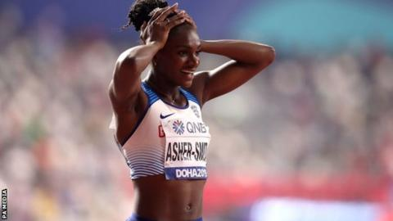

Slide 15
Hebrews 12 Therefore, since we are surrounded by such a great cloud of witnesses, let us throw off everything that hinders and the sin that so easily entangles. And let us run with perseverance the race marked out for us, ² fixing our eyes on Jesus, the pioneer and perfecter of faith.
We were created to leave a mark on the lives and world around us! Let us walk together in faith, hope and love (1 Cor 13) to see the Kingdom come in our day, on earth as it is in heaven!

