Slide 1
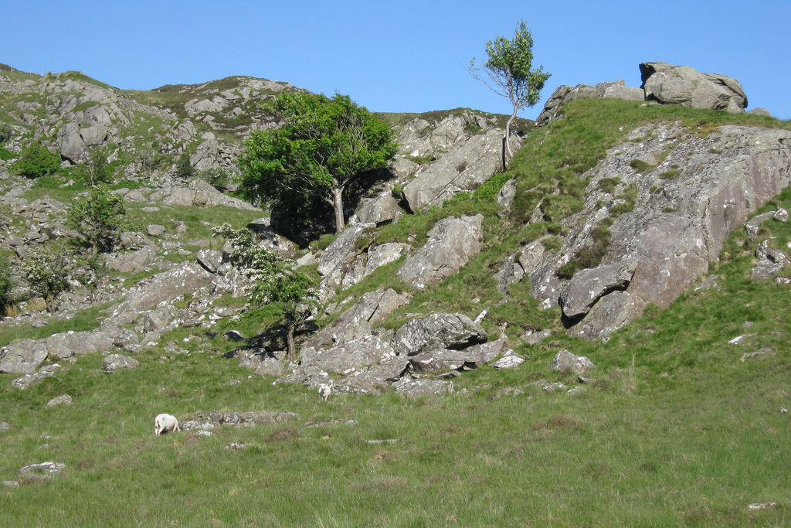
Luke 15:1-10
The Lost and Found

Slide 2
“Prayer should be
our first resource,
not our last resort”
Andrew Ollerton
“The Church on its knees”
(Sermon at Penrallt Baptist Church, 23/10/2016)

Slide 3
Luke 15:1-3 (NIV)
Now the tax collectors and sinners were all gathering round to hear Jesus. But the Pharisees and the teachers of the law muttered, ‘This man welcomes sinners, and eats with them.’
Then Jesus told them this parable:

Slide 4
Luke 15:4-7 (NIV)
‘Suppose one of you has a hundred sheep and loses one of them. Doesn’t he leave the ninety-nine in the open country and go after the lost sheep until he finds it? And when he finds it, he joyfully puts it on his shoulders and goes home. Then he calls his friends and neighbours together and says, “Rejoice with me; I have found my lost sheep.” I tell you that in the same way there will be more rejoicing in heaven over one sinner who repents than over ninety-nine righteous people who do not need to repent.

Slide 5
Luke 15:8-10 (NIV)
‘Or suppose a woman has ten silver coins and loses one. Doesn’t she light a lamp, sweep the house and search carefully until she finds it? And when she finds it, she calls her friends and neighbours together and says, “Rejoice with me; I have found my lost coin.” In the same way, I tell you, there is rejoicing in the presence of the angels of God over one sinner who repents.’

Slide 7
Luke 19:10 (NIV)
‘For the Son of Man came to seek and to save the lost.’
John 3:16 (NIV)
For God so loved the world that he gave his one and only Son, that whoever believes in him shall not perish but have eternal life.

Slide 8
Ezekiel 18:23, 30 (NIV)
“Do I take any pleasure in the death of the wicked? declares the Sovereign Lord. Rather, am I not pleased when they turn from their ways and live?... For I take no pleasure in the death of anyone, declares the Sovereign Lord. Repent and live!”

Slide 9
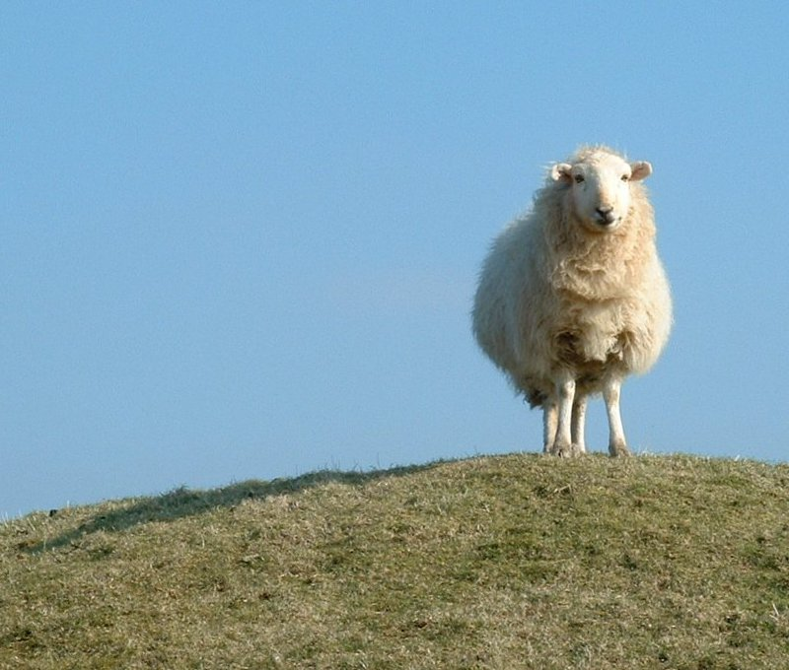
John 10:11 (NIV)
‘I am the good shepherd. The good shepherd lays down his life for the sheep.’

Slide 10
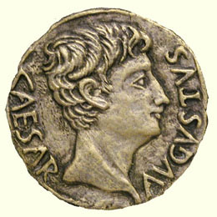
Roman denarius
=
Greek drachma
Roughly one day’s wage for a labourer
(1st century Palestine)

Slide 11
1. God doesn’t give up searching
v4: ‘Doesn’t he … go after the lost sheep until he finds it?
v8: Doesn’t she … search carefully until she finds it?

Slide 12
Psalm 139:1-4 (NIV)
You have searched me, Lord, and you know me.
You know when I sit and when I rise; you perceive my thoughts from afar.
You discern my going out and my lying down; you are familiar with all my ways.
Before a word is on my tongue you, Lord, know it completely.

Slide 13


Slide 14
2. Finding the lost is a cause for great celebration
v6b: ‘Then he calls his friends and neighbours together and says, “Rejoice with me; I have found my lost sheep.” ’
v9: …“Rejoice with me; I have found my lost coin.”

Slide 15
v7: ‘I tell you that in the same way there will be more rejoicing in heaven over one sinner who repents than over ninety-nine righteous people who do not need to repent.’
v10: ‘In the same way, I tell you, there is rejoicing in the presence of the angels of God over one sinner who repents.’

Slide 16

“When you can’t run, you crawl. And when you can’t do that, you find someone to carry you”

Slide 17
3. God seeks and finds those we might sometimes prefer to lose
v1-3: Now the tax collectors and sinners were all gathering round to hear Jesus. But the Pharisees and the teachers of the law muttered, ‘This man welcomes sinners, and eats with them.’ Then Jesus told them this parable:…

Slide 18
Matt. 7:2-5 (NIV)
‘Why do you look at the speck of sawdust in your brother’s eye and pay no attention to the plank in your own eye? How can you say to your brother, “Let me take the speck out of your eye,” when all the time there is a plank in your own eye? You hypocrite, first take the plank out of your own eye, and then you will see clearly to remove the speck from your brother’s eye.

Slide 19
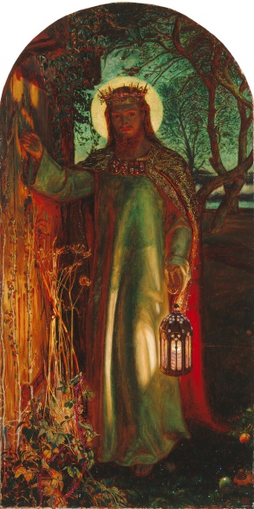
Rev. 3:20 (NIV)
“Here I am! I stand at the door and knock. If anyone hears my voice and opens the door, I will come in and eat with that person, and they with me.”
The Light of the World (Manchester version)
by Holman Hunt (c. 1851-56)

