Slide 1
Love Yourself
It’s a commandment !

Slide 2
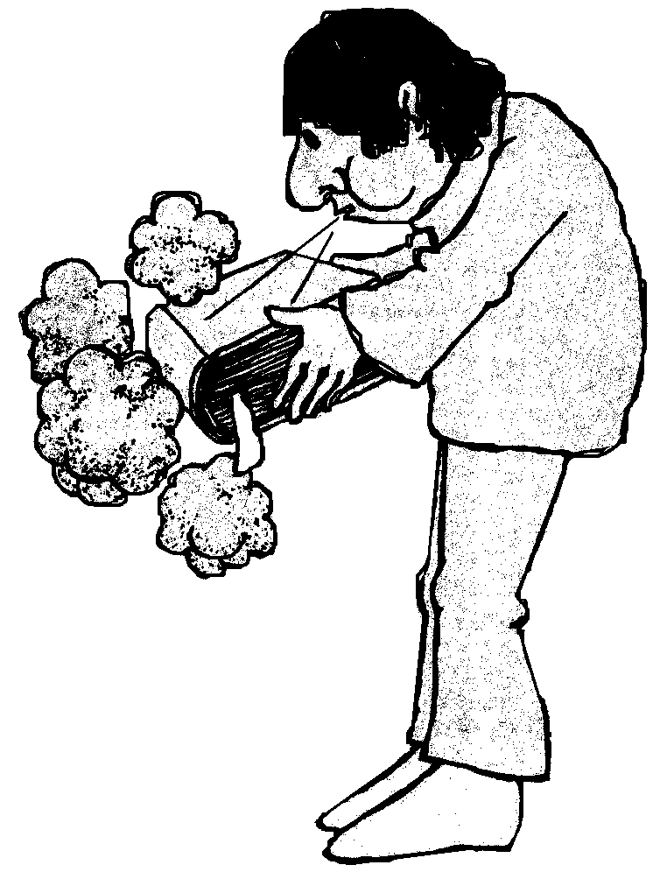
²⁶ God said, Let Us [Father, Son, and Holy Spirit] make mankind in Our image, after Our likeness, and let them have complete authority over the fish of the sea, the birds of the air, the [tame] beasts, and over all of the earth, and over everything that creeps upon the earth. Genesis 1:26 (Amplified)

Slide 3
Then God said, “Let us make mankind in our image, in our likeness, so that they may rule over the fish in the sea and the birds in the sky, over the livestock and all the wild animals, and over all the creatures that move along the ground.” So God created mankind in his own image, in the image of God he created them; male and female he created them. Genesis 1:26-27(NIV)

Slide 4
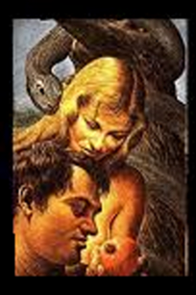
God’s plan is that human kind would be like him , ‘image’ here does not mean simply appearance but spirit and character, the ‘Imago Dei’, God created man in two forms [male and female] so that they could be complete as He is; [Father, Son and Holy Spirit] he is not alone within Himself and does not want his created people to be alone either but we have the fall to contend with. Sin spoilt the relationship between God and Man but also within man came selfishness; which became rife.

Slide 5
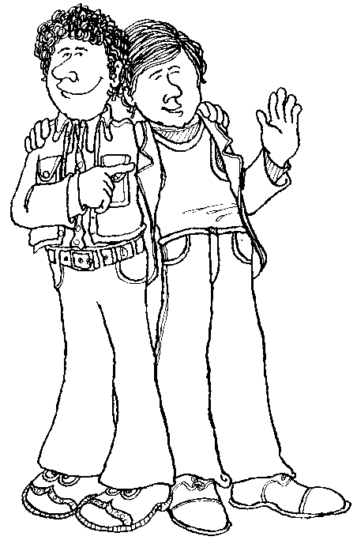
¹⁶ “‘Do not go about spreading slander among your people. “‘Do not do anything that endangers your neighbour's life. I am the Lord. ¹⁷ “‘Do not hate a fellow Israelite (church member) in your heart. Rebuke your neighbour frankly so you will not share in their guilt. ¹⁸ “‘Do not seek revenge or bear a grudge against anyone among your people, but love your neighbour as yourself. I am the Lord. ¹⁹ “‘Keep my decrees.
Leviticus 19:16-19 (NIV)

Slide 6
⁸ Let no debt remain outstanding, except the continuing debt to love one another, for whoever loves others has fulfilled the law. ⁹ The commandments, “You shall not commit adultery,” “You shall not murder,” “You shall not steal,” “You shall not covet,” and whatever other command there may be, are summed up in this one command:
“Love your neighbour as yourself.”
¹⁰ Love does no harm to a neighbour. Therefore love is the fulfilment of the law. Romans 13:8-10 (NIV)

Slide 7
²⁵ On one occasion an expert in the law stood up to test Jesus. “Teacher,” he asked, “what must I do to inherit eternal life?” ²⁶ “What is written in the Law?” he replied. “How do you read it?” ²⁷ He answered, “‘Love the Lord your God with all your heart and with all your soul and with all your strength and with all your mind’; and, ‘Love your neighbour as yourself.’” ²⁸ “You have answered correctly,” Jesus replied. “Do this and you will live.” ²⁹ But he wanted to justify himself, so he asked Jesus, “And who is my neighbour?”
Luke 10:25-29(NIV)

Slide 8
Jesus told the parable of the ‘Good Samaritan’,
The Samaritan saw what was immediately needed and did his best to meet that need.
He then went on to anticipate the victim’s further need and made provision for that too.
Jesus intended this illustration to be an example.
You will have noticed Jesus did not tell a parable about the teacher’s need to love himself, did he?
Jesus recognised in the questioner a harboured prejudice and this obstructed his view of the world in which he lived.

Slide 9
Bernard of Clairvaux (1090–1153), the abbot of a Cistercian monastery in France, was perhaps the greatest Christian leader and writer of his day. In his great work entitled ‘Loving God’, Bernard describes four degrees of love: 1. Loving ourselves for our own sake. 2. Loving God for his gifts and blessings. 3. Loving God for himself alone. 4. Loving ourselves for the sake of God. The highest degree of love, for Bernard, was simply that we love ourselves as God loves us — in the same degree, in the same manner, and with the very same love. We love the self that God loves, the essential image and likeness of God in us that has been damaged by sin.
(From Emotionally Healthy Spirituality Day by Day)

Slide 10
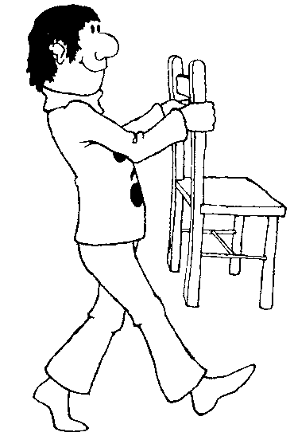
¹³You, my brothers and sisters, were called to be free. But do not use your freedom to indulge the flesh; rather, serve one another humbly in love. ¹⁴For the entire law is fulfilled in keeping this one command: “Love your neighbour as yourself.” ¹⁵If you bite and devour each other, watch out or you will be destroyed by each other.¹⁶ So I say, walk by the Spirit, and you will not gratify the desires of the flesh. ¹⁷For the flesh desires what is contrary to the Spirit, and the Spirit what is contrary to the flesh. They are in conflict with each other, so that you are not to do whatever you want.
Galatians 5:13-17(NIV)

Slide 11
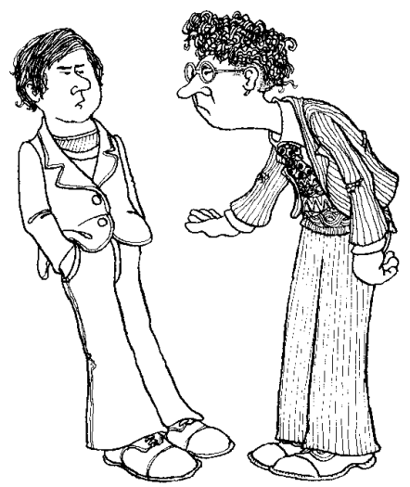
¹⁸But if you are led by the Spirit, you are not under the law. ¹⁹The acts of the flesh are obvious: sexual immorality, impurity and debauchery; ²⁰idolatry and witchcraft; hatred, discord, jealousy, fits of rage, selfish ambition, dissensions, factions ²¹and envy; drunkenness, orgies, and the like. I warn you, as I did before, that those who live like this will not inherit the kingdom of God.
Galatians 5:18-21(NIV)

Slide 12
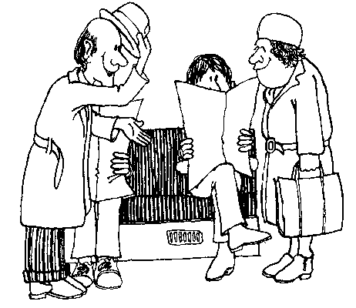
²²But the fruit of the Spirit is love, joy, peace, forbearance, kindness, goodness, faithfulness, ²³gentleness and self-control. Against such things there is no law. ²⁴Those who belong to Christ Jesus have crucified the flesh with its passions and desires. ²⁵Since we live by the Spirit, let us keep in step with the Spirit. ²⁶Let us not become conceited, provoking and envying each other.
Galatians 5:22-26(NIV)

Slide 13
This is not a call to self-centeredness
The motive for doing anything should not be that I will be blessed.
Never forget God loves you,
You are someone else’s neighbour; so in that; God your Father has your back.
Do not be tempted to tell the Father how he should answer your prayers nor be disappointed if the answers are not quite what you expected or hoped for.
TRUST God our Father in all things!
Notes:
Paul had grown up, been educated as Jew of the first order knowing the law and what he had been taught, but without question. If something didn’t agree with what he been taught then it wasn’t kosher; but as we know he met the Lord in a vision outside Damascus and the rest is history, it is arguable that if Paul did not love himself as God our Father and Jesus our Lord loved him we would not be here now worshiping as we do.
Clearly part of loving one’s self as God your Father loves you is being obedient to His instructions. Think of Mary a teenage girl allowed herself to be used to mother the Saviour, Joseph recognised the hand of God in the dreams he had and followed instructions, yet after the family’s return to Nazareth we hear no more of him except for an oblique reference that Jesus was obedient to his parents.
Getting to know what God requires of you is a good idea, we are not all called to be Paul or Peter or another significant person in human history.
Do you love yourself enough to be obedient to the call of God to do a simple, maybe obscure task for God Our Father?

Slide 14
Don’t give in to self-condemnation.
God is our Father and He loves you.
Not the you, that you wish you were but the whole person you were made to be; in his image.
Do you have the courage to ask Him what He might require of you?

Slide 15
Now to him who is able to do immeasurably more than all we ask or imagine, according to his power that is at work within us, to him be glory in the church,[in me] and in Christ Jesus throughout all generations, for ever and ever!
Amen.
Ephesians 3:20-21(NIV)

Slide 16
Amen.

