Slide 1
HEBREWS עברית
Jesus - our model of worship
Hebrews Chapters 8 – 10

Slide 2
The High Priest of a New Covenant
Hebrews 8: ¹Now the main point of what we are saying is this: We do have such a high priest, who sat down at the right hand of the throne of the Majesty in heaven, ² and who serves in the sanctuary, the true tabernacle set up by the Lord, not by a mere human being.

Slide 3
The earthly is an inferior pattern of the heavenly
³ Every high priest is appointed to offer both gifts and sacrifices, and so it was necessary for this one also to have something to offer. ⁴ If he were on earth, he would not be a priest, for there are already priests who offer the gifts prescribed by the law. ⁵ They serve at a sanctuary that is a copy and shadow of what is in heaven. This is why Moses was warned when he was about to build the tabernacle: “See to it that you make everything according to the pattern shown you on the mountain.” ⁶ But in fact the ministry Jesus has received is as superior to theirs as the covenant of which he is mediator is superior to the old one, since the new covenant is established on better promises….

Slide 4
Worship in the Earthly Tabernacle
Hebrews 9 ¹Now the first covenant had regulations for worship and also an earthly sanctuary. ² A tabernacle was set up. In its first room were the lampstand and the table with its consecrated bread; this was called the Holy Place. ³ Behind the second curtain was a room called the Most Holy Place, ⁴ which had the golden altar of incense and the gold-covered ark of the covenant. This ark contained the gold jar of manna, Aaron’s staff that had budded, and the stone tablets of the covenant. ⁵ Above the ark were the cherubim of the Glory, overshadowing the atonement cover. But we cannot discuss these things in detail now.

Slide 5
⁶ When everything had been arranged like this, the priests entered regularly into the outer room to carry on their ministry. ⁷ But only the high priest entered the inner room, and that only once a year, and never without blood, which he offered for himself and for the sins the people had committed in ignorance. ⁸ The Holy Spirit was showing by this that the way into the Most Holy Place had not yet been disclosed as long as the first tabernacle was still functioning. ⁹ This is an illustration for the present time, indicating that the gifts and sacrifices being offered were not able to clear the conscience of the worshiper. ¹⁰ They are only a matter of food and drink and various ceremonial washings—external regulations applying until the time of the new order.

Slide 6
The Blood of Christ
¹¹ But when Christ came as high priest of the good things that are now already here, he went through the greater and more perfect tabernacle that is not made with human hands, that is to say, is not a part of this creation. ¹² He did not enter by means of the blood of goats and calves; but he entered the Most Holy Place once for all by his own blood, thus obtaining eternal redemption.

Slide 7
Christ’s Sacrifice Once for All
Hebrews 10: ¹The law is only a shadow of the good things that are coming—not the realities themselves. For this reason it can never, by the same sacrifices repeated endlessly year after year, make perfect those who draw near to worship.

Slide 8
RECAP - JESUS CHRIST IS GREATER
Jesus Christ is greater than the angels (Heb 1)
Jesus Christ is greater than Moses (Heb 3)
Jesus Christ is greater than Aaron and the Levitical priesthood (Heb 5)
He is ‘our great high priest who has gone into the heavens’ Heb 4:14
Jesus Christ is more than a priest. He is also Priest-King in the order of Melchizedek. (Heb 7)
Jesus Christ is both Priest and Sacrifice. Hebrews 10:11

Slide 9
JESUS CHRIST IS GREATER
Jesus Christ is greater than the earthly tabernacle/temple
John 2: ¹⁸ The Jews then responded to him, “What sign can you show us to prove your authority to do all this?”
¹⁹ Jesus answered them, “Destroy this temple, and I will raise it again in three days.” ²⁰ They replied, “It has taken forty-six years to build this temple, and you are going to raise it in three days?” ²¹ But the temple he had spoken of was his body. ²² After he was raised from the dead, his disciples recalled what he had said. Then they believed the scripture and the words that Jesus had spoken.

Slide 10
Tabernacle Keys to Worship

Slide 11
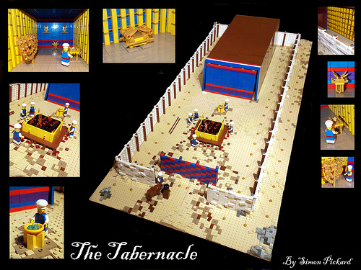

Slide 12
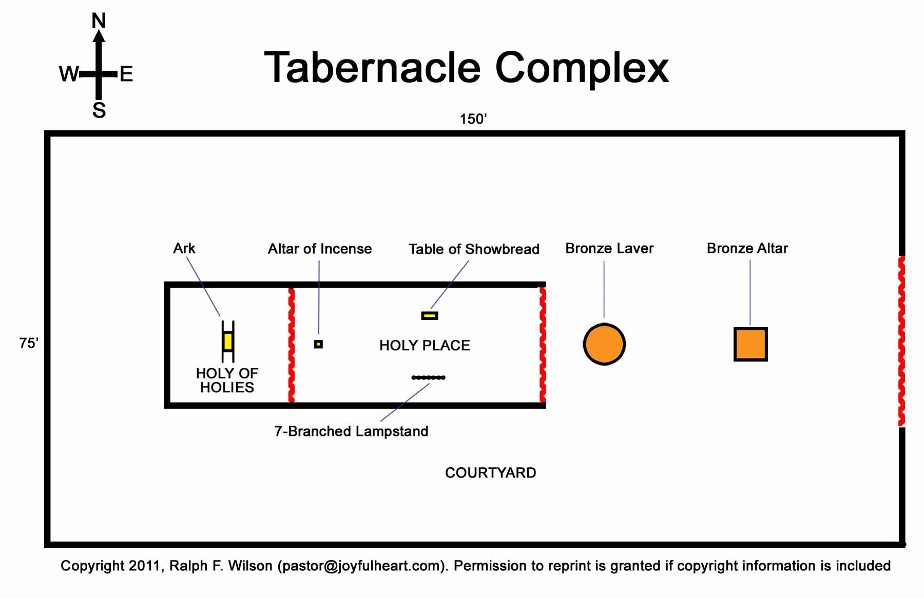

Slide 13
CHRIST OUR MODEL OF WORSHIP, WHO HIMSELF IS THE WAY INTO THE PRESENCE OF GOD, BY HIS BODY.
Enter his gates with thanksgiving (Ps 100)
Come with gifts (Rom 12:1)
Come with clean hands and a pure heart. (Ps 24:3)
Come in unity (John 17, 1 Cor 10:17)
Come, Enlightened by the Holy Spirit’s light (John 8:12)
Come with prayer and intercessions (Rom 8:26)
Come with awe and wonder
Rest in his provision, righteousness and resurrection
Come, with all the company of heaven, with angels and archangels, and all the saints - and enter into His communion.

Slide 14
… A Call to Persevere in Faith
¹⁹ Therefore, brothers and sisters, since we have confidence to enter the Most Holy Place by the blood of Jesus, ²⁰ by a new and living way opened for us through the curtain, that is, his body, ²¹ and since we have a great priest over the house of God, ²² let us draw near to God with a sincere heart and with the full assurance that faith brings, having our hearts sprinkled to cleanse us from a guilty conscience and having our bodies washed with pure water. ²³ Let us hold unswervingly to the hope we profess, for he who promised is faithful. ²⁴ And let us consider how we may spur one another on toward love and good deeds, ²⁵ not giving up meeting together, as some are in the habit of doing, but encouraging one another—and all the more as you see the Day approaching.

