Slide 1
The Cleansing of the Temple
Inviting the Holy Spirit to remain
Righteous anger?
The Holy Spirit: adjust to the Dove
1) James 1v20: “Human anger does not produce the righteousness that God desires.”
2) The effect of anger on our witness

Slide 2
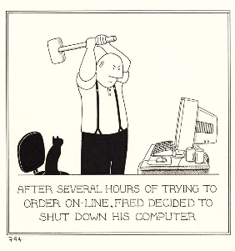

Slide 3
The Cleansing of the Temple
Gal 5 v22: The fruit of the Spirit is Love, joy, peace, patience, kindness, goodness, faithfulness, gentleness, self-control.

Slide 4
The Cleansing of the Temple
Jesus finds an absence of faith in the Temple
A First and Second cleansing?
A House of Prayer for all nations
A Temple that needed to be cleansed
The righteous anger and authority of Jesus

Slide 5
The Cleansing of the Temple
A Prophetic Sign – the ultimate sacrifice to come
An obviated system
A cosmic exchange
New Temple(s) in our hearts

Slide 6
The Cleansing of the Temple
A prophetic sign – the ultimate sacrifice… Put your trust in Jesus
A second cleansing of our hearts… Turn back to Jesus
Adjust to the Dove of the Holy Spirit... Know the Love of Jesus

