Slide 1
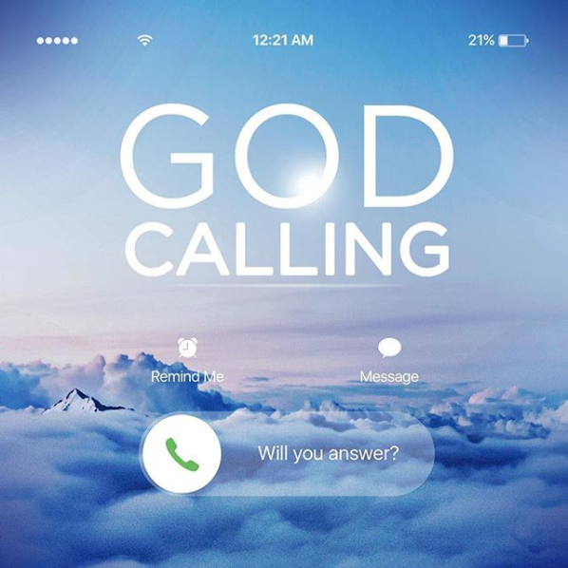
Ezekiel 1:3

Slide 2
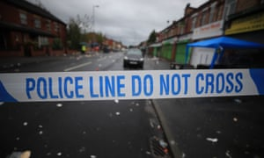
Homicides in England and Wales hit highest level in a decade
Figures show knife crime is up 6% and proportion of offenders being charged has fallen.
Rising youth crime reflects wider societal problems.

Slide 3
Britain the worst in Europe for drug use.
Britain the worst in Europe for drug use
by MATTHEW HICKLEY, Daily Mail
Britain is now the drugs capital of Europe, with higher levels of cocaine and amphetamine abuse than anywhere else in the EU, a survey said yesterday.
11 Christians Killed Every Day for Their Faith
Last year, Christians were persecuted more than ever before in the modern era — and this year is expected to be worse: "4,136 Christians were killed for faith-related reasons," according to Open Doors USA.

Slide 4
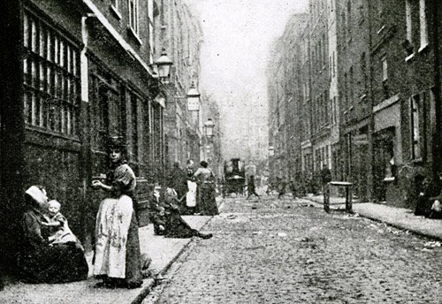
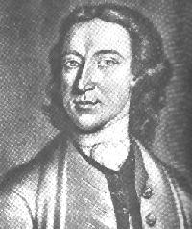
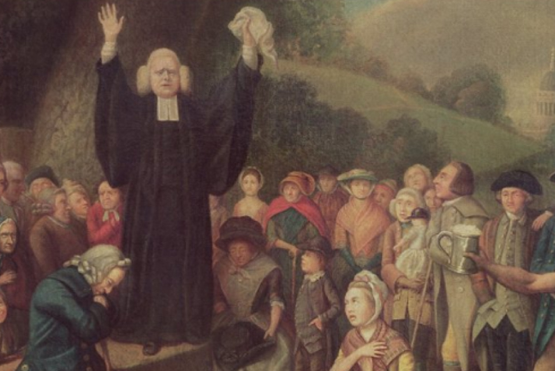
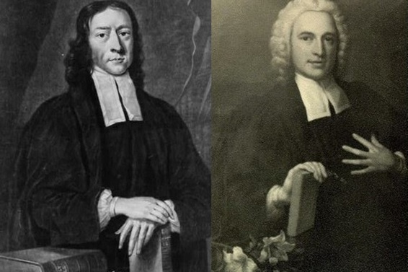
Great Britain in 1740.

Slide 5
The Call of Ezekiel
“The word of the Lord came to Ezekiel the priest, the son of Buzi, by the Kebar River in the land of the Babylonians. There the hand of the Lord was on him”
Ezekiel 1:3 NIV

Slide 6
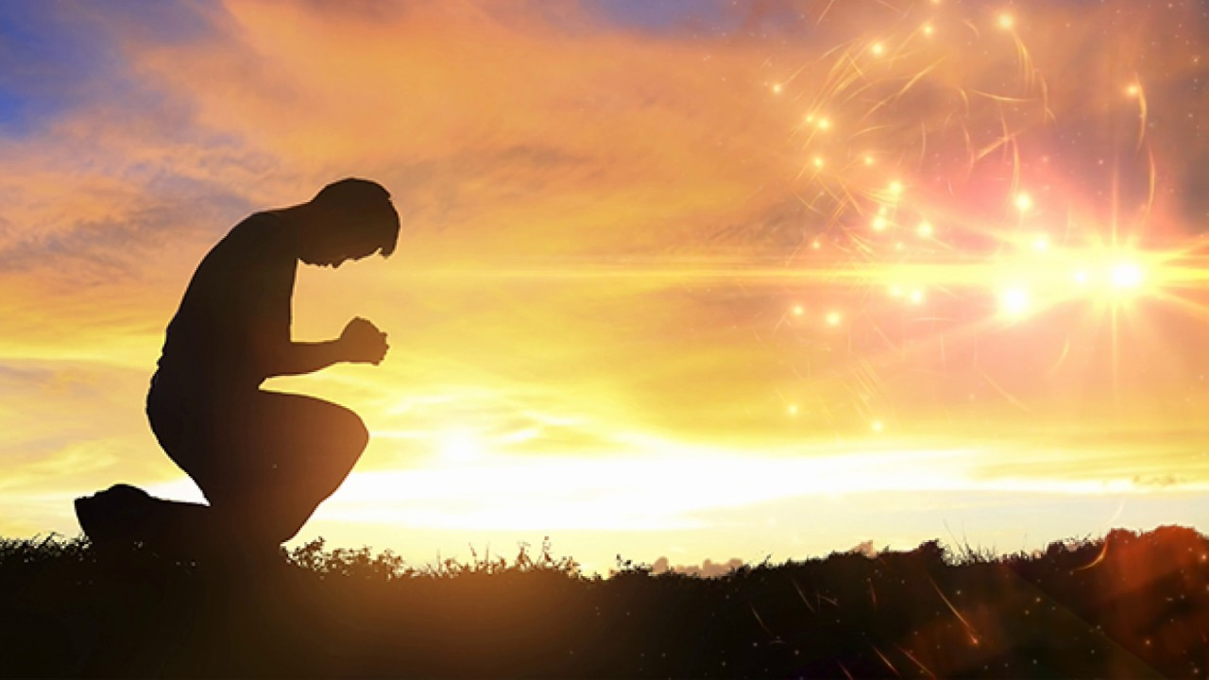
Let’s Pray…

Slide 7
The Call of Ezekiel
“The word of the Lord came to Ezekiel the priest, the son of Buzi, by the Kebar River in the land of the Babylonians. There the hand of the Lord was on him”
Ezekiel 1:3 NIV

Slide 9
I. Ezekiel must have courage.
⁶ And you, son of man, do not be afraid of them or their words. Do not be afraid, though briers and thorns are all around you and you live among scorpions. Do not be afraid of what they say or be terrified by them, though they are a rebellious people. ⁷ You must speak my words to them, whether they listen or fail to listen, for they are rebellious.
Ezekiel 2:6-7 (NIV)

Slide 10
II. Ezekiel must be a man of integrity.
“But you, son of man, listen to what I say to you. Do not rebel like that rebellious people; open your mouth and eat what I give you.”
Ezekiel 2:8 (NIV)
“Then He said to me, “Son of man, eat this scroll I am giving you and fill your stomach with it.” So I ate it, and it tasted as sweet as honey in my mouth.”
Ezekiel 3:3 (NIV)

Slide 11
God encourages us to be people of integrity.
God calls his people to be sanctified, to be holy, to be different. The witness we have among people in our community is a sermon in itself. It gives us credibility or it robs us of it.
“You are to be holy to me because I, the LORD, am holy, and I have set you apart from the nations to be my own”. Leviticus 20:26 (NIV)

Slide 12
God encourages us to be people of integrity.
We cannot speak with authority against a sin
if we are involved in it.
People are watching to see
if we are people of integrity or not.

Slide 13
III. Ezekiel is called to be obedient .
⁷ But the people of Israel are not willing to listen to you because they are not willing to listen to me, for all the Israelites are hardened and obstinate. ⁸ But I will make you as unyielding and hardened as they are. ⁹ I will make your forehead like the hardest stone, harder than flint. Do not be afraid of them or terrified by them, though they are a rebellious people.”
Ezekiel 3:7-9 (NIV)

Slide 14
“God is faithful, and He expects His people to be faithful.”
Vance Havner
The majority of the exiles were gripped with a sense of despair. Many things had happened to shake their faith. They feared that God had either completely cast them off or that His power was inferior to that of the gods of the Babylonians.
T.T. Crabtree

Slide 15
Ezekiel 18:20-23
The one who sins is the one who will die. The child will not share the guilt of the parent, nor will the parent share the guilt of the child. The righteousness of the righteous will be credited to them, and the wickedness of the wicked will be charged against them.
²¹ “But if a wicked person turns away from all the sins they have committed and keeps all my decrees and does what is just and right, that person will surely live; they will not die. ²² None of the offenses they have committed will be remembered against them. Because of the righteous things they have done, they will live. ²³ Do I take any pleasure in the death of the wicked? declares the Sovereign LORD. Rather, am I not pleased when they turn from their ways and live?....

Slide 16
Ezekiel 18:31-32 (NIV)
³¹ Rid yourselves of all the offenses you have committed, and get a new heart and a new spirit. Why will you die, people of Israel? ³² For I take no pleasure in the death of anyone, declares the Sovereign LORD. Repent and live!

Slide 17
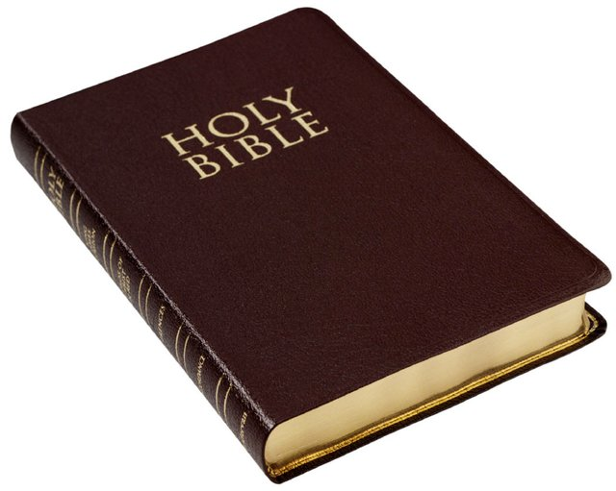
We, like Ezekiel, should “eat the book.” By so doing we will give God a better opportunity to speak to us, and we will have a message for the people of our day. We are not called to be a success; we are called to be faithful.

Slide 18
I. God equipped Ezekiel with courage.
II. God encouraged Ezekiel to be a man of integrity.
III. God evaluated Ezekiel’s success not on numbers,
but on obedience .

Slide 19
Ezekiel 18:31-32 (NIV)
³¹ Rid yourselves of all the offenses you have committed, and get a new heart and a new spirit. Why will you die, people of Israel? ³² For I take no pleasure in the death of anyone, declares the Sovereign LORD. Repent and live!

