Slide 1
Lessons from Psalms #24:
God’s Word is Faithful.
Psalm 119:81-88

Slide 2
Kaph
Is the 11th letter of the Hebrew alphabet…
In your unfailing love preserve my life, that I may obey the statutes of your mouth.
Psalm 119:88 (NIV)
God’s Word is Faithful.

Slide 3
Let’s Pray…

Slide 4
Confession and Petition.
“My soul faints with longing for your salvation, but I have put my hope in your Word”.
Psalm 119:81 (NIV)
“His soul faints”
The psalmist wanted things to happen!

Slide 5
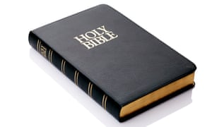
I have put my hope in your Word…
“I wait for OR I wait upon Your word!”

Slide 6
My eyes fail, looking for your promise; I say, “When will you comfort me?”
Psalm 119:82 (NIV)
HOW LONG, O GOD?
HOW LONG! HOW LONG WILL THIS LAST

Slide 7
II. The Psalmist considers his condition.
“Though I am like a wineskin in the smoke, I do not forget your decrees”.
Psalm 119:83 (NIV)

Slide 8
“…I have NOT forgotten your statutes…”

Slide 9
“How long must your servant wait? When will you punish my persecutors?”
Psalm 119:84 (NIV)
HELP ME I’M in trouble
How long?......When?

Slide 10
“The arrogant dig pits to trap me, contrary to your law”.
Psalm 119:85 (NIV)
“The insolent have dug pitfalls for me; they do not live according to your law”.
Psalm 119:85 (NKJV)

Slide 11
II. The Psalmist acknowledges his Faith
in the Word of God .
“All your commands are trustworthy; help me, for I am being persecuted without cause”.
Psalm 119:86 (NIV)
“All your commandments are sure; they persecute me with falsehood; help me!”
Psalm 119:86 (NKJV)

Slide 12
“But he was pierced for our transgressions, he was crushed for our iniquities; the punishment that brought us peace was on him, and by his wounds we are healed”.
Isaiah 53:5 (NIV)

Slide 13
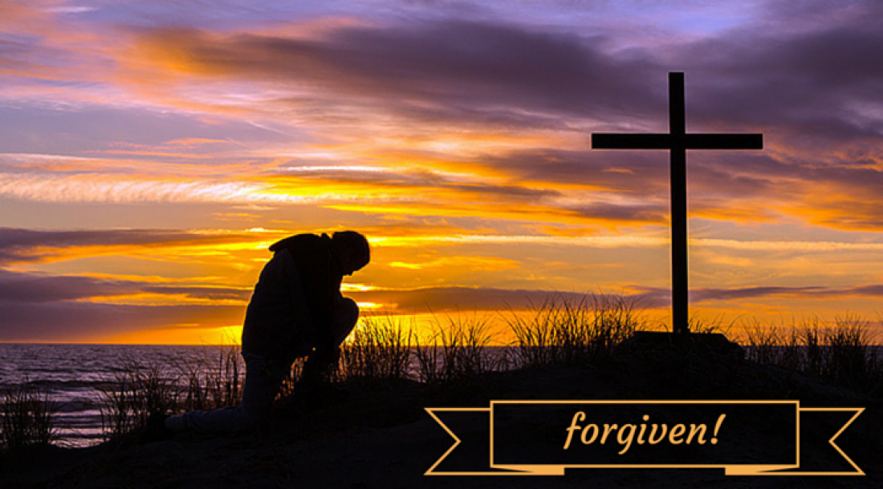
In John 14:6 Jesus said,
“I am the way the TRUTH and the life…”

Slide 14
“They almost wiped me from the earth, but I have not forsaken your precepts”.
Psalm 119:87 (NIV)
“In your unfailing love preserve my life, that I may obey the statutes of your mouth”.
Psalm 119:88 (NIV)

Slide 15
God’s Word is a word of promise.
HELP ME I’M in trouble
How long?......When?

Slide 16
For the psalmist, the Word of God
is the source of joy and comfort.
God’s Word is Faithful.

