Slide 1
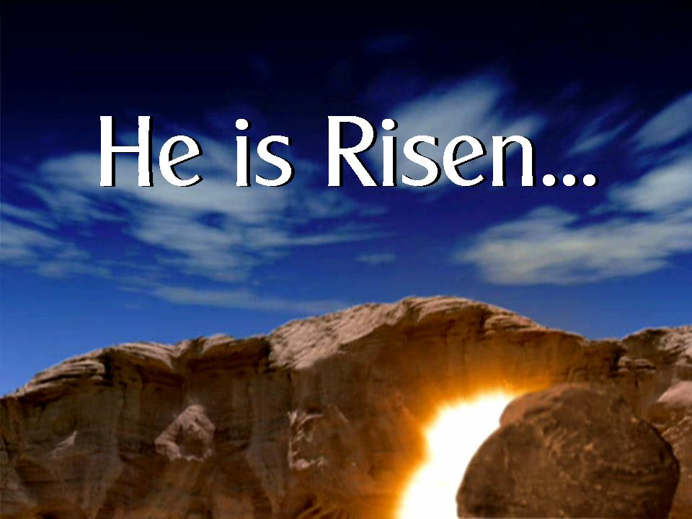
The Resurrection of Jesus Christ.
Luke 24:1-12
John 20:19-29

Slide 2
¹⁹ On the evening of that first day of the week, when the disciples were together, with the doors locked for fear of the Jewish leaders, Jesus came and stood among them and said, “Peace be with you!” ²⁰ After He said this, He showed them His hands and side. The disciples were overjoyed when they saw the Lord…²⁴ Now Thomas (also known as Didymus), one of the Twelve, was not with the disciples when Jesus came. ²⁵ So the other disciples told him, “We have seen the Lord!”
But he said to them, “Unless I see the nail marks in His hands and put my finger where the nails were, and put my hand into His side, I will not believe.”
John 20:19-20, 24-29 (NIV)

Slide 3
²⁶ A week later his disciples were in the house again, and Thomas was with them. Though the doors were locked, Jesus came and stood among them and said, “Peace be with you!” ²⁷ Then he said to Thomas, “Put your finger here; see my hands. Reach out your hand and put it into my side. Stop doubting and believe.”
²⁸ Thomas said to him, “My Lord and my God!”
²⁹ Then Jesus told him, “Because you have seen me, you have believed; blessed are those who have not seen and yet have believed.”
John 20:19-20, 24-29 (NIV)

Slide 4
Let’s pray…

Slide 5
He is risen.
He is risen indeed.

Slide 6
I. The resurrection was unexpected
(They still did not understand from Scripture that Jesus had to rise from the dead.)
John 20:9 (NIV)

Slide 7
II. There was Unbelief
¹⁰ She went and told those who had been with him and who were mourning and weeping. ¹¹ When they heard that Jesus was alive and that she had seen him, they did not believe it.
Mark 16:10-11 (NIV)
“There was not a 100% belief.”

Slide 8
III. Unbelief is a reality in our lives.
Jesus wants ALL our trust so He can give us a new life.
“There is not a 100% belief.”

Slide 9
"Rejoice in the Lord always..." The Lord is near. "Do not be anxious about anything, but in every situation, by prayer and petition, with thanksgiving, present your requests to God. And the peace of God, which transcends all understanding, will guard your hearts and your minds in Christ Jesus."
Philippians 4:4 (NIV)

Slide 10
THOMAS
"A week later his disciples were in the house again, and Thomas was with them... Jesus came and stood among them and said, "Peace be with you!" Then He said to Thomas, "Put your finger here; see my hands. Reach out your hand and put it into my side.
Stop doubting and believe."
John 20:26-27 (NIV)

Slide 11
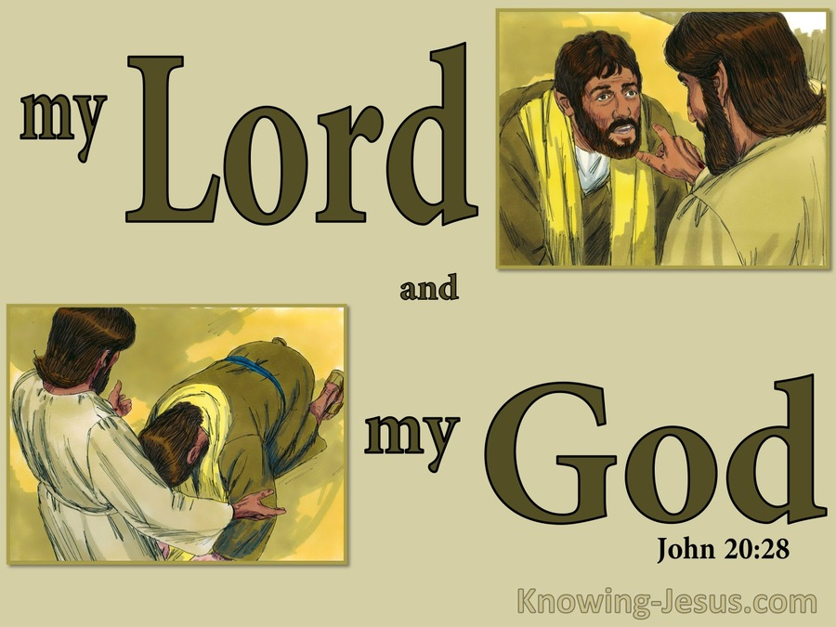

Slide 12
"Caesar is Lord, Caesar is God!"
‘Jesus is Lord, Jesus is God!’
"His statement, is not only the culmination of belief; it is also the climax of the Gospel.“
Charles Erdman, “The Gospel of John”, The Westminster Press, Philadelphia, 1944, p170

Slide 13
Then Jesus told Thomas, "Because you have seen me, you have believed;
blessed are those who have not seen and yet have believed."
Supremely happy… are those who have not seen and yet have believed!

Slide 14
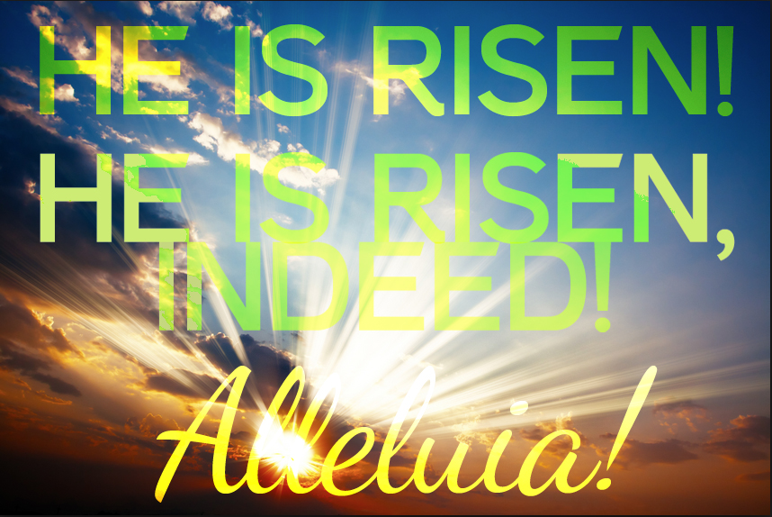
“…that Christ died for our sins according to the Scriptures, ⁴ that he was buried, that he was raised on the third day according to the Scriptures,”
1 Corinthian 15:3-4 (NIV)

