Slide 1
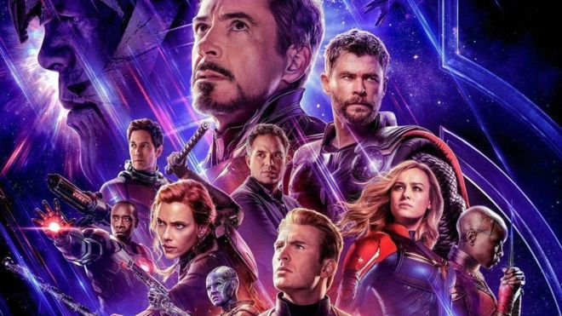
Avengers:
Endgame fans queue for hours for cinema tickets
Tickets are being resold from $20 Singapore dollars (£11) all the way up to $600 Singapore dollars (£340).

Slide 2
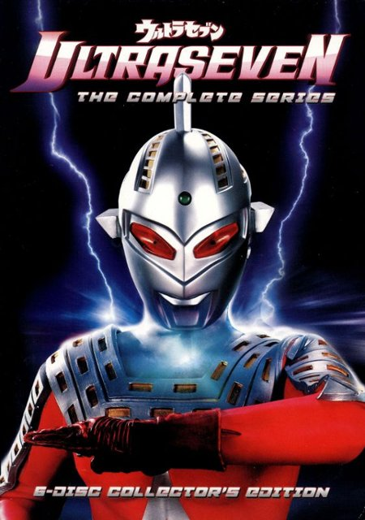
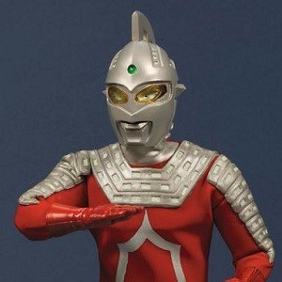

Slide 3

The Entry of the King
Luke 19:28-44

Slide 4
Luke 19:28-44 (NIV)
⁴¹ As he approached Jerusalem and saw the city, he wept over it ⁴² and said, “If you, even you, had only known on this day what would bring you peace—but now it is hidden from your eyes.

Slide 5
Let’s Pray…

Slide 6
I. Jesus (Luke 19:28-35)
What Jesus Did
“After Jesus had said this, he went on ahead, going up to Jerusalem”.
Luke 19:28 (NIV)
“As he approached Bethphage and Bethany at the hill called the Mount of Olives,…”
Luke 19:29 (NIV)

Slide 7
Bethphage
=
(Means House of Unripe Figs)
Bethany
=
(Means House of Many Figs)

Slide 8
²⁹ As he approached Bethphage and Bethany at the hill called the Mount of Olives, he sent two of his disciples, saying to them, ³⁰ “Go to the village ahead of you, and as you enter it, you will find a colt tied there, which no one has ever ridden. Untie it and bring it here. ³¹ If anyone asks you, ‘Why are you untying it?’ say, ‘The Lord needs it.’” ³² Those who were sent ahead went and found it just as he had told them. ³³ As they were untying the colt, its owners asked them, “Why are you untying the colt?” ³⁴ They replied, “The Lord needs it.” ³⁵ They brought it to Jesus, threw their cloaks on the colt and put Jesus on it.

Slide 9
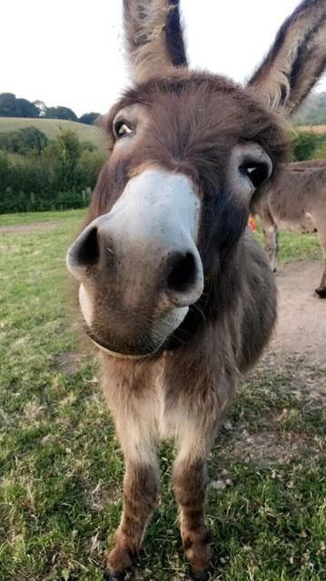
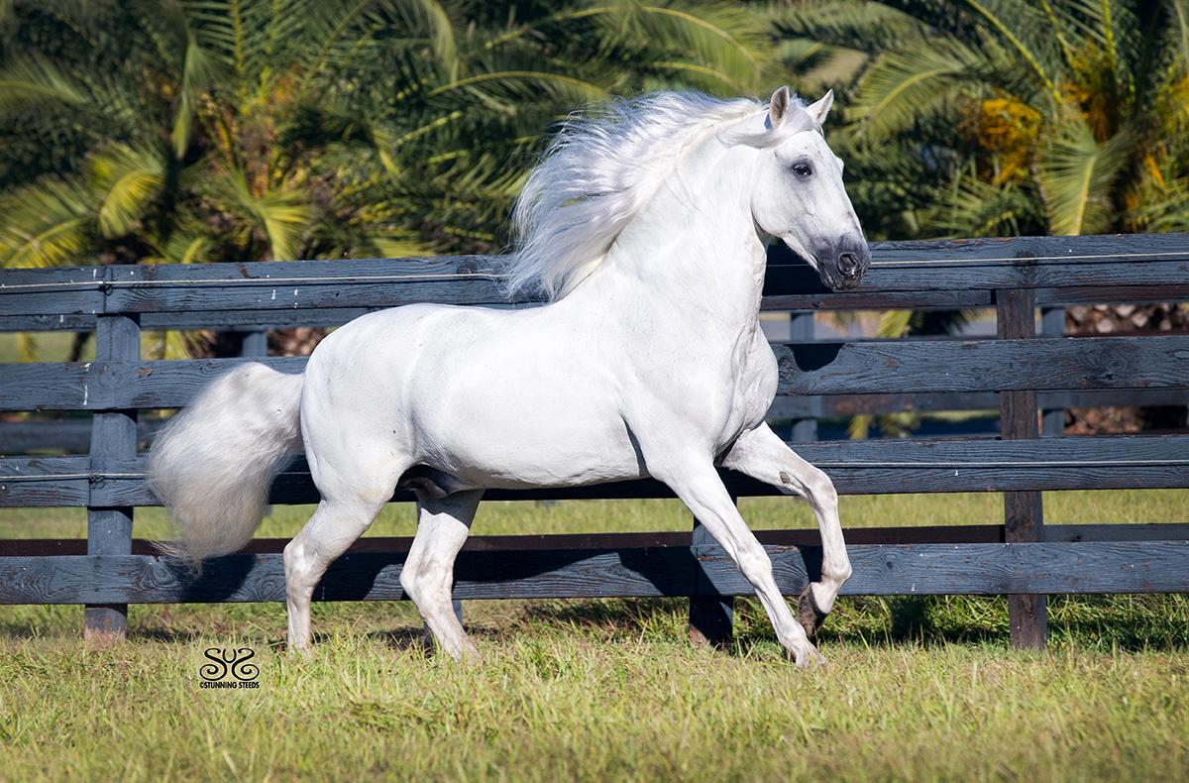

Slide 10
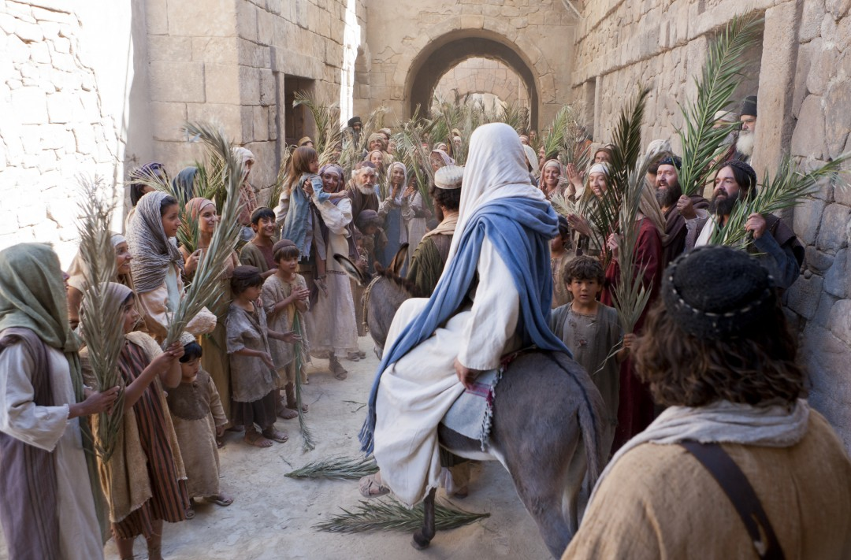
II. The Crowds.
What the Crowds Did…
They responded in adoration.
“As he went along, people spread their cloaks on the road.” Luke 19:36 (NIV)

Slide 11
What did the Crowds want?
When he came near the place where the road goes down the Mount of Olives, the whole crowd of disciples began joyfully to praise God in loud voices for all the miracles they had seen:
Luke 19:37 (NIV)
“Blessed is the King who comes in the name of the Lord!”

Slide 12
Some of the Pharisees in the crowd said to Jesus,
“Teacher, rebuke your disciples!”
Luke 19:39 (NIV)
“I tell you,” he replied, “if they keep quiet, the stones will cry out.”
Luke 19:40 (NIV)

Slide 13
“The phrase if these become silent should be understood not as something that may possibly happen, but as something that will inevitably happen. After His entry, Jesus will receive no more praises from the crowd, the next time the crowd would scream for Jesus to be crucified…If the crowd become silent, at that point the stones will cry out, but the stones will not cry out in joyful praises and hosannas, but in affirmation of God’s judgement on Israel’s wickedness”.
John MacArthur, “New Testament Commentary-Luke 18-24”, Moody Publishers, 2014, p98

Slide 14
III. Jesus.
What Jesus Wanted
⁴¹ As he approached Jerusalem and saw the city, he wept over it ⁴² and said, “If you, even you, had only known on this day what would bring you peace—but now it is hidden from your eyes.
They did not know what day it was.

Slide 15
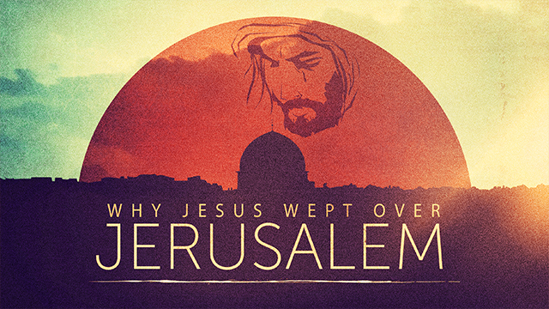
“Blessed is the King who comes in the name of the Lord!”
But their hearts were far from Him (Isa 29:13; Matt 15:8).

Slide 16
“The word translated wept is the strongest word in the Greek language for weeping. It denotes Jesus’ agonized sobbing over their superficiality, hypocrisy, shallowness, and rejection of Him- and the inevitable divine wrath that would follow”.
John MacArthur, “New Testament Commentary-Luke 18-24”, Moody Publishers, 2014, p98

Slide 17
But they did not understand...
⁴³ The days will come upon you when your enemies will build an embankment against you and encircle you and hem you in on every side. ⁴⁴ They will dash you to the ground, you and the children within your walls. They will not leave one stone on another, because you did not recognize the time of God’s coming to you.”
Luke 19:43-44 (NIV)

Slide 18
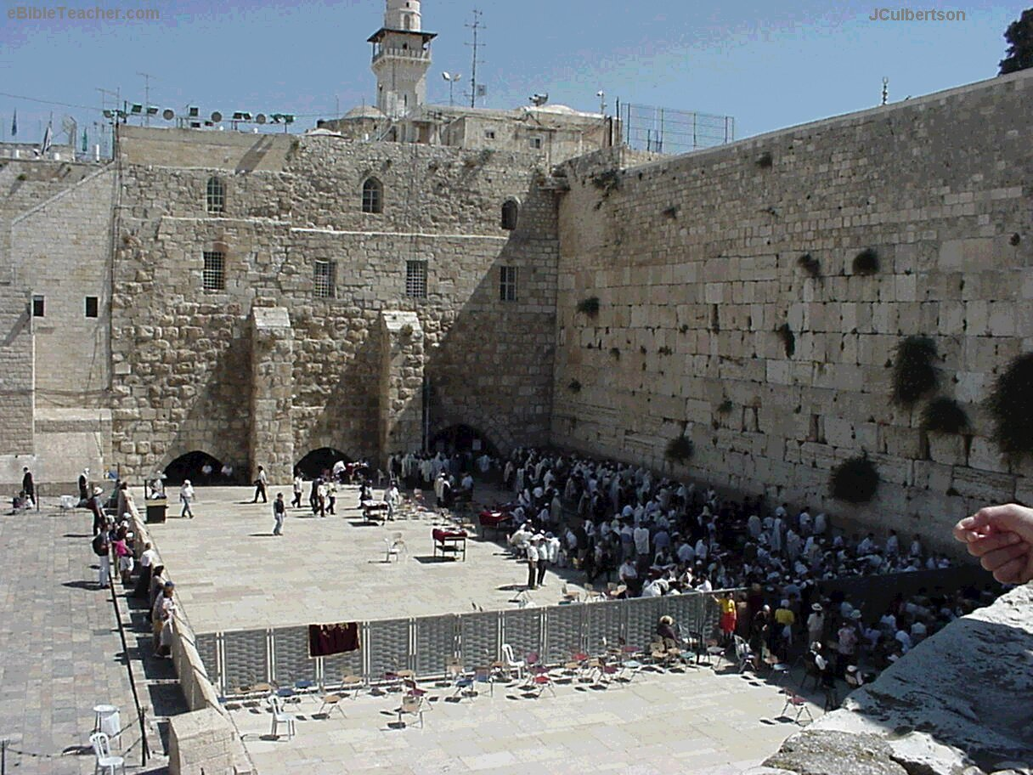
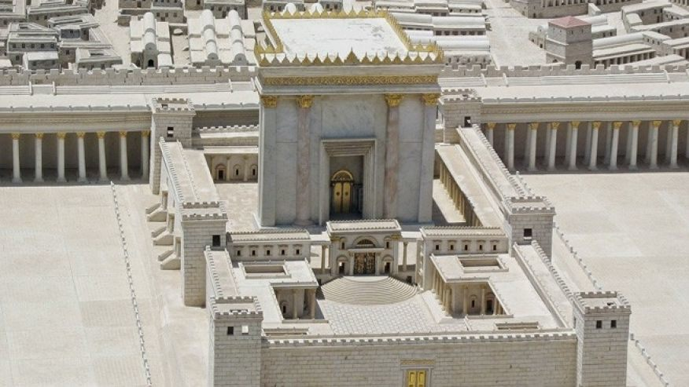
What happened to Jerusalem will happen to any nation, any city, any church, or any individual who refuses to find shelter in Christ.

Slide 19
IV. What do You Want, and What Will You Do?
The second Entry of the King
Revelation 19
¹¹ I saw heaven standing open and there before me was a white horse, whose rider is called Faithful and True. With justice he judges and wages war. ¹² His eyes are like blazing fire, and on his head are many crowns. He has a name written on him that no one knows but he himself. ¹³ He is dressed in a robe dipped in blood, and his name is the Word of God.

Slide 20
¹⁴ The armies of heaven were following him, riding on white horses and dressed in fine linen, white and clean.¹⁵Coming out of his mouth is a sharp sword with which to strike down the nations. “He will rule them with an iron scepter.” He treads the winepress of the fury of the wrath of God Almighty. ¹⁶ On his robe and on his thigh he has this name written:
king of kings and lord of lords.
The second Entry of the King

Slide 21
The Entry of the King
Luke 19:28-44

Slide 22
⁴¹ As he approached Jerusalem and saw the city, he wept over it ⁴² and said, “If you, even you, had only known on this day what would bring you peace—but now it is hidden from your eyes.

