Slide 1
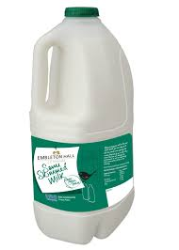

Slide 2
“Dr Livingstone, I presume”

Slide 3
See, I lay a stone in Zion, a chosen and precious cornerstone, and the one who trusts in him will never be put to shame
(Isaiah 28:16)

Slide 4
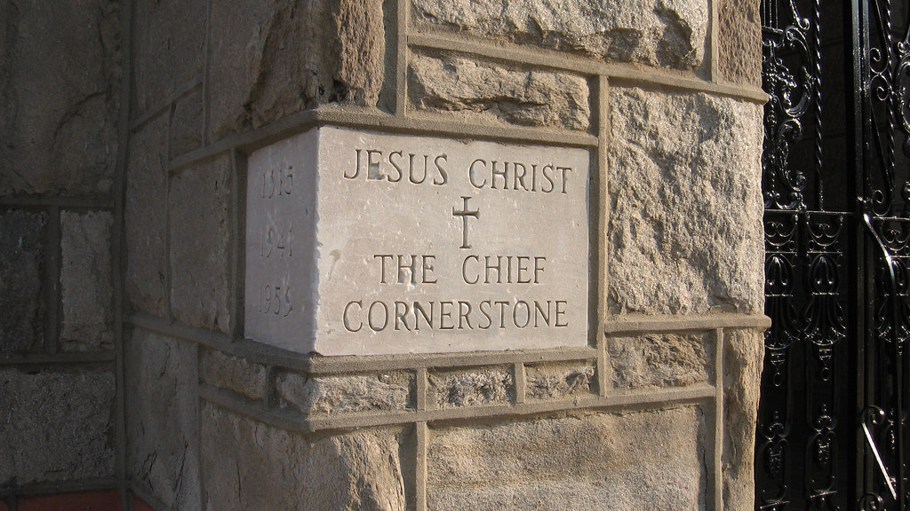

Slide 5
A stone that causes people to stumble and a rock that makes them fall
(Is.8:14)

Slide 6
The stone the builders rejected has become the cornerstone
(Psalm 118:22)

Slide 7
All Christians form a holy priesthood, in order to:
praise and worship God
pray for others
declare God’s truth

Slide 8
“You did not choose me, but I chose you and appointed you to go and bear fruit—fruit that will last.” (Jn.15:16)

