Slide 2
A Mother’s Prayer
Matthew 20:20-28

Slide 3
Matthew 20:20-21 (NIV)
“²⁰ Then the mother of the sons of Zebedee came up to him with her sons, and kneeling before him she asked him for something. ²¹ And he said to her, “What do you want?” She said to him, “Say that these two sons of mine are to sit, one at your right hand and one at your left, in your kingdom.””

Slide 4
Let’s Pray…

Slide 5
A Mother’s Prayer
²¹ Going on from there, he saw two other brothers, James son of Zebedee and his brother John. They were in a boat with their father Zebedee, preparing their nets. Jesus called them, ²² and immediately they left the boat and their father and followed him.
Matthew 4:21-22 (NIV)

Slide 6
A Mother’s Prayer
I. Salome was a mother of great Faith and Devotion.
⁵⁵ Many women were there, watching from a distance. They had followed Jesus from Galilee to care for his needs. ⁵⁶ Among them were Mary Magdalene, Mary the mother of James and Joseph, and the mother of Zebedee’s sons.
Matthew 27:55-56 (NIV)

Slide 7
I. Salome was a mother of great Faith and Devotion.
When the Sabbath was over, Mary Magdalene, Mary the mother of James, and Salome bought spices so that they might go to anoint Jesus’ body.
Mark 16:1 (NIV)

Slide 8
II. Salome was a woman of warm spiritual ambition.
“Then the mother of Zebedee’s sons came to Jesus with her sons and, kneeling down, asked a favour of him”.
Matthew 20:20 (NIV)
She said, “Grant that one of these two sons of mine may sit at your right and the other at your left in your kingdom.”

Slide 9
Salome listened and accepted correction from Jesus.
“Jesus answered, “You do not know what you are asking. Are you able to drink the cup that I am to drink?”
Matthew 20:22 (NIV)

Slide 10
III. Jesus’ Teaching.
²⁵ Jesus called them together and said, “You know that the rulers of the Gentiles lord it over them, and their high officials exercise authority over them. ²⁶ Not so with you. Instead, whoever wants to become great among you must be your servant, ²⁷ and whoever wants to be first must be your slave—
Matthew 20:25-27 (NIV)

Slide 11
“Whoever wants to become great among you…”
“Must be your SERVANT.”
“Just as the Son of Man did not come to be served, but to serve, and to give his life as a ransom for many.”
Matthew 20:28 (NIV)

Slide 12
“Servant is from the word diakonos, from which the term deacon is derived. The original Greek word was pure secular, referring to a person who did menial labour, such as house cleaning or serving tables…But Christ elevated diakonos to a place of greater significance, using it to describe His most faithful and favoured disciples…Jesus chose this word because it best reflects the selfless, humble life that He honours.
John MacArthur, “New Testament Commentary-Matthew 16-23”, Moody Publishers, 1988, p241

Slide 13
Philippians 2:5-8 (GNT)
The attitude you should have is the one that
Christ Jesus had:
He always had the nature of God,
but he did not think that by force he should
try to remain equal with God. Instead of this, of his own free will he gave up all he had, and took the nature of a servant. He became like a human being and appeared in human likeness. He was humble and walked the path of obedience
all the way to death—his death on the cross.

Slide 14
It speaks of our wretched condition because of sin.

Slide 15
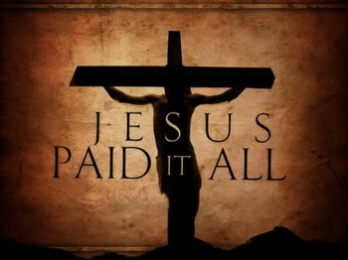

Slide 16
James, the son of Zebedee and Salome, became the first of the apostles to experience martyrdom.
“It was about this time that King Herod arrested some who belonged to the church, intending to persecute them. ² He had James, the brother of John, put to death with the sword”.
Acts 12:1-2 (NIV)

Slide 17
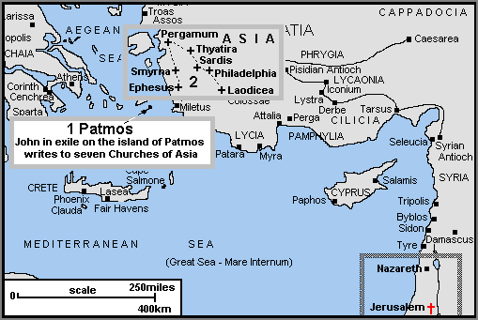
John became the “apostle of love.”
He was exiled to the island of Patmos

Slide 18
A Mother’s Prayer
I. Her Faith and Devotion.
II. Her Spiritual Ambition.
III. Her Willingness to Listen to Jesus.
“…Are you able to drink the cup that I am to drink?”
Matthew 20:22 (NIV)

