Slide 1
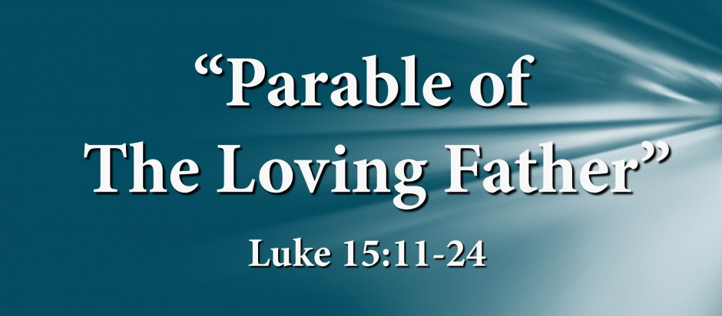

Slide 2
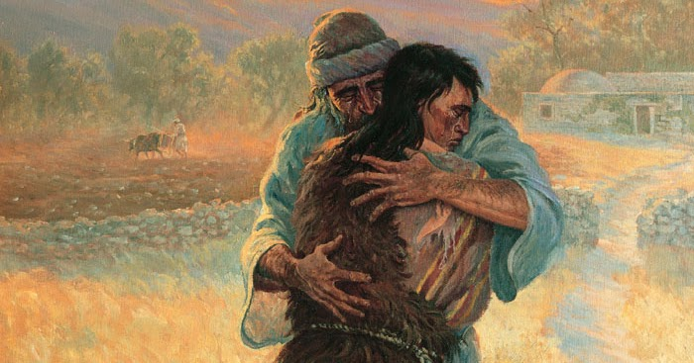
Luke 15:24 (NIV)
“For this son of mine was dead and is alive again; he was lost and is found.’ So they began to celebrate”.

Slide 3
Let’s Pray…

Slide 4
Luke 15
A lost Sheep.
A lost Coin.
A lost Younger Son.
A lost Older Son.
These are parables of God’s sorrow (Luke 15:4, 8, 13).
These are parables of God’s struggles (Luke 15:6, 8, 23).
Parables that portrait God’s joy (Luke 15:6, 10, 22–24, 32).

Slide 5
The Parable of a Loving Father
I. The Rebellion of a Son.
¹¹ Jesus continued: “There was a man who had two sons. ¹² The younger one said to his father, ‘Father, give me my share of the estate.’ So he divided his property between them.
Luke 15:11-12 (NIV)

Slide 6
¹³ “Not long after that, the younger son got together all he had, set off for a distant country and there squandered his wealth in wild living.¹⁴ After he had spent everything, there was a severe famine in that whole country, and he began to be in need.
Luke 15:13-14 (NIV)

Slide 7
“He wanted to sin beyond the range of all accountability, far away from his father and people who knew him…His action symbolizes the foolishness of the sinner trying to flee from God, to whom he does not want to be answerable.”
John MacArthur, “The Gospel of Luke 11-17”, p309

Slide 8
“So he went and hired himself out to a citizen of that country, who sent him to his fields to feed pigs”.
Luke 15:15 (NIV)
“He longed to fill his stomach with the pods that the pigs were eating, but no one gave him anything”.
Luke 15:16 (NIV)

Slide 9
The Parable of a Loving Father
II. The Repentance of a Rebellious Son.
“When he came to his senses, he said, ‘How many of my father’s hired servants have food to spare, and here I am starving to death!”
Luke 15:17 (NIV)
“The first step to Repentance”.

Slide 10
¹⁸ I will set out and go back to my father and say to him: Father, I have sinned against heaven and against you. ¹⁹ I am no longer worthy to be called your son; make me like one of your hired servants.’
Luke 15:18-19 (NIV)
He confesses, "I have sinned; I am unworthy."

Slide 11
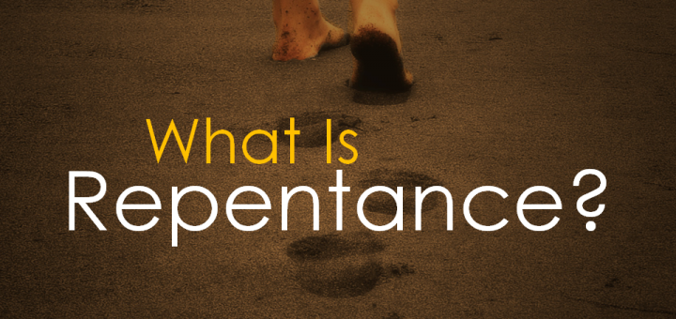
“Repentance is the sinner’s part in the process of being restored to God, and there is no true gospel apart from it.
The called for sinners for repent is at the heart of all biblical evangelism, beginning in the Old Testament (Psalm 32:5; 51:1-4, 14, 17; Isaiah 1:16-18; 55:6-7; Ezekiel 18:30, 32; 33:19; Jonah 3:5-10), Repentance was central in the New Testament”

Slide 12
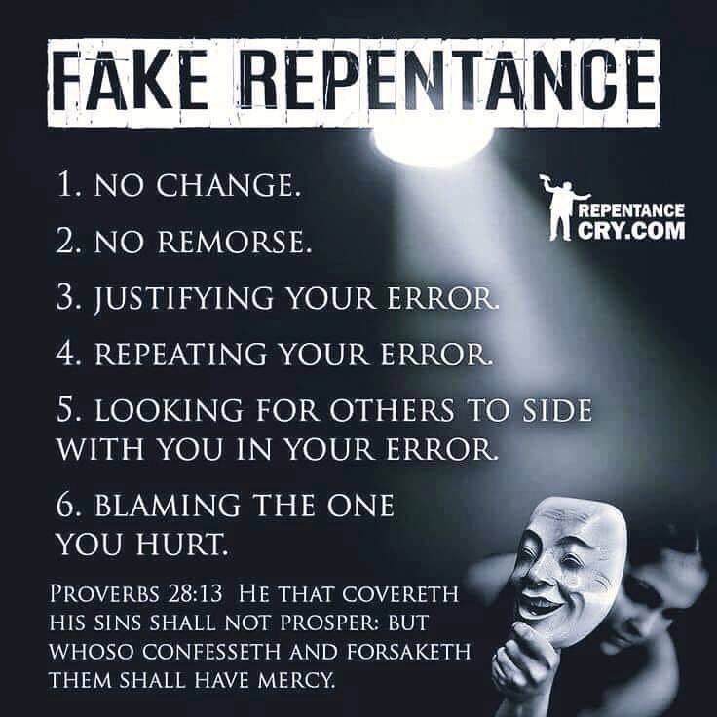

Slide 13
A mark of true repentance is the prodigal’s desire to be subject again to authority.
“Repentance is not only sorrow for sin; it is an acknowledgement that the offense has been committed against a holy God; it is a change of heart toward Him, and a resolution for a new life which manifest itself in confident action.”
Charles. Erdman, “The Gospel of Luke”, p144
He said; “I will set out and go back to my father…”

Slide 14
III. The Reception and Reconciliation.
“ So he got up and went to his father.
“But while he was still a long way off, his father saw him and was filled with compassion for him; he ran to his son, threw his arms around him and kissed him.”
Luke 15:20 (NIV)

Slide 15
²¹ “The son said to him, ‘Father, I have sinned against heaven and against you. I am no longer worthy to be called your son.’
²² “But the father said to his servants, ‘Quick! Bring the best robe and put it on him. Put a ring on his finger and sandals on his feet.
Luke 15:21-22 (NIV)

Slide 16
²³ Bring the fattened calf and kill it. Let’s have a feast and celebrate. ²⁴ For this son of mine was dead and is alive again; he was lost and is found.’ So they began to celebrate.
Luke 15:23-24 (NIV)
Sometimes we think we need to clean themselves up before we come to God.
All we need is to come home...and the Father will give His best even though we’re filthy.

Slide 17
IV. Resentment and a shameful reaction
²⁵ “Meanwhile, the older son was in the field. When he came near the house, he heard music and dancing. ²⁶ So he called one of the servants and asked him what was going on. ²⁷ ‘Your brother has come,’ he replied, ‘and your father has killed the fattened calf because he has him back safe and sound.’

Slide 18
²⁸ “The older brother became angry and refused to go in. So his father went out and pleaded with him. ²⁹ But he answered his father, ‘Look! All these years I’ve been slaving for you and never disobeyed your orders. Yet you never gave me even a young goat so I could celebrate with my friends. ³⁰ But when this son of yours who has squandered your property with prostitutes comes home, you kill the fattened calf for him!’
Luke 15:28-30 (NIV)

Slide 19
³¹ “‘My son,’ the father said, ‘you are always with me, and everything I have is yours. ³² But we had to celebrate and be glad, because this brother of yours was dead and is alive again; he was lost and is found.’”
Luke 15:31-32 (NIV)

Slide 20
The loving father chose to forgive;
the older brother refused.
God rejoices like a shepherd who returns home with a lost sheep that has been found.
God rejoices like the woman rejoices with her friends when she recovers the lost coin.
God rejoices like the loving father who receives a rebellious son.

Slide 21
God is far more eager to forgive
than He is to punish.
Say to them, ‘As surely as I live, declares the Sovereign LORD, I take no pleasure in the death of the wicked, but rather that they turn from their ways and live. Turn! Turn from your evil ways!
Why will you die, people of Israel?’
Ezekiel 33:11 (NIV)

Slide 22
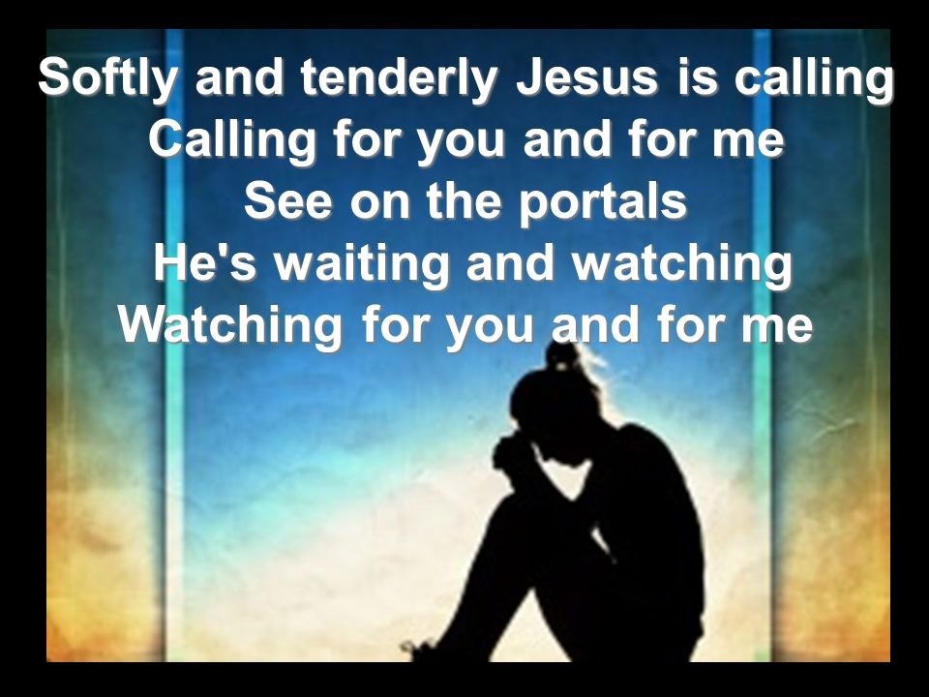

Slide 23
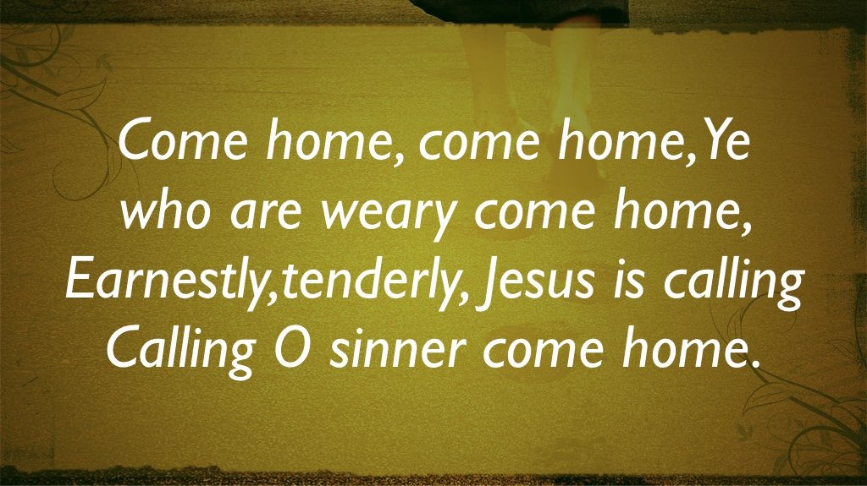

Slide 24
“For this son of mine was dead and is alive again; he was lost and is found.’ So they began to celebrate”.

