Slide 1
Jesus’ Sorrow for Jerusalem
Luke 13:31-35

Slide 2
Luke 13:31-35 (NRSV)
³¹ At that very hour some Pharisees came and said to him, “Get away from here, for Herod wants to kill you.” ³² He said to them, “Go and tell that fox for me, ‘Listen, I am casting out demons and performing cures today and tomorrow, and on the third day I finish my work. ³³ Yet today, tomorrow, and the next day I must be on my way, because it is impossible for a prophet to be killed outside of Jerusalem.’

Slide 3
Luke 13:31-35 (NRSV)
³⁴ Jerusalem, Jerusalem, the city that kills the prophets and stones those who are sent to it! How often have I desired to gather your children together as a hen gathers her brood under her wings, and you were not willing! ³⁵ See, your house is left to you. And I tell you, you will not see me until the time comes when you say, ‘Blessed is the one who comes in the name of the Lord.’”

Slide 4
Let’s Pray…

Slide 5
Jesus’ Sorrow for Jerusalem
They wanted to shut down His teaching.
“³¹ At that very hour some Pharisees came and said to him, “Get away from here, for Herod wants to kill you.”
Luke 13:31 (NRSV)

Slide 6
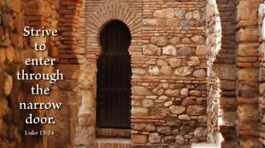
I. Jesus’ Message to His Enemies.
Luke chapter 13:22-30
“Strive to enter through the narrow gate, for many, I say to you, will seek to enter and will not be able”.

Slide 7
“³¹ At that very hour some Pharisees came and said to him, “Get away from here, for Herod wants to kill you.” Luke 13:31 (NRSV)
a) Jesus sent a Message to King Herod.
“He said to them, “Go and tell that fox for me, ‘Listen, I am casting out demons and performing cures today and tomorrow, and on the third day I finish my work.”
Luke 13:32 (NRSV)

Slide 8
Go and tell that fox…
“To the Jew the Fox was a symbol of three things.
First it was regarded as the slyest of animals. Second, it was regarded as the most destructive (nuisance) of animals.
Third, it was the symbol of a worthless and insignificant man”
William Barclay, “The Daily Study Bible, The Gospel of Luke”, The Saint Andrew Press, Edinburgh, 1975, p186

Slide 9
“Behold, I cast out demons and perform cures…”
“…today and tomorrow,
and on the third day I finish my work”.

Slide 10
a) Jesus’ Message to the Pharisees.
“Yet today, tomorrow, and the next day I must be on my way, because it is impossible for a prophet to be killed outside of Jerusalem.”
Luke 13:33 (NRSV)
“…and on the third day I finish my work.”

Slide 11
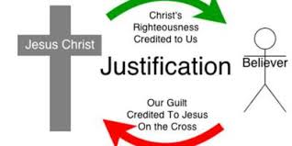
Propitiation.
“A sacrifice that bears God’s wrath and turns it to favour”

Slide 12
“For Christ did not send me to baptize, but to preach the gospel—not with wisdom and eloquence, lest the cross of Christ be emptied of its power”.
1 Corinthians 1:17 (NIV)

Slide 13
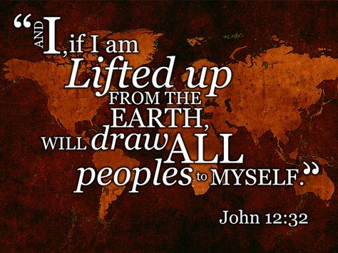
Romans 5:8,
“While we were yet sinners, Christ died for us.”

Slide 14
II. Jesus’ Message to Jerusalem.
a) Jesus’ Compassion
“O Jerusalem, Jerusalem, the city that kills the prophets and stones those who are sent to it! How often would I have gathered your children together as a hen gathers her brood under her wings, and you were not willing!”
Luke 13:34 (NRSV)

Slide 15
Say to them, ‘As surely as I live, declares the Sovereign LORD, I take no pleasure in the death of the wicked, but rather that they turn from their ways and live. Turn! Turn from your evil ways! Why will you die, people of Israel?’
Ezekiel 33:11 (NIV)

Slide 17
b) Jesus’ prophecy.
“See! Your house is left to you desolate; and assuredly, I say to you, you shall not see Me until the time comes when you say, ‘Blessed is He who comes in the name of the LORD!’ ”
Luke 13:35 (NKJV)
“See! Your house is left to you desolate…”

Slide 18
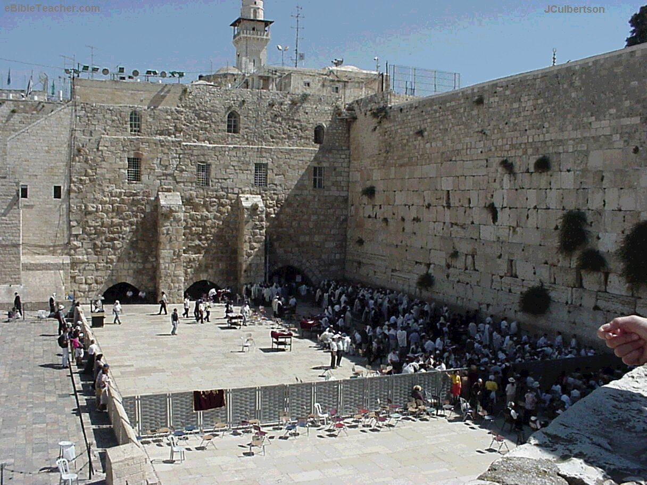
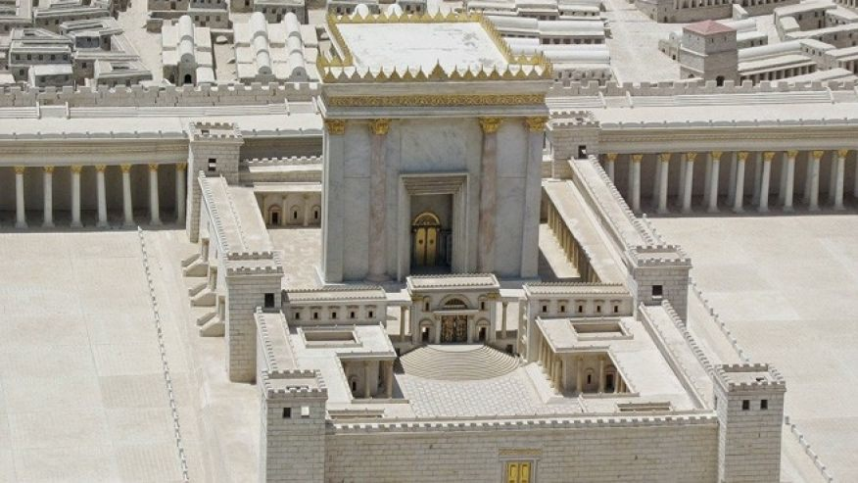
What happened to Jerusalem will happen to any nation, any city, any church, or any individual who refuses to find shelter in Christ.

Slide 19
“…I say to you, you shall not see Me until the time comes when you say, ‘Blessed is He who comes in the name of the LORD!’ ”
Luke 13:35 (NKJV)
Jesus’ Sorrow for Jerusalem

