Slide 1
Lessons from Psalms #23
The Goodness of God’s Word
Psalm 119:65-72

Slide 2
Let’s Pray…

Slide 3
The Goodness of God’s Word.
I. A Thankful Acknowledgment of God’s Grace.
“You have dealt well with Your servant,
O LORD, according to Your word”.
Psalm 119:65 (NKJV)
God is good and what He does is good.

Slide 4
Count your many blessings
When upon life’s billows you are tempest-tossed,
When you are discouraged, thinking all is lost,
Count your many blessings, name them one by one,
And it will surprise you what the Lord has done.
Count your blessings, name them one by one,
Count your blessings, see what God has done!
Count your blessings, name them one by one,
Count your many blessings, see what God has done.
[And it will surprise you what the Lord has done.]

Slide 5
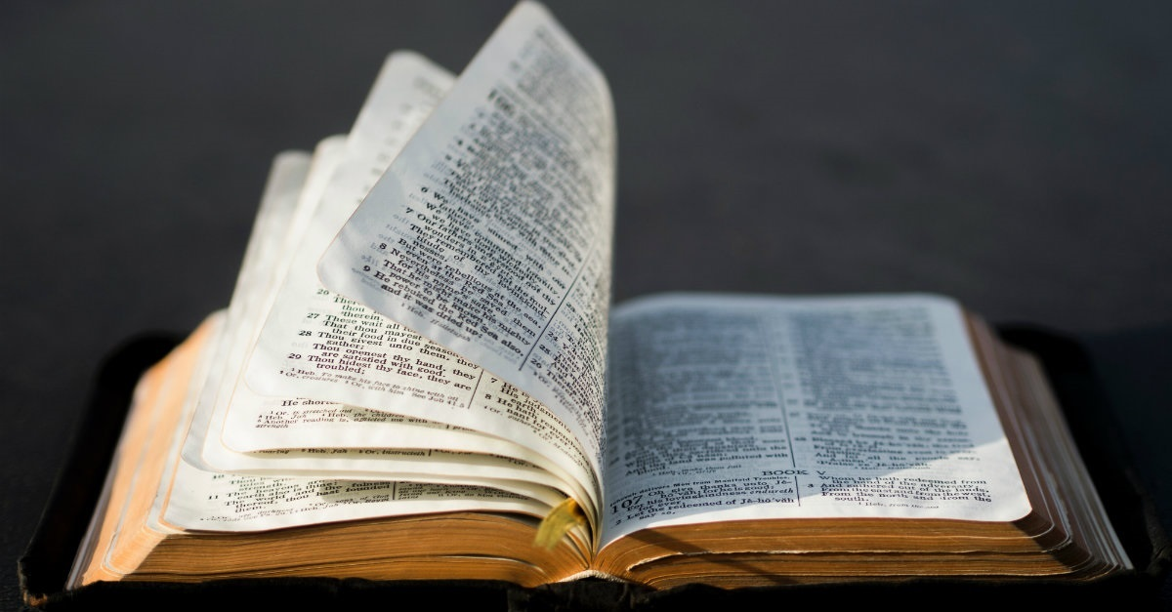
You have dealt well with Your servant.
O LORD, according to Your word”.
The Lord is not delivering the psalmist from all trial,
but is sending him the promises in His Word.

Slide 6
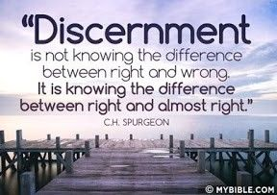
II. The psalmist seeks good discernment (v 66-68).
“Teach me good judgment and knowledge,
For I believe Your commandments”.
Psalm 119:66 (NKJV)

Slide 7

The psalmist
declares his Faith
=
"I have believed
Your commandments."
And there is
a special petition
based upon it:
=

Slide 8
“Before I was afflicted I went astray,
But now I keep Your word”.
Psalm 119:67 (NKJV)
“By affliction God separates the sin which he hates from the soul which he loves”.
John Mason.

Slide 9
“You are good, and do good;
Teach me Your statutes”.
Psalm 119:68 (NKJV)
The psalmist was a learner, he was delighted to learn.

Slide 10
III. The psalmist trust during his affliction (v 69-70).
“The proud have forged a lie against me,
But I will keep Your precepts with my whole heart”.
Psalm 119:69 (NKJV)
WE FOCUS ON GOD’S LAW… HIS WORD!

Slide 11
“He who dwells in the secret place of the Most High Shall abide under the shadow of the Almighty….⁵ You shall not be afraid of the terror by night,… ⁹ Because you have made the LORD, who is my refuge, Even the Most High, your dwelling place, ¹⁰ No evil shall befall you,
Psalm 91:1, 5, 9-10 (NIV)
THE PSALMIST TRUST DURING HIS AFLICTION

Slide 12
“Their heart is as fat as grease,
But I delight in Your law.”.
Psalm 119:70 (NKJV)
A fatty heart.
²⁶ I will give you a new heart and put a new spirit in you; I will remove from you your heart of stone and give you a heart of flesh. ²⁷ And I will put my Spirit in you and move you to follow my decrees and be careful to keep my laws.
Ezekiel 36:26-27 (NIV)

Slide 13

IV. A Good Result of Affliction. (v71-72)
“It is good for me that I have been afflicted,
That I may learn Your statutes”.
Psalm 119:71 (NKJV)

Slide 14
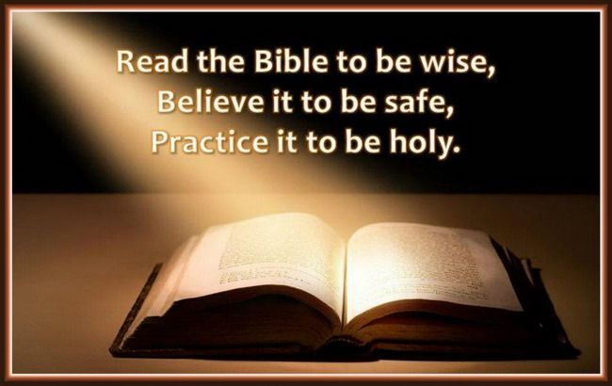
“The law of Your mouth is better to me
Than thousands of coins of gold and silver”.
Psalm 119:72 (NKJV)

Slide 15
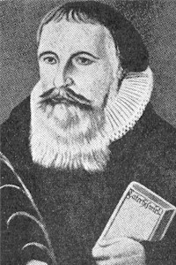
“Now Thank We All Our God”
Martin Rinkart

Slide 16
“Now Thank We All Our God”
“Now thank we all our God,
with heart and hands and voices,
Who wondrous things has done,
in Whom this world rejoices;
Who from our mothers’ arms
has blessed us on our way
With countless gifts of love,
and still is ours today”.

Slide 17
Lessons from
Psalm 119:65-72
The Goodness of God’s Word.
Remember,
our afflictions are not designed to break us
but to bring us to God.

