Slide 1
Peter, an apostle of Jesus Christ, To God’s elect, exiles scattered throughout the provinces of Pontus, Galatia, Cappadocia, Asia and Bithynia, who have been chosen according to the foreknowledge of God the Father, through the sanctifying work of the Spirit, to be obedient to Jesus Christ and sprinkled with his blood: Grace and peace be yours in abundance. (vv.1,2)

Slide 2
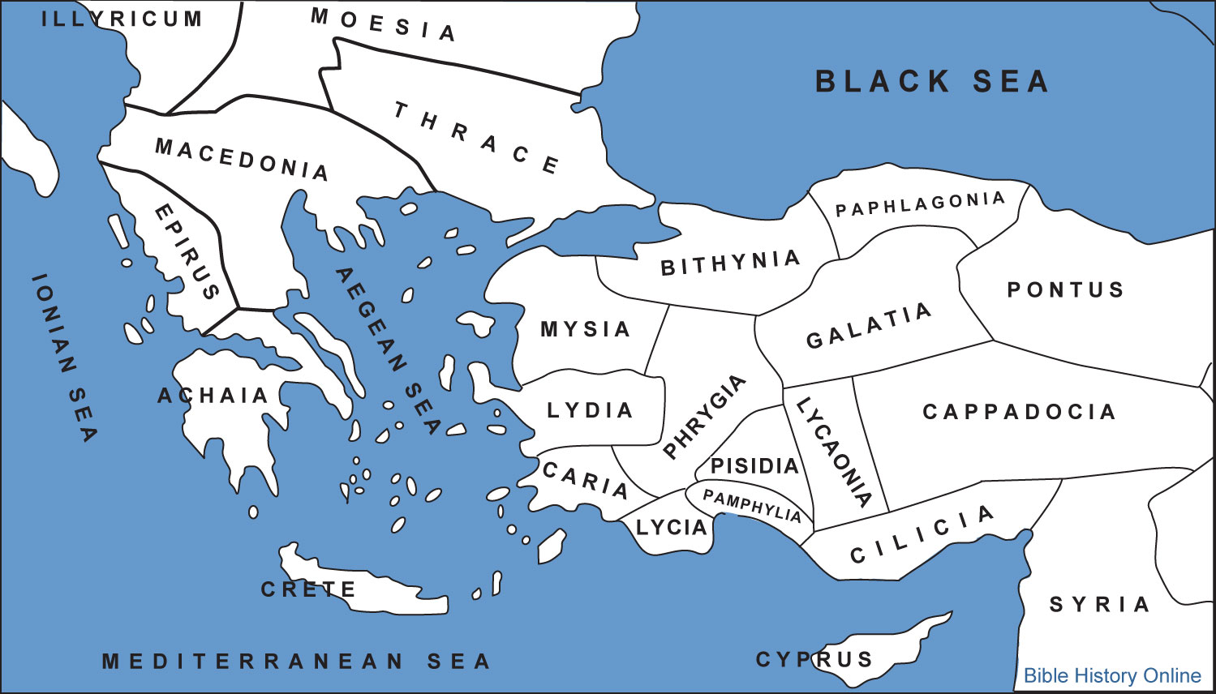

Slide 3
Why do you call me ‘Lord, Lord’ and do not do what I say?
(Lk.6:46)

Slide 4
Praise be to the God and Father of our Lord Jesus Christ! In his great mercy he has given us new birth into a living hope through the resurrection of Jesus Christ from the dead, and into an inheritance that can never perish, spoil or fade. This inheritance is kept in heaven for you, who through faith are shielded by God’s power until the coming of the salvation that is ready to be revealed in the last time.
In all this you greatly rejoice, though now for a little while you may have had to suffer grief in all kinds of trials. These have come so that the proven genuineness of your faith—of greater worth than gold, which perishes even though refined by fire—may result in praise, glory and honour when Jesus Christ is revealed. Though you have not seen him, you love him; and even though you do not see him now, you believe in him and are filled with an inexpressible and glorious joy, for you are receiving the end result of your faith, the salvation of your souls. (vv.3-9)

Slide 5
Praise be to the God and Father of our Lord Jesus Christ! In his great mercy he has given us new birth into a living hope through the resurrection of Jesus Christ from the dead (v.3)

Slide 6
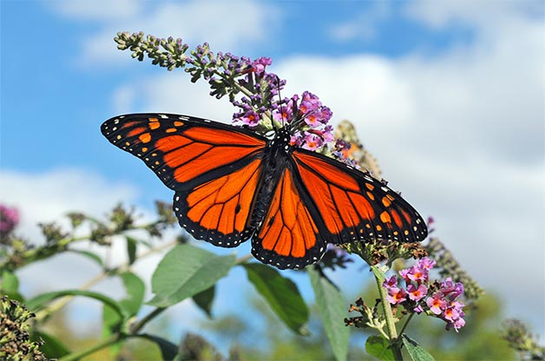

Slide 7
A living hope (v.3)
Jesus has prepared a
place for us (Jn.14:2)

Slide 8
who through faith are shielded by God’s power until the coming of the salvation that is ready to be revealed in the last time (v.5)

Slide 9
Though you have not seen him, you love him; and even though you do not see him now, you believe in him and are filled with an inexpressible and glorious joy, for you are receiving the end result of your faith, the salvation of your souls. (vv.8,9)

Slide 10
We know that when he appears, we shall be like him, for we shall see him
as he is’ (1 John 3:2)

Slide 11
You are receiving the end result of your faith, the salvation of your souls
(vv.8,9)

Slide 12
“Are you saved, brother?”

Slide 13
John Newton
‘Amazing Grace’

Slide 14
Concerning this salvation, the prophets, who spoke of the grace that was to come to you, searched intently and with the greatest care, trying to find out the time and circumstances to which the Spirit of Christ in them was pointing when he predicted the sufferings of the Messiah and the glories that would follow. It was revealed to them that they were not serving themselves but you, when they spoke of the things that have now been told you by those who have preached the gospel to you by the Holy Spirit sent from heaven. Even angels long to look into these things. (vv.10-12)

Slide 15
He said to them, “This is what I told you while I was still with you: Everything must be fulfilled that is written about me in the Law of Moses, the Prophets and the Psalms.”
(Lk.24:44)
4(Lk.24:44)

Slide 16
Therefore, with minds that are alert and fully sober, set your hope on the grace to be brought to you when Jesus Christ is revealed at his coming. As obedient children, do not conform to the evil desires you had when you lived in ignorance. But just as he who called you is holy, so be holy in all you do; for it is written: “Be holy, because I am holy.”
Since you call on a Father who judges each person’s work impartially, live out your time as foreigners here in reverent fear. For you know that it was not with perishable things such as silver or gold that you were redeemed from the empty way of life handed down to you from your ancestors, but with the precious blood of Christ, a lamb without blemish or defect.
He was chosen before the creation of the world, but was revealed in these last times for your sake. Through him you believe in God, who raised him from the dead and glorified him, and so your faith and hope are in God.
Now that you have purified yourselves by obeying the truth so that you have sincere love for each other, love one another deeply, from the heart. For you have been born again, not of perishable seed, but of imperishable, through the living and enduring word of God.
For, “All people are like grass, and all their glory is like the flowers of the field; the grass withers and the flowers fall, but the word of the Lord endures for ever.”
And this is the word that was preached to you.

Slide 17
Just as he who called you is holy, so be holy in all you do; for it is written: Be holy, because I am holy
(vv.15,16)

Slide 18
We’ve been justified.
We need to be sanctified.

Slide 19
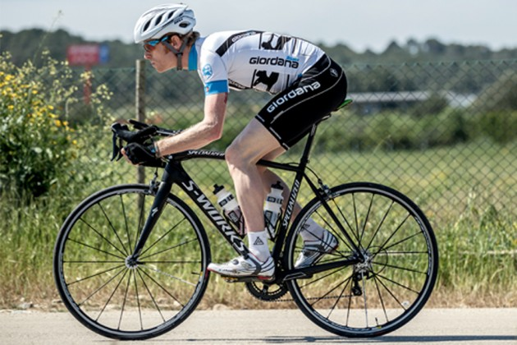

Slide 20
“Why do you call me,
‘Lord, Lord,’ and do not
do what I say?”
(Lk.6:46)

Slide 21
This world is not my home; I’m just passing through

Slide 22
Just as he who called you is holy, so be holy in all you do; for it is written: Be holy, because I am holy

