Slide 1
The Mountain Top of Glory
“And the glory of the LORD will be revealed, and all people will see it together….”
Isaiah 40:5 (NIV)
“The Son is the radiance of God’s glory and the exact representation of his being, sustaining all things by his powerful word…”.
Hebrews 1:3 (NIV)

Slide 2
The Mountain Top of Glory
Luke 9:28-39 (NIV)
“As he was praying, the appearance of his face changed, and his clothes became as bright as a flash of lightning.”
Luke 9:29 (NIV)

Slide 3
Let’s Pray…

Slide 4
The Mountain Top of Glory
I. Jesus’ Transformation.
About eight days after Jesus said this, he took Peter, John and James with him and went up onto a mountain to pray.
Luke 9:28 (NIV)

Slide 5
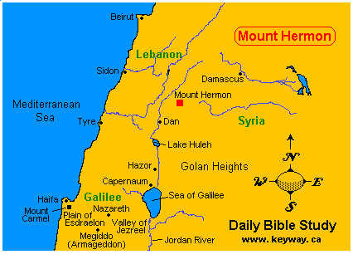

Slide 6
“As he was praying, the appearance of his face changed, and his clothes became as bright as a flash of lightning.”
Luke 9:29 (NIV)
‘His clothing became white and gleaming’
“The Son is the radiance of God’s glory and the exact representation of his being,…”
Hebrews 1:3 (NIV)

Slide 7
II. The Saints’ Association. (Saints’ get-together)
³⁰ And behold, two men were talking with him, Moses and Elijah, ³¹ who appeared in glory and spoke of his departure, which he was about to accomplish at Jerusalem.
Luke 9:30-31 (ESV)

Slide 8
“Both law and prophecy pointed forward to Calvary; ..both Moses and Elijah had received a special revelation of the grace of God; and God was to manifest His grace supremely in the death of His Son”
Charles R. Erdman, “The Gospel of Luke”, p.98

Slide 9
III. The Sleepers’ Suggestion.
“But Peter and those with him were heavy with sleep; and when they were fully awake, they saw His glory and the two men who stood with Him.”
Luke 9:32
When they were fully awake,
they saw His glory.

Slide 10
“In life we miss so much because our minds are asleep…There is prejudice. We may be so set in our ideas that our minds are shut… A new idea knocks at the door but we are like sleepers who will not awake”.
William Barclay, “The Daily Study Bible, The Gospel of Luke”, The saint Andrew Press, 1975, p124
Luke basically says:
“Peter didn’t know what he was saying.”

Slide 11
IV. God the Father’s Revelation
³⁴ As he was saying these things, a cloud came and overshadowed them, and they were afraid as they entered the cloud. ³⁵ And a voice came out of the cloud, saying, “This is my Son, my Chosen One; listen to him!”
Luke 9:34-35 (ESV)

Slide 12
“And when the voice had spoken, Jesus was found alone. And they kept silent and told no one in those days anything of what they had seen”.
Luke 9:36
They saw Jesus glowing with the glory of God.
They saw Moses and Elijah raised from the dead.
They saw the cloud of God’s glory.
They had heard Moses and Elijah talking with Jesus about the crucifixion to come.

Slide 13
And they had heard the voice of God the Father declare that Jesus was His beloved Son, the Chosen One whom they must listen to and obey.

Slide 14
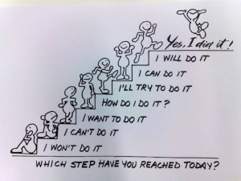
“Remember your Creator in the days of your youth, before the days of trouble come and the years approach when you will say, “I find no pleasure in them”—⁸ “Meaningless! Meaningless!” says the Teacher. “Everything is meaningless!”
Ecclesiastes 12:1, 8 (NIV)

Slide 15
¹³ Now all has been heard; here is the conclusion of the matter: Fear God and keep his commandments, for this is the duty of all mankind.
¹⁴ For God will bring every deed into judgment, including every hidden thing, whether it is good or evil.
Ecclesiastes 12:13-14 (NIV)
“Look to Me, and be saved, All you ends of the earth! For I am God, and there is no other.
Isaiah 45:22 (NKJV)

Slide 16
And we all, who with unveiled faces contemplate the Lord’s glory, are being transformed into His image with ever-increasing glory, which comes from the Lord, who is the Spirit.
2 Corinthians 3:18 (NIVUK)

Slide 17
To see God’s glory:
I. We need to visit “the mountaintop” to have communion with God that will transform us.

Slide 18
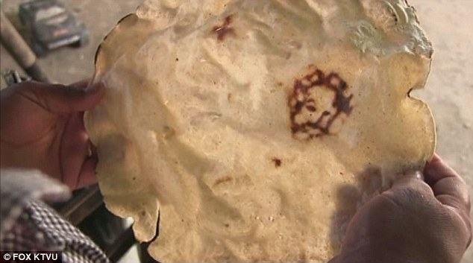
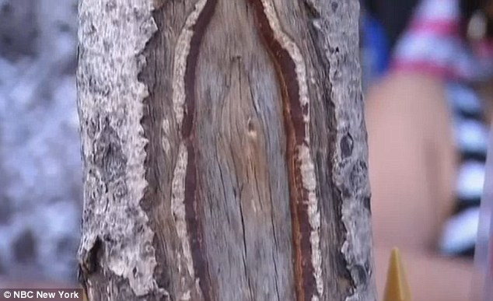
Maize the Lord! Mexican woman says Jesus appeared to her on homemade corn tortilla
Spruce almighty!
Is this the Virgin Mary
on a tree trunk?

Slide 19
To see God’s glory:
The first lesson we learn from today’s story is:
We need to visit “the mountaintop” to have communion with God (Prayer and worship) that will change us.

Slide 20
To see God’s glory:
II. We need to leave “the mountaintop” and serve.
Our time with God in Prayer & Worship
equips for the valley.
Jesus answered, “It is written:
“Worship the Lord your God and serve him only”. Luke 4:8 (NIV)

Slide 21
Lord, the light of your love is shining In the midst of the darkness, shining Jesus, Light of the world, shine upon us.
Shine, Jesus, shine Fill this land with the Father's glory Blaze, Spirit, blaze Set our hearts on fire Flow, river, flow Flood the nations with grace and mercy Send forth your word Lord, and let there be light.

Slide 22
Shine, Jesus, shine Fill this land with the Father's glory.

