Slide 1
Lessons from Psalms #22
Perseverance in the Word of God
Psalm 119:57-64

Slide 2
Let’s Pray…

Slide 3
Perseverance in the Word of God
I. The Psalmist proclaims his loyalty and request mercy.
“You are my portion, LORD;
I have promised to obey your words”.
Psalm 119:57 (NIV)
“But if we take the Lord as our portion, we must take him as our king… Here is the Christian complete – taking the Lord as his portion, and his word as his rule.”
Charles Bridges

Slide 4
“I have sought your face with all my heart;
be gracious to me according to your promise”.
Psalm 119:58 (NIV)
The Psalmist dwells upon favour and mercy, he never dreams of merit.

Slide 5
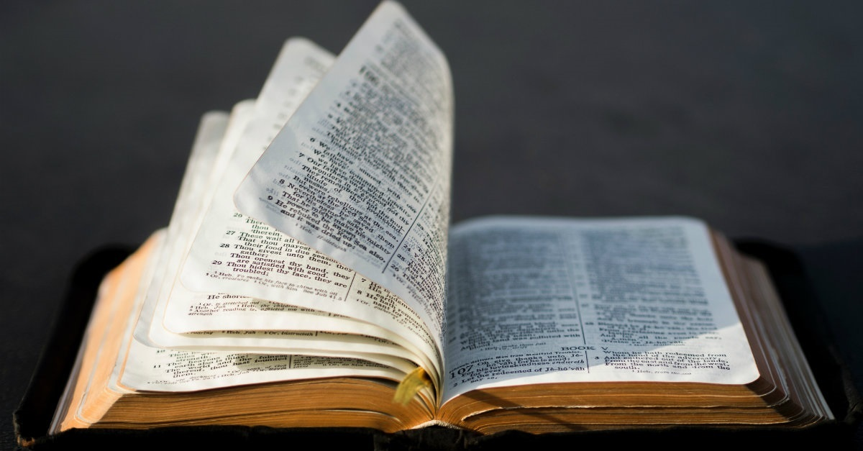
II. The psalmist’s life is directed towards God’s word.
“I have considered my ways
and have turned my steps to your statutes”.
Psalm 119:59 (NIV)

Slide 6
“Blaise Pascal, the brilliant French philosopher and devout Christian, loved Psalm 119. He is another person who had memorized it, and he called verse 59 ‘the turning point of man’s character and destiny.’ He meant that it is vital for every person to consider his or her ways, understand that our ways are destructive and will lead us to destruction, and then make an about-face and determine to go in God’s ways instead.”
James Montgomery Boice

Slide 7
“I will hasten and not delay
to obey your commands”.
Psalm 119:60 (NIV)
“Speed in repentance and speed in obedience are two excellent things. We are too often in haste to sin; O that we may be in a greater hurry to obey”.
Charles Spurgeon

Slide 8
III. The psalmist is Faithful to God’s word in adversity.
“Though the wicked bind me with ropes,
I will not forget your law”.
Psalm 119:61 (NIV)
“At midnight I rise to give you thanks for your righteous laws”.
Psalm 119:62 (NIV)

Slide 9
IV. The psalmist has Fellowship (friendship) with those
who are friends of God’s word.
“I am a friend to all who fear you,
to all who follow your precepts”.
Psalm 119:63 (NIV)
“The earth is filled with your love, LORD;
teach me your decrees”.
Psalm 119:64 (NIV)

Slide 10
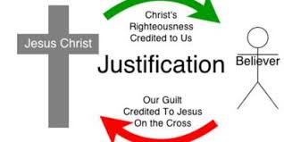
“The earth is filled with your love, LORD;
teach me your decrees”.

