Slide 1
God, what is your will?
God I want your will more than I want my will.

Slide 2
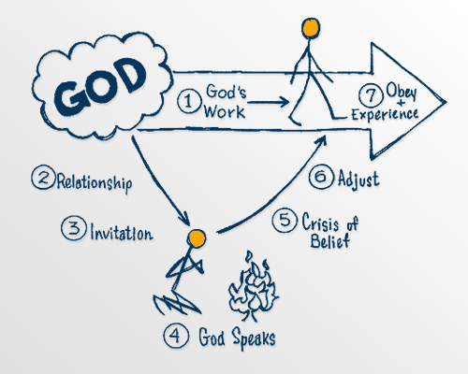
Experiencing God through obedience
How do I know that I really know God?

Slide 3
1 John 2:1-6
My little children, these things I write to you, so that you may not sin. And if anyone sins, we have an Advocate with the Father, Jesus Christ the righteous. ² And He Himself is the propitiation for our sins, and not for ours only but also for the whole world. ³ Now by this we know that we know Him, if we keep His commandments.

Slide 4
⁴ He who says, “I know Him,” and does not keep His commandments, is a liar, and the truth is not in him. ⁵ But whoever keeps His word, truly the love of God is perfected in him. By this we know that we are in Him. ⁶ He who says he abides in Him ought himself also to walk just as He walked.
1 John 2:1-6 (NKJV)
Let’s Pray…

Slide 5
How do I know that I really know God?
I. We need to know that Jesus is our advocate.
“My little children, these things I write to you, so that you may not sin. And if anyone sins, we have an Advocate with the Father, Jesus Christ the righteous. ² And He Himself is the propitiation for our sins,…”
1 John 2:1-2 (NKJV)

Slide 6
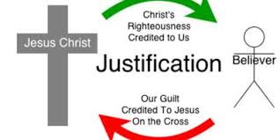
Propitiation.
“A sacrifice that bears God’s wrath and turns it to favour”

Slide 7
“God justice must be satisfied. Every sin ever committed by every person who has ever lived will be punished in one or two ways.
Either God’s wrath will be satisfied when all unrepentant and unbelieving sinners suffer eternally in hell (Matthew 13;42; 25:41, 46; 2 Thessalonians 1:9; Revelations 20:15), or for all who, by the convicting and regenerating power of the Spirit, repent and believe savingly in Jesus, God’s wrath is satisfied by the punishment of Christ Himself on the cross (John 3:14-18).”
The MacArthur New Testament Commentary (1-3 John) p. 48

Slide 8
²³ for all have sinned and fall short of the glory of God, ²⁴ being justified freely by His grace through the redemption that is in Christ Jesus, ²⁵ whom God set forth as a propitiation by His blood, through faith, to demonstrate His righteousness, because in His forbearance God had passed over the sins that were previously committed,
Romans 3:23-25 (NKJV)

Slide 9
⁸ If we say that we have no sin, we deceive ourselves, and the truth is not in us. ⁹ If we confess our sins, He is faithful and just to forgive us our sins and to cleanse us from all unrighteousness. ¹⁰ If we say that we have not sinned, we make Him a liar, and His word is not in us.
1 John 1:8-10 (NKJV)

Slide 10
How do I know that I really know God?
II. Jesus needs to be our example to follow.
“Now by this we know that we know Him, if we keep His commandments”.
1 John 2:3
Jesus replied, “Anyone who loves me will obey my teaching. My Father will love them, and we will come to them and make our home with them”
John 14:23 (NIV)

Slide 11
⁴ He who says, “I know Him,” and does not keep His commandments, is a liar, and the truth is not in him. ⁵ But whoever keeps His word, truly the love of God is perfected in him. By this we know that we are in Him.
1 John 2:4-5 (NKJV)
Legalism:
is the misguided attempt to earn our salvation
by obedience of the law.

Slide 12
“But if you look closely into the perfect law that sets people free, and keep on paying attention to it and do not simply listen and then forget it, but put it into practice—you will be blessed by God in what you do”.
James 1:25 (GNT)

Slide 13
III. The Certainty of Christian Assurance.
“He who says he abides in Him ought himself also to walk just as He walked”.
1 John 2:6 (NKJV)
⁴ Abide in Me, and I in you. As the branch cannot bear fruit of itself, unless it abides in the vine, neither can you, unless you abide in Me.⁵ “I am the vine, you are the branches. He who abides in Me, and I in him, bears much fruit; for without Me you can do nothing. John 15:4-5 (NKJV)

Slide 14
“Assurance of salvation, in the subjective sense, comes by examining one’s life to see if there is evidence of the Spirit’s working in one’s attitudes. Such spiritual dispositions manifest themselves in corresponding acts of “love, joy, peace,” and so forth, in submission to the commands of Scripture”
John MacArthur

Slide 15
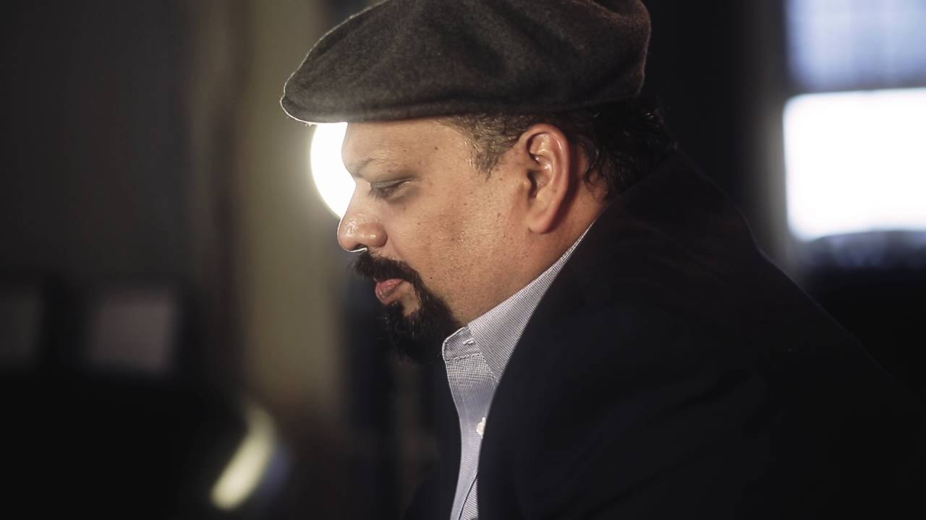
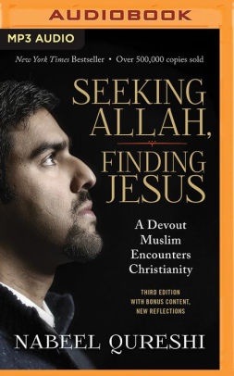
Cyril Prabhu
Nabeel Qureshi

Slide 16
How do I know that I really know God?
I. We need to know that Jesus is our advocate.
II. Jesus needs to be our example to follow.
III. The Certainty of Christian Assurance.

