Slide 1
Wow, I’m free to serve
Psalm 119:41-48

Slide 2
ו
6
8

Slide 3
⁴¹ Let your steadfast love come to me, O Lord, your salvation according to your promise;
⁴² then shall I have an answer for him who taunts me, for I trust in your word.
⁴³ And take not the word of truth utterly out of my mouth, for my hope is in your rules.
⁴⁴ I will keep your law continually, forever and ever,
⁴⁵ and I shall walk in a wide place, for I have sought your precepts.
⁴⁶ I will also speak of your testimonies before kings and shall not be put to shame,
⁴⁷ for I find my delight in your commandments, which I love.
⁴⁸ I will lift up my hands toward your commandments, which I love, and I will meditate on your statutes.
Psalm 119:41-48 (ESV)

Slide 4
⁴¹ Let your steadfast love come to me, O Lord, your salvation according to your promise;
⁴² then shall I have an answer for him who taunts me, for I trust in your word.
⁴³ And take not the word of truth utterly out of my mouth, for my hope is in your rules.
⁴⁴ I will keep your law continually, forever and ever,
⁴⁵ and I shall walk in a wide place, for I have sought your precepts.
⁴⁶ I will also speak of your testimonies before kings and shall not be put to shame,
⁴⁷ for I find my delight in your commandments, which I love.
⁴⁸ I will lift up my hands toward your commandments, which I love, and I will meditate on your statutes.
Psalm 119:41-48 (ESV)

Slide 5
“Do not think that I have come to abolish the Law or the Prophets; I have not come to abolish them but to fulfill them.”
Matthew 5:17 (ESV)

Slide 6
Psalm 119 is a richly woven tapestry on the subject of God’s law

Slide 7
“ Let your steadfast love come to me, O Lord,…”
Psalm 119:41a (ESV)
“May your unfailing love come to me, Lord,…”
Psalm 119:41a (NIV)
חֶסֶד (ḥesed)

Slide 8
“For God so loved the world, that he gave his only Son, that whoever believes in him should not perish but have eternal life.”
John 3:16 (ESV)

Slide 9
“ Let your steadfast love come to me, O Lord, your salvation according to your promise…”
Psalm 119:41 (ESV)

Slide 10
“There is therefore now no condemnation for those who are in Christ Jesus.”
Romans 8:1 (ESV)

Slide 11
Psalm 119 is a richly woven tapestry on the subject of God’s law
The steadfast love of God runs through the tapestry (and the rest of Scripture)

Slide 12
“We love because he first loved us.”
1 John 4:19 (ESV)

Slide 13
“We love because he first loved us. If anyone says, “I love God”, and hates his brother, he is a liar; for he who does not love his brother whom he has seen cannot love God whom he has not seen. And this commandment we have from him: whoever loves God must also love his brother.”
1 John 4:19-21 (ESV)

Slide 14
“If you love me, you will keep my commandments.”
John 14:15 (ESV)

Slide 15
“for I find my delight in your commandments, which I love.
I will lift up my hands towards your commandments, which I love, and I will meditate on your statutes.”
Psalm 119:47-48 (ESV)

Slide 16
“I will keep your law continually,
for ever and ever, and I shall walk in a wide place, for I have sought your precepts.”
Psalm 119:44-45 (ESV)

Slide 17
“I will keep your law continually,
for ever and ever, and I shall walk in a wide place, for I have sought your precepts.”
Psalm 119:44-45 (ESV)
“I will walk about in freedom,
for I have sought out your precepts.” v45 (NIV)

Slide 18
Psalm 119 is a richly woven tapestry on the subject of God’s law
The steadfast love of God runs through the tapestry (and the rest of Scripture)
There is freedom in following God’s law

Slide 19
“You have heard that it was said to those of old, ‘You shall not murder; and whoever murders will be liable to judgement.’ But I say to you that everyone who is angry with his brother will be liable to judgement…”
“I say to you that everyone who looks at a woman with lustful intent has already committed adultery with her in his heart.”
Matthew 5:21-22a, 28 (ESV)

Slide 20
“There is therefore now no condemnation for those who are in Christ Jesus. For the law of the Spirit of life has set you free in Christ Jesus from the law of sin and death.”
Romans 8:1,2 (ESV)

Slide 21
“For those who live according to the flesh set their minds on the things of the flesh, but those who live according to the Spirit set their minds on the things of the Spirit. For to set the mind on the flesh is death, but to set the mind on the Spirit is life and peace. For the mind that is set on the flesh is hostile to God, for it does not submit to God's law; indeed, it cannot. Those who are in the flesh cannot please God.”
Romans 8:5-8 (ESV)

Slide 22
“For freedom Christ has set us free; stand firm therefore, and do not submit again to a yoke of slavery.”
Galatians 5:1 (ESV)

Slide 23
“Those who live as their human nature tells them to, have their minds controlled by what human nature wants… Those who obey their human nature cannot please God.”
Romans 8:5,8 (GNT)

Slide 24
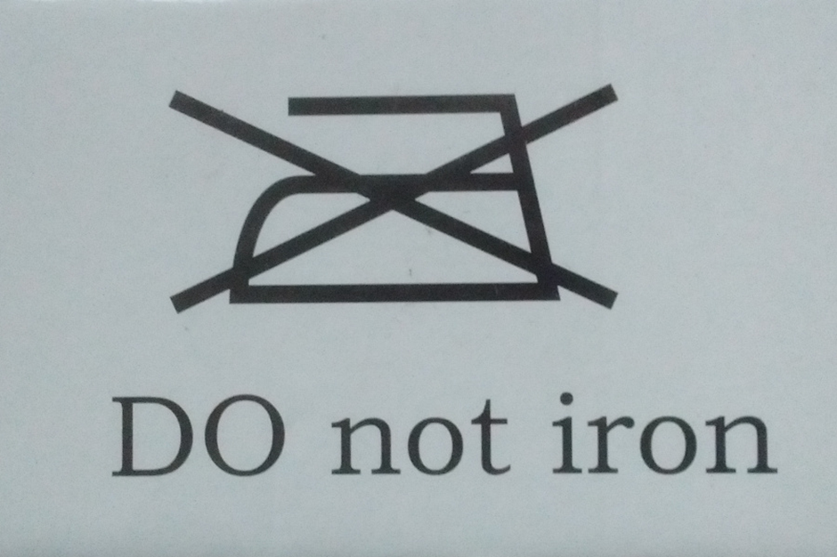

Slide 25
“For freedom Christ has set us free; stand firm therefore, and do not submit again to a yoke of slavery.”
Galatians 5:1 (ESV)

Slide 26
“… all have sinned and fall short of the glory of God…”
Romans 3:23 (ESV)

Slide 27
“… all have sinned and fall short of the glory of God, and are justified by his grace as a gift, through the redemption that is in Christ Jesus…”
Romans 3:23-24 (ESV)

Slide 28
Not the labours of my hands,
Can fulfill thy law's demands;
Could my zeal no respite know,
Could my tears forever flow,
All for sin could not atone;
Thou must save and thou alone.
Rock of Ages (v2) Augustus M. Toplady

Slide 29
Dictionary result for atonement
/əˈtəʊnm(ə)nt/
noun
noun: atonement; plural noun: atonements
the action of making amends for a wrong or injury.
(in religious contexts) reparation or expiation for sin.
CHRISTIAN THEOLOGY
the reconciliation of God and mankind through Jesus Christ.
[google.co.uk search for “atonement meaning”, 2/1/2019, first search result]

Slide 30
atonement
=
at-one-ment

Slide 31
Psalm 119 is a richly woven tapestry on the subject of God’s law
The steadfast love of God runs through the tapestry (and the rest of Scripture)
There is freedom in following God’s law (but we also need his grace through Christ)

