Slide 1
“Hope in healing and wholeness”
(Luke 17:11-19)
“Jesus Heals Ten Men with Leprosy”
- or -
“Nine Men got healed, One got whole”
- or -
If you want to worship, God moved heaven and earth to make a way for you, and he still does today!

Slide 2
Luke 17: ¹¹ Now on his way to Jerusalem, Jesus travelled along the border between Samaria and Galilee. ¹² As he was going into a village, ten men who had leprosy^{[b]} met him. They stood at a distance ¹³ and called out in a loud voice, “Jesus, Master, have pity on us!”
¹⁴ When he saw them, he said, “Go, show yourselves to the priests.” And as they went, they were cleansed.
¹⁵ One of them, when he saw he was healed, came back, praising God in a loud voice. ¹⁶ He threw himself at Jesus’ feet and thanked him—and he was a Samaritan.
¹⁷ Jesus asked, “Were not all ten cleansed? Where are the other nine? ¹⁸ Has no one returned to give praise to God except this foreigner?” ¹⁹ Then he said to him, “Rise and go; your faith has made you well.”

Slide 3
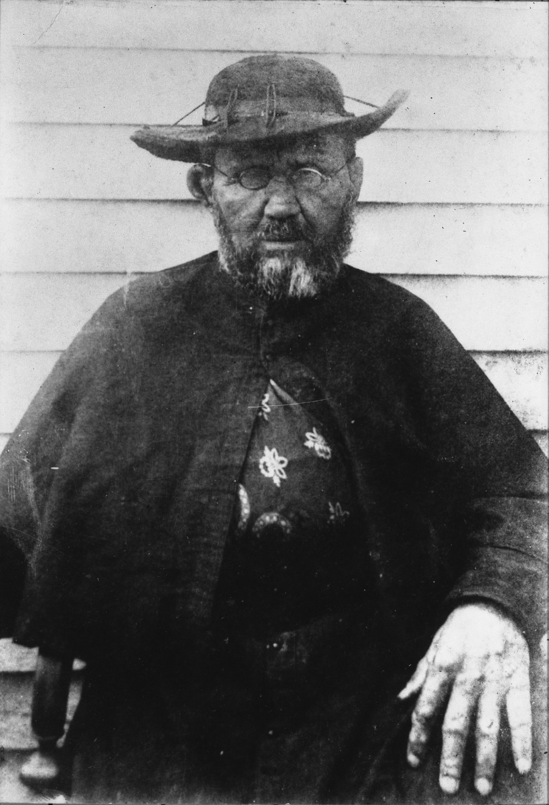
Fr. Damien of Molokai
1840-1889 (Age 49)
He won recognition for his ministry from 1873 to 1889 in the Kingdom of Hawaiʻi to people with leprosy (Hansen's disease), who were required to live under a government-sanctioned medical quarantine on the island of Molokaʻi on the Kalaupapa Peninsula.

Slide 4
Hansen’s Disease—which is still most commonly known as leprosy—was extremely stigmatized around the world for centuries. (The name change was prompted in part by ongoing efforts to move past that stigma and is based on the physician who first identified the bacteria that causes it.)
Described frequently in the Bible as repulsive and unclean, the disease was long feared to be highly contagious. Leprosy causes skin sores, nerve damage, and muscle weakness—symptoms that become debilitating if left unaddressed, but are now treatable with antibiotics. It’s hardly as contagious as once thought, and as many as 95 percent of people may be naturally immune to the bacteria.
Several cases recently reported in University Hospital of Wales.

Slide 5
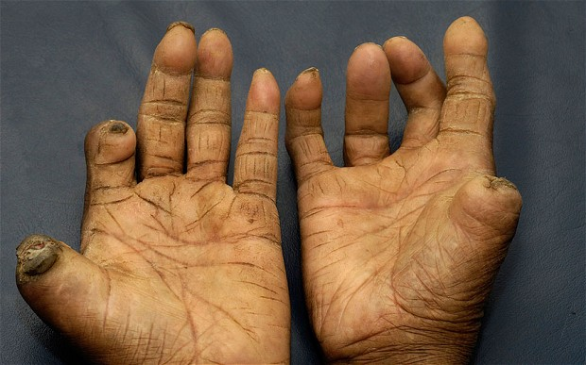

Slide 6
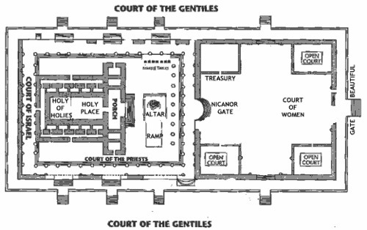

Slide 7
Hope in healing and wholeness
What lessons for the Christian life are here for us, what hope can we gain?
Obedience first, understanding second – lean not on your own understanding.

Slide 8
Hope in healing and wholeness
What lessons for the Christian life are here for us, what hope can we gain?
Obedience first, understanding second – lean not on your own understanding.
‘…and as they went, they were cleansed.’ Lk 17:14)
Proverbs 3:5-6 New International Version (NIV)
⁵ Trust in the Lord with all your heart and lean not on your own understanding; ⁶ in all your ways submit to him, and he will make your paths straight.

Slide 9
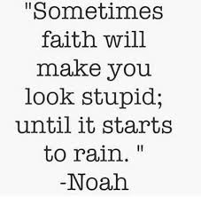

Slide 10
Hope in healing and wholeness
What lessons for the Christian life are here for us, what hope can we gain?
Obedience first, understanding second – lean not on your own understanding.
Attitude of gratitude.

Slide 11
Hope in healing and wholeness
What lessons for the Christian life are here for us, what hope can we gain?
Obedience first, understanding second – lean not on your own understanding.
Attitude of gratitude – leading to wholeness.
‘If you seek him [with all your heart], he will be found by you’
2 Chronicles 15:2/Jer 29:13
‘Blessed be Your name On the road marked with suffering Though there's pain in the offering Blessed be Your name’ (Redman)

Slide 12
Hope in healing and wholeness
What lessons for the Christian life are here for us, what hope can we gain?
Obedience first, understanding second – lean not on your own understanding.
Attitude of gratitude – leading to wholeness.
Called to be different.

Slide 13

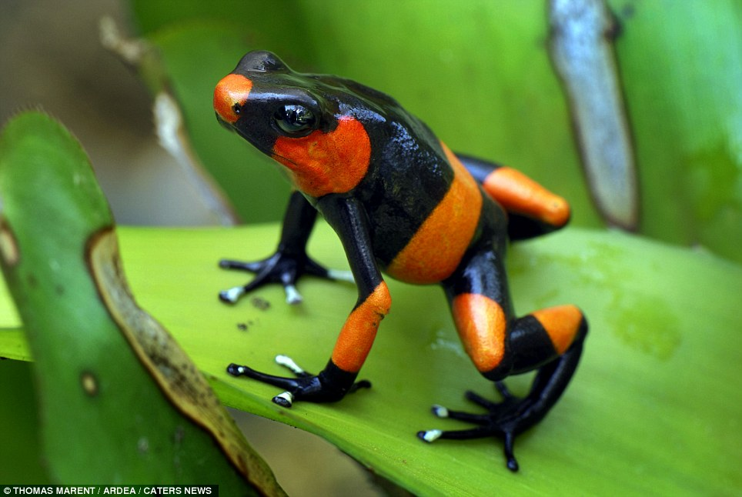

Slide 14
Hope in healing and wholeness
What lessons for the Christian life are here for us, what hope can we gain?
Obedience first, understanding second – lean not on your own understanding.
Attitude of gratitude – leading to wholeness.
Called to be different – so dare to be different.
“You are the light of the world. A town built on a hill cannot be hidden…In the same way, let your light shine before others, that they may see your good deeds and glorify your Father in heaven.” Matt 6:14-16

Slide 15
Hope in healing and wholeness
What lessons for the Christian life are here for us, what hope can we gain?
Obedience first, understanding second – lean not on your own understanding.
Attitude of gratitude – leading to wholeness.
Called to be different – so dare to be different.
4. Jesus sees past the skin – he came for the ‘whoevers’

Slide 16
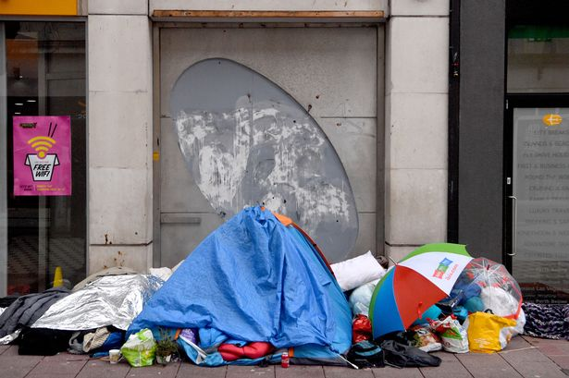

Slide 17
Hope in healing and wholeness
What lessons for the Christian life are here for us, what hope can we gain?
Obedience first, understanding second – lean not on your own understanding.
Attitude of gratitude – leading to wholeness.
Called to be different – so dare to be different.
4. Jesus sees past the skin – he came for the ‘whoevers’
”For God so loved the world that he gave his one and only Son, that whoever believes in him shall not perish but have eternal life.” John 3:16

Slide 18
Fr. Damien of Molokai
1840-1889 (Age 49)
Father Damien cared for the patients himself and established leadership within the community to build houses, schools, roads, hospitals, and churches. He dressed residents' ulcers, built a reservoir, made coffins, dug graves, shared pipes, and ate poi from his hands with them, providing both medical and emotional support.
After eleven years caring for the physical, spiritual, and emotional needs of those in the leper colony, Father Damien contracted leprosy. He continued with his work despite the infection but finally succumbed to the disease on 15 April 1889.

Slide 19
“Hope in healing and wholeness”
(Luke 17:11-19)
“Jesus Heals Ten Men with Leprosy”
- or -
“Nine Men got healed, One got whole”
- or -
If you want to worship, God moved heaven and earth to make a way for you, and he still does today!

