Slide 1
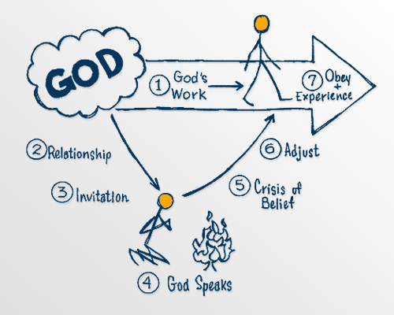
“Adjusting Your Life to God.”

Slide 2
In the same way, those of you who do not give up everything you have cannot be my disciples.
Luke 14:33 (NIV)

Slide 3
Let’s Pray…

Slide 4
“Many of us want God to speak to us and give us an assignment. However, we are not interested in making major adjustments in our lives.”
Henry Blackaby
“Behold the proud, His soul is not upright in him; But the just shall live by his faith.
Habakkuk 2:4 (NKJV)
But without faith it is impossible to please Him,…
Hebrews 11:6 (NKJV)

Slide 5
“Adjusting Your Life to God.”
In your circumstances – (job, home, finances)
In your relationships – (family, friends, business associates)
In your thinking – (prejudices, your potential, your past)
In your commitments – (to family, church, job, plans)
In your actions – how you pray, give, and serve
In your beliefs – about God, His purposes, His ways,
your relationship with Him

Slide 6
In the same way, those of you who do not give up everything you have cannot be my disciples.
Luke 14:33 (NIV)
²⁵ Large crowds were traveling with Jesus, and turning to them he said: ²⁶ “If anyone comes to me and does not hate father and mother, wife and children, brothers and sisters—yes, even their own life—such a person cannot be my disciple. ²⁷ And whoever does not carry their cross and follow me cannot be my disciple.

Slide 7
“If anyone comes to me and does not HATE father and mother, wife and children, brothers and sisters—…”
“Hate in this context is a Semitic way of expressing preference.”
MacArthur New Testament Commentary, The - MacArthur New Testament Commentary – Luke 11-17.

Slide 8
“But they all alike began to make excuses. The first said, ‘I have just bought a field, and I must go and see it. Please excuse me.’
Luke 14:18 (NIV)
“Suppose one of you wants to build a tower. Won’t you first sit down and estimate the cost to see if you have enough money to complete it?
Luke 14:28 (NIV)

Slide 9
1 Kings 19:19-20 (NIV)
¹⁹ So Elijah went from there and found Elisha son of Shaphat. He was plowing with twelve yoke of oxen, and he himself was driving the twelfth pair. Elijah went up to him and threw his cloak around him. ²⁰ Elisha then left his oxen and ran after Elijah. “Let me kiss my father and mother goodbye,” he said, “and then I will come with you.”

Slide 10
So Elisha left him and went back. He took his yoke of oxen and slaughtered them. He burned the plowing equipment to cook the meat and gave it to the people, and they ate.
Then he set out to follow Elijah and became his servant.
1 Kings 19:21 (NIV)

Slide 11
“When God invites you to join Him in His work, He has a God-sized assignment for you. You will quickly realize you cannot do what He is asking on your own. If God doesn’t help you, you will fail. This is the crisis of belief when you must decide whether to believe God for what He wants to do through you.
Henry Blackaby
“Adjusting Your Life to God.”

Slide 12
³³ In the same way, those of you who do not give up everything you have cannot be my disciples.
³⁴ “Salt is good, but if it loses its saltiness, how can it be made salty again? ³⁵ It is fit neither for the soil nor for the manure pile; it is thrown out.
“Whoever has ears to hear, let them hear.”
Do you have ears that hear?

