Slide 1
A new command I give you: Love one another. As I have loved you, so you must love one another.
By this everyone will know that you are my disciples, if you love one another.”
John 13:34-35 (NIV)

Slide 2
My prayer is not for them alone. I pray also for those who will believe in me through their message, that all of them may be one, Father, just as you are in me and I am in you. May they also be in us so that the world may believe that you have sent me.
John 17:20-21 (NIV)
How can the church be united as one?

Slide 3
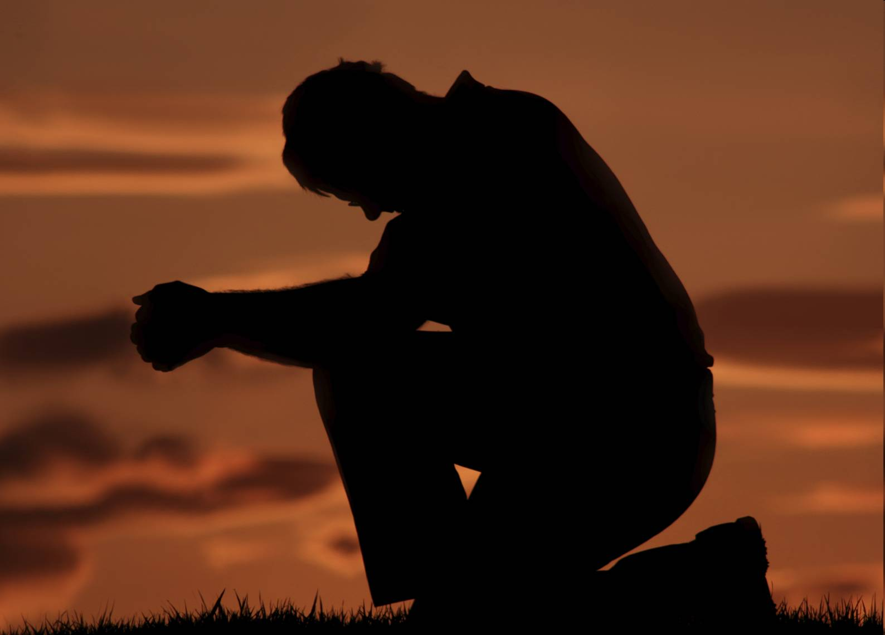

Slide 4

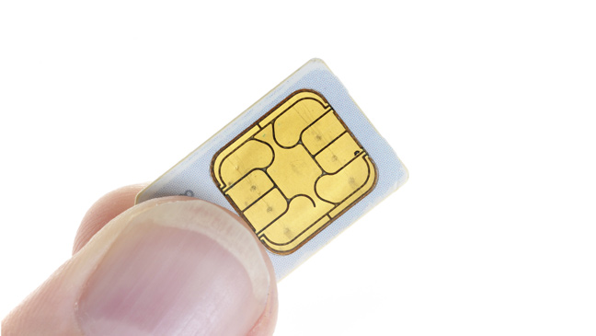

Slide 5

“That all of them may be one, …
so the world may believe”.
John chapter 17 is a prayer of three sections:

Slide 6
John 17
In verses 1-5 Jesus prays for Himself,
Verses 6-19 He prays for His eleven disciples,
and in verses 20-26 He prays for all believers yet to come.
“that they may all be one”.

Slide 7
Jesus prayed “that they also may be in us”.
How can the church be united as one?
I. First of all we need to respond to His love for us.
“If you love me, keep my commands”.
John 14:15 (NIV)

Slide 8
²³ Jesus replied, “Anyone who loves me will obey my teaching. My Father will love them, and we will come to them and make our home with them. ²⁴ Anyone who does not love me will not obey my teaching.
John 14:23-24 (NIV)

Slide 9
“Despite their outward denominational differences, all true Christians are spiritually united by regeneration in their belief that salvation is by grace alone through faith alone, in Christ alone, and their commitment to the absolute authority of Scripture”.
John MacArthur

Slide 10
II. This Christian unity can be advance only by an increasing knowledge of Christ and of the truth which He reveals.
“Just as you are in me and I am in you”.
The Father and Son are united in mission
The Father and Son are united in holiness
The Father and Son are united in love

Slide 11
By this everyone will know that you are my disciples, if you love one another.”
John 13:35 (NIV)

Slide 12
III. The blessings of Unity come as a result of surrendering.
2 Kings 4:38-44

Slide 13
Elisha returned to Gilgal and there was a famine in that region. While the company of the prophets was meeting with him, he said to his servant, “Put on the large pot and cook some stew for these prophets.”
2 Kings 4:38 (NIV)
Psalm 37:25
I was young and now I am old, yet I have never seen the righteous forsaken or their children begging bread.

Slide 14
³⁹ One of them went out into the fields to gather herbs and found a wild vine and picked as many of its gourds as his garment could hold. When he returned, he cut them up into the pot of stew, though no one knew what they were. ⁴⁰ The stew was poured out for the men, but as they began to eat it, they cried out, “Man of God, there is death in the pot!” And they could not eat it.
2 Kings 4:39-40 (NIV)

Slide 15
Elisha said, “Get some flour.” He put it into the pot and said, “Serve it to the people to eat.” And there was nothing harmful in the pot.
2 Kings 4:41 (NIV)
Very truly I tell you, unless a kernel of wheat falls to the ground and dies, it remains only a single seed. But if it dies, it produces many seeds.
John 12:24 (NIV)

Slide 16

⁵⁵ “Where, O death, is your victory? Where, O death, is your sting?”
⁵⁶ The sting of death is sin, and the power of sin is the law. ⁵⁷ But thanks be to God! He gives us the victory through our Lord Jesus Christ.
1 Corinthians 15:55-57 (NIV)
This is what we need. The Church needs Jesus.

