Slide 1
Joshua 1:1-9 (NIV)
After the death of Moses the servant of the Lord, the Lord said to Joshua son of Nun, Moses’ aide: ² “Moses my servant is dead. Now then, you and all these people, get ready to cross the Jordan River into the land I am about to give to them—to the Israelites. ³ I will give you every place where you set your foot, as I promised Moses.⁴ Your territory will extend from the desert to Lebanon, and from the great river, the Euphrates—all the Hittite country—to the Mediterranean Sea in the west. ⁵ No one will be able to stand against you all the days of your life. As I was with Moses, so I will be with you; I will never leave you nor forsake you.

Slide 2
Joshua 1:1-9 (NIV)
⁶ Be strong and courageous, because you will lead these people to inherit the land I swore to their ancestors to give them. ⁷ “Be strong and very courageous. Be careful to obey all the law my servant Moses gave you; do not turn from it to the right or to the left, that you may be successful wherever you go. ⁸ Keep this Book of the Law always on your lips; meditate on it day and night, so that you may be careful to do everything written in it. Then you will be prosperous and successful. ⁹ Have I not commanded you? Be strong and courageous. Do not be afraid; do not be discouraged, for the Lord your God will be with you wherever you go.”

Slide 3
Let’s pray…

Slide 4
“This is the victory that overcomes the world, our faith”
1 John 5:4.
Numbers 27:18 says that Joshua was
“a man in whom is the Spirit” (RSV).

Slide 5
¹⁰ The Lord’s anger was aroused that day and he swore this oath:¹¹ ‘Because they have not followed me wholeheartedly, not one of those who were twenty years old or more when they came up out of Egypt will see the land I promised on oath to Abraham, Isaac and Jacob— ¹² not one except Caleb son of Jephunneh the Kenizzite and Joshua son of Nun, for they followed the Lord wholeheartedly.’
Numbers 32:10–12 (NIV)

Slide 6
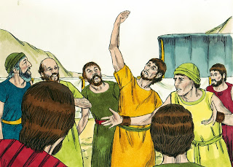
Conquering by Faith
I. Faith’s challenge (Joshua 1:2).
“You and all these people, get ready to cross the Jordan River into the land I am about to give to them—to the Israelites”.

Slide 7
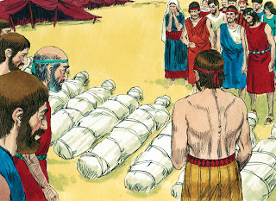
³⁶ So the men Moses had sent to explore the land, who returned and made the whole community grumble against him by spreading a bad report about it— ³⁷ these men who were responsible for spreading the bad report about the land were struck down and died of a plague before the Lord. ³⁸ Of the men who went to explore the land, only Joshua son of Nun and Caleb son of Jephunneh survived.
Numbers 14:36-38 (NIV)

Slide 8
II. BE STRONG AND COURAGEOUS
What is courage?
Courage has several synonyms: bravery, fearlessness, heroism, confidence, nerve.
It also has several nicknames: guts, grit, backbone.
“Be strong and courageous.”
“For the Lord your God will be with you wherever you go.”

Slide 9
¹⁷ You may say to yourselves, “These nations are stronger than we are. How can we drive them out?” ¹⁸ But do not be afraid of them; remember well what the Lord your God did to Pharaoh and to all Egypt. ¹⁹ You saw with your own eyes the great trials, the signs and wonders, the mighty hand and outstretched arm, with which the Lord your God brought you out. The Lord your God will do the same to all the peoples you now fear…²¹ Do not be terrified by them, for the Lord your God, who is among you, is a great and awesome God.
Deuteronomy 7:17-19, 21 (NIV)

Slide 10
²⁶ But you were unwilling to go up; you rebelled against the command of the Lord your God. ²⁷ You grumbled in your tents and said, “The Lord hates us; so he brought us out of Egypt to deliver us into the hands of the Amorites to destroy us. ²⁸ Where can we go? Our brothers have made our hearts melt in fear. They say, ‘The people are stronger and taller than we are; the cities are large, with walls up to the sky. We even saw the Anakites there.’” ²⁹ Then I said to you, “Do not be terrified; do not be afraid of them.
Deuteronomy 1:26-32 (NIV)

Slide 11
³⁰ The Lord your God, who is going before you, will fight for you, as he did for you in Egypt, before your very eyes, ³¹ and in the wilderness. There you saw how the Lord your God carried you, as a father carries his son, all the way you went until you reached this place.” ³² In spite of this, you did not trust in the Lord your God,
“Be strong and courageous.”
“For the Lord your God will be with you wherever you go.”

Slide 12
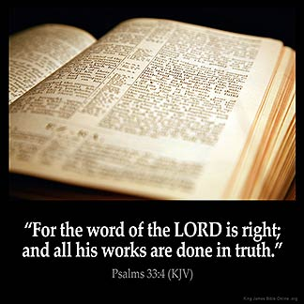
III. OBEDIENCE TO GOD’S COMMANDS (v. 7)
“Be careful to obey ALL the law….”
We are not under that same law today,
but we live by the same principles.
Jesus said that there are two commands that are most important.
Love the Lord your God with all your heart, soul, mind and strength.
Love your neighbour as yourself.

Slide 13
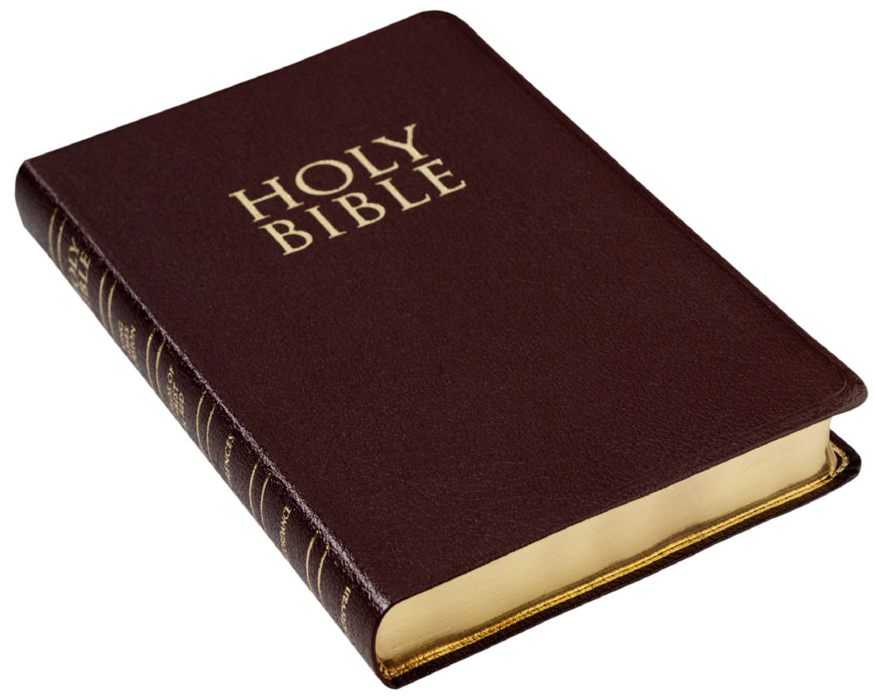
IV. SATURATION IN GOD’S WORD (v. 8)
“Keep this Book of the Law always on your lips; meditate on it day and night, so that you may be careful to do everything written in it.”
The wisdom we need is available. It’s not just about reading it;
it’s about meditating on it, and
letting God’s word saturate our spirit.

Slide 14
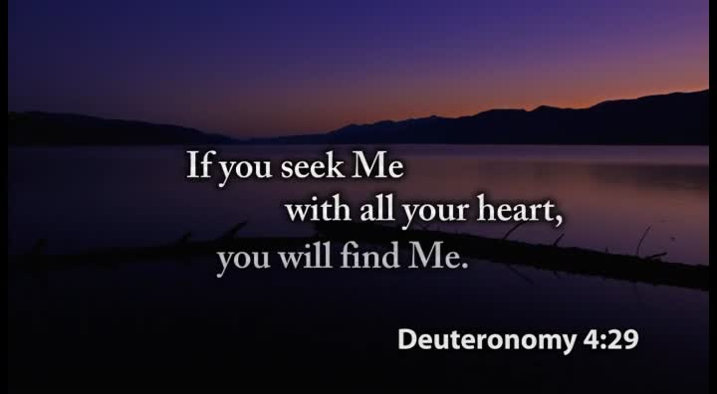

Slide 15
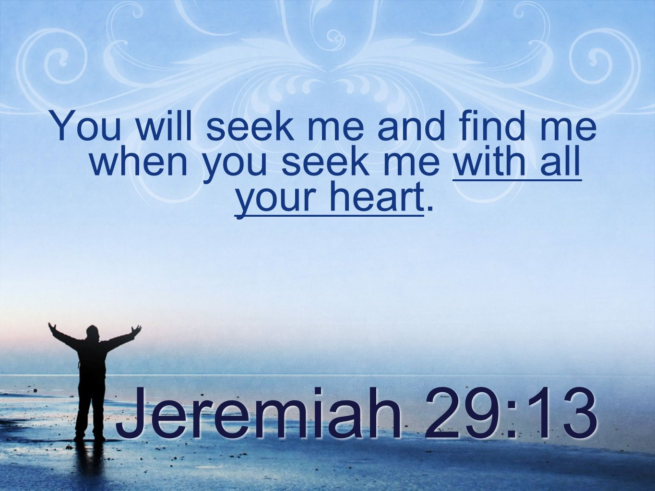

Slide 16

“And you also were included in Christ when you heard the message of truth, the gospel of your salvation. When you believed, you were marked in him with a seal, the promised Holy Spirit”
Ephesians 1:13 (NIV)

Slide 17
Guide Me O Thou Great Redeemer
Guide me, O thou great redeemer, Pilgrim through this barren land; I am weak, but thou art mighty, Hold me with thy powerful hand; Bread of heaven, bread of heaven Feed me till I want no more; Feed me till I want no more.

Slide 18
Have I not commanded you? Be strong and courageous. Do not be afraid; do not be discouraged, for the Lord your God will be with you wherever you go.”
Joshua 1:9 (NIV)

