Slide 1
Luke 2:8-14 (NIV)
⁸ And there were shepherds living out in the fields nearby, keeping watch over their flocks at night. ⁹ An angel of the Lord appeared to them, and the glory of the Lord shone around them, and they were terrified. ¹⁰ But the angel said to them, “Do not be afraid. I bring you good news that will cause great joy for all the people. ¹¹ Today in the town of David a Saviour has been born to you; he is the Messiah, the Lord. ¹² This will be a sign to you: You will find a baby wrapped in cloths and lying in a manger.”

Slide 2
Luke 2:8-14 (NIV)
¹³ Suddenly a great company of the heavenly host appeared with the angel, praising God and saying, ¹⁴ “Glory to God in the highest heaven, and on earth peace to those on whom his favour rests.”
Let’s pray…

Slide 3
But the angel said to them, “Do not be afraid. I bring you good news that will cause great joy for all the people.
Luke 2:10 (NIV)
The miracles of Christmas

Slide 4

Dr Chris Barnard performs the world's first human heart transplant in 1967
Dr. Philip Blaiberg

Slide 5
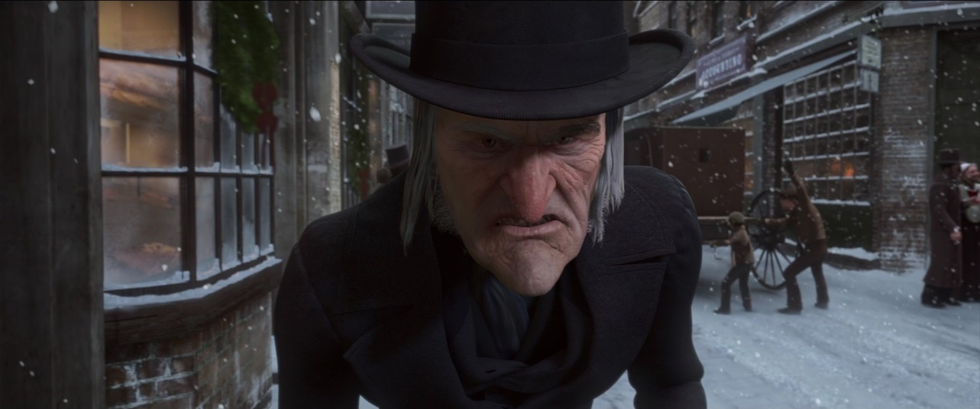
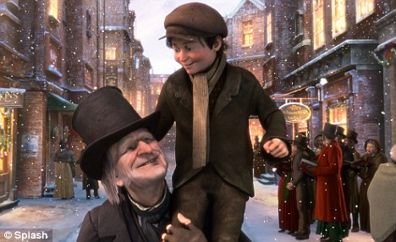
I will honour Christmas in my heart and try to keep it all the year.
SCROOGE
The Miracle of Christmas

Slide 6
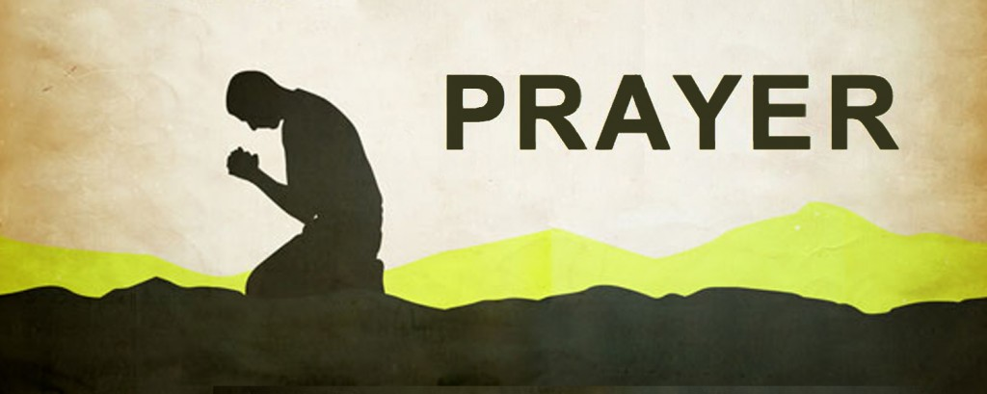
I. Don’t Give Up on Prayer.
Luke 1:11-25 gives the story that God did hear their prayer.
But the angel said to him: “Do not be afraid, Zechariah; your prayer has been heard. Your wife Elizabeth will bear you a son, and you are to call him John.
Luke 1:13 (NIV)

Slide 7
“Therefore, if anyone is in Christ, he is a new creation; the old has gone, the new has come?”
2 Corinthians 5:17 (NIV)
God can change our hearts and our lives.

Slide 8

God can change hearts.

Slide 9
II. Build Your Life on the Foundation of Faith.
³⁰ But the angel said to her, “Do not be afraid, Mary; you have found favour with God.³¹ You will conceive and give birth to a son, and you are to call him Jesus. ³² He will be great and will be called the Son of the Most High. The Lord God will give him the throne of his father David,
Luke 1:30-32 (NIV)

Slide 10

Mary responded, “I am the Lord’s servant, May it be to me as you have said.”
Luke 1:38 (NIV)
“I don’t know how this is possible, but may it be as you have said.”

Slide 11
III. A Life Committed to Praise.
And there were shepherds living out in the fields nearby, keeping watch over their flocks at night. ⁹ An angel of the Lord appeared to them, and the glory of the Lord shone around them, and they were terrified. ¹⁰ But the angel said to them, “Do not be afraid. I bring you good news that will cause great joy for all the people. ¹¹ Today in the town of David a Saviour has been born to you; he is the Messiah, the Lord. ¹² This will be a sign to you: You will find a baby wrapped in cloths and lying in a manger.”
Luke 2:8-12 (NIV)

Slide 12
III. A Life Committed to Praise.
Suddenly a great company of the heavenly host appeared with the angel, praising God and saying, ¹⁴ “Glory to God in the highest heaven, and on earth peace to those on whom his favour rests.” ¹⁵ When the angels had left them and gone into heaven, the shepherds said to one another, “Let’s go to Bethlehem and see this thing that has happened, which the Lord has told us about.”…^{.20} The shepherds returned, glorifying and praising God for all the things they had heard and seen, which were just as they had been told.
Luke 2:13-15; 20 (NIV)

Slide 13
“Nothing ever Happens to a Shepherd
It’s cold out tonight in this God forsaken place and we’re stuck here with a thousand sheep. While life is exciting everywhere else.
The highlight of our day is sleep.
Shepherds are notorious for making little profit. We garner just enough for room and board. While everyone else wallows in their wealth. We’re financially ignored.
It’s lonely out here in this isolated job. Our position is without esteem. We’re socially challenged. We are society’s scourged.

Slide 14
“Nothing ever Happens to a Shepherd
We are not exactly every woman’s dream.
Shepherds have a humble purpose. Of our fate few people really care. Some times I wonder if God knows we exist.
If He does I’m certain He’s forgotten where.
Nothing ever happens to a shepherd; Life is as boring as boring can be. While exciting things occur all over the world; nothing ever happens to me.
Nothing ever happens to me.

Slide 15
But the angel said to them, “Do not be afraid. I bring you good news that will cause great joy for all the people.
The shepherds returned, glorifying and praising God for all the things they had heard and seen, which were just as they had been told.
Luke 2:20 (NIV)

Slide 16

a. Praise helps us evaluate our priorities.
“The heavens declare the glory of God; the skies proclaim the work of his hands. Day after day they pour forth speech; night after night they reveal knowledge” Psalm 19:1 – 2 (NIV).

Slide 17
b. Praise gives indication of a divine encounter.
“When they had seen him, they spread the word concerning what had been told them about this child”
Luke 2:17 (NIV)

Slide 18
c. Praise develops our own faith.
The person who grows spiritually, the person who goes on to know God in a deep and intimate way, is the one who can affirm that God is good even though there may be many or hundreds appearances to the contrary.
Dr John B. Dyer

Slide 19
c. Praise develops our own faith.
The Shorter Westminster Catechism ask the question, ‘What is the chief end of man?
And answers it in this way:
“The chief end of man is to glorify (Praise) God and enjoy Him for ever”.

Slide 20
…The Messiah will suffer and rise from the dead on the third day, ⁴⁷ and repentance for the forgiveness of sins will be preached in his name to all nations, beginning at Jerusalem.
Luke 24:47 (NIV)

Slide 21
This Christmas
Let’s learn from Zechariah and Elizabeth,
1. “Don’t give up on prayer.”
From Joseph and Mary,
2. “Build your Life on the Foundation of Faith.
From the Shepherds,
3. Live a Life - Committed to the Praise Principle.”

