Slide 1
Lessons from Psalms #16:
How can a young man cleanse his way?
Psalm 119:9-16

Slide 2
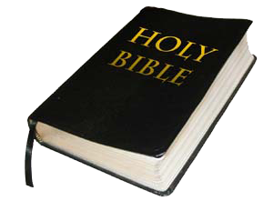
ב Beth
=
“a house.”
How can a young person stay on the path of purity? By living according to your word.
Psalm 119:9.(NIV)

Slide 3
Let’s Pray…

Slide 4
Psalm 119:9-16
How can a young man cleanse his way?
A young man finds a cleansed life
through the Word of God.
Verse 9 says;
“How can a young person stay on the path of purity? By living according to your word.”

Slide 5
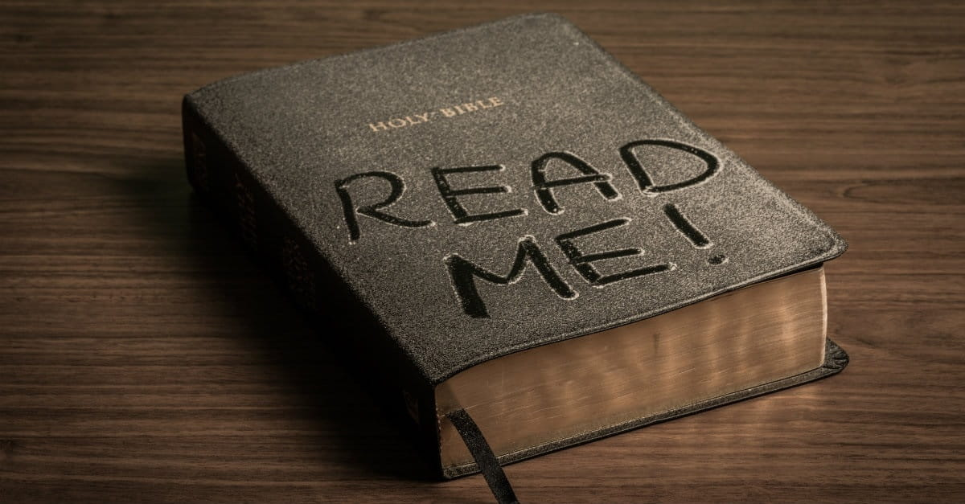
How can a young man cleanse his way? By taking heed according to Your word.
Psalm 119:6 (NKJV)
By taking heed according to Your word.
A life moral purity
does not happen accidentally.

Slide 6
“Sanctify them by the truth; your word is truth”.
John 17:17 (NIV)

Slide 7
II. How a person takes heed (pay attention) to the Word of God.
¹⁰ With my whole heart I have sought You; Oh, let me not wander from Your commandments! ¹¹ Your word I have hidden in my heart, That I might not sin against You.
“The psalmist heart had gone after God himself: he had not only desired to obey his laws, but to commune with His person.”
Charles Spurgeon

Slide 8
Oh, let me not wander from Your commandments!
Dependence upon God.
Your Word I have hidden in my heart,
It is hidden in the sense that it is on the inside, where none can see it and it is safe so that none can take it away.

Slide 9

FAITH engages every department of your personality.
Mind
Heart
Will
That I might not sin against You.

Slide 10

1 Corinthians 2:14
The person without the Spirit does not accept the things that come from the Spirit of God but considers them foolishness, and cannot understand them because they are discerned only through the Spirit.

Slide 11
The Bible will keep you from sin and sin will keep you from the Bible!
Ephesians 5:25-26
²⁵ Husbands, love your wives, just as Christ loved the church and gave himself up for her ²⁶ to make her holy, cleansing her by the washing with water through the Word.

Slide 12
III. BLESSED BY THE WORD.
“Blessed are You, O LORD! Teach me Your statutes.”
Psalm 119:12 (NKJV)
Teach me Your statutes.
“We need to be disciples or learners— ‘teach me;’ but what an honour to have God himself for a teacher: how bold is David to beg the blessed God to teach him!” (Charles Spurgeon)

Slide 13
IV. The Psalmist’s Decision - A declaration of commitment.
¹³ With my lips I have declared All the judgments of Your mouth. ¹⁴ I have rejoiced in the way of Your testimonies, As much as in all riches. ¹⁵ I will meditate on Your precepts, And contemplate Your ways. ¹⁶ I will delight myself in Your statutes; I will not forget Your word.

Slide 14
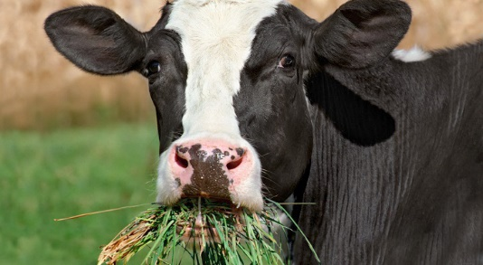
I will meditate… and contemplate… I will delight… I will not forget Your word:
CHEWING THEIR CUD.

Slide 15
How can a young man cleanse his way?
By living according to your word.
“Sanctify them by the truth; your word is truth”.
John 17:17 (NIV)

