Slide 1



Slide 2
When our faith is on trial in this world.
²⁸ Then Agrippa said to Paul, “Do you think that in such a short time you can persuade me to be a Christian?”
²⁹ Paul replied, “Short time or long—I pray to God that not only you but all who are listening to me today may become what I am, except for these chains.”
Acts 26:28-29 (NIV)

Slide 3
^{Let’s pray}

Slide 4
When our faith is on trial in this world.
I. We must obey God’s vision
¹⁹ “So then, King Agrippa, I was not disobedient to the vision from heaven. ²⁰ First to those in Damascus, then to those in Jerusalem and in all Judea, and then to the Gentiles, I preached that they should repent and turn to God and demonstrate their repentance by their deeds.
Acts 26:19-20 (NIV)

Slide 5
The apostle Paul summarizes God's will and vision for all humanity in a nutshell:
“… God our Saviour … desires all men to be saved and to come to the knowledge of the truth”
1 Timothy 2:3-4 (NIV)
⁴⁷ and repentance for the forgiveness of sins will be preached in his name to all nations, beginning at Jerusalem.⁴⁸ You are witnesses of these things.
Luke 24:47-48 (NIV)

Slide 6
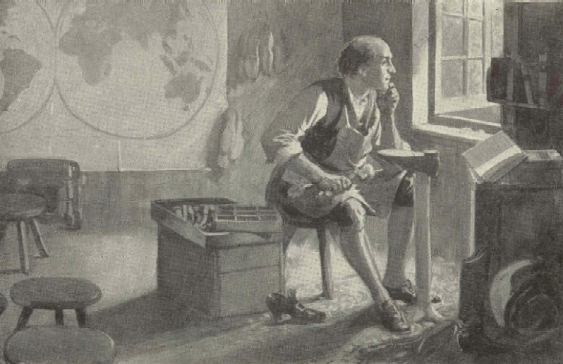
William Carey (August 17, 1761 – June 9, 1834)
One man had the vision of God and the other did not!
WHAT ABOUT US?

Slide 7
HAVE YOU CAUGHT THAT VISION?
“The thing that keeps us going for God, even when everything or everyone around us is tumbling and stumbling, is our vision of God, not our devotion to principles or our devotion to duty.”
Oswald Chambers
God put us here to lead people to Christ.
Have you caught that vision?

Slide 8
When our faith is on trial in this world.
II. WE MUST NOT FEAR
²⁴ At this point Festus interrupted Paul’s defense. “You are out of your mind, Paul!” he shouted. “Your great learning is driving you insane.”
²⁵ “I am not insane, most excellent Festus,” Paul replied. “What I am saying is true and reasonable.
Acts 26:24-25 (NIV)
William Carey (August 17, 1761 – June 9, 1834)

Slide 9
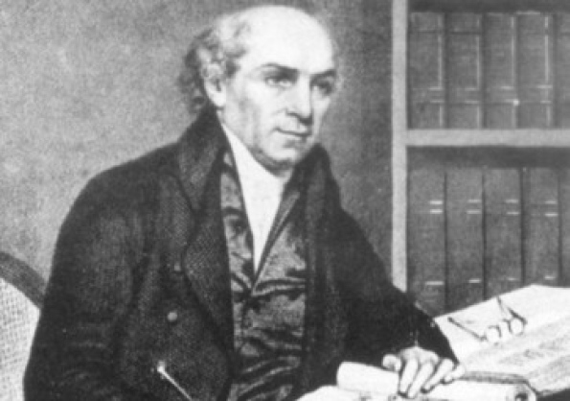
When our faith is on trial in this world.
II. WE MUST NOT FEAR
William Carey
(August 17, 1761 – June 9, 1834)
“Expect great things from God;
attempt great things for God.”

Slide 10
When our faith is on trial in this world.
III. WE MUST PRESENT THE TRUTH OF GOD
²⁶ The king is familiar with these things, and I can speak freely to him. I am convinced that none of this has escaped his notice, because it was not done in a corner. ²⁷ King Agrippa, do you believe the prophets? I know you do.” ²⁸ Then Agrippa said to Paul, “Do you think that in such a short time you can persuade me to be a Christian?” ²⁹ Paul replied, “Short time or long—I pray to God that not only you but all who are listening to me today may become what I am, except for these chains.”
Acts 26:26-29 (NIV)

Slide 11
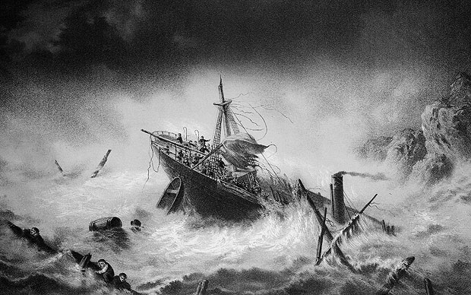
When our faith is on trial in this world.
Storms
Shipwreck
⁴² The soldiers planned to kill the prisoners to prevent any of them from swimming away and escaping. ⁴³ But the centurion wanted to spare Paul’s life and kept them from carrying out their plan. He ordered those who could swim to jump overboard first and get to land. ⁴⁴ The rest were to get there on planks or on other pieces of the ship. In this way everyone reached land safely.
Acts 27:42-44 (NIV)

Slide 12
Once safely on shore, we found out that the island was called Malta. ² The islanders showed us unusual kindness. They built a fire and welcomed us all because it was raining and cold. ³ Paul gathered a pile of brushwood and, as he put it on the fire, a viper, driven out by the heat, fastened itself on his hand. ⁴ When the islanders saw the snake hanging from his hand, they said to each other, “This man must be a murderer; for though he escaped from the sea, the goddess Justice has not allowed him to live.” ⁵ But Paul shook the snake off into the fire and suffered no ill effects. ⁶ The people expected him to swell up or suddenly fall dead; but after waiting a long time and seeing nothing unusual happen to him, they changed their minds and said he was a god.
Acts 28:1-10 (NIV)

Slide 13
⁷ There was an estate nearby that belonged to Publius, the chief official of the island. He welcomed us to his home and showed us generous hospitality for three days. ⁸ His father was sick in bed, suffering from fever and dysentery. Paul went in to see him and, after prayer, placed his hands on him and healed him. ⁹ When this had happened, the rest of the sick on the island came and were cured. ¹⁰ They honoured us in many ways; and when we were ready to sail, they furnished us with the supplies we needed.
Acts 28:1-10 (NIV)

Slide 14
When our faith is on trial in this world.
God can use us even when we feel utterly useless, helpless, unable, and sometimes, discouraged.
Paul stood before King Agrippa and presented the truth of God about Christ.
“Then Agrippa said to Paul, "Do you think that in such a short time you can persuade me to be a Christian?"

Slide 15
HAVE YOU EVER PERSUADED ANYONE TO BECOME A CHRISTIAN?
“Don’t worry about it.”
When our faith is on trial in this world.
I. We must obey God’s vision
II. WE MUST NOT FEAR
III. WE MUST PRESENT THE TRUTH OF GOD

Slide 16
Psalm 46

Slide 17
The Veteran’s Lament
So here we stand again. A year has passed. Once more our sorrow turns to millions killed.
What have we learned? What do you say to us, dear soldier from your eternal silence?
Do you implore us to improve our killing efficiency, to make bigger and better bombs, condemning millions more to your sad fate?
Do you cheer us on in our blindness? How many thousands have we added to your number, this past year?

Slide 18
The Veteran’s Lament
No – I hear you plead now.
I hear you cry to us across the years:
‘Weep not for me but for those yet unborn. Go! – save your own children from my fate Go! – thank me, by walking away today to reject the futility, the waste, and the lie that you have repeated over and over even as you stand for where do your billions go, if not to ensure far more will know the hell I knew?

Slide 19
The Veteran’s Lament
It is too late for me. I have no voice but yours, please – speak for me. So, when you stand here again, when this next year has passed, come here in certainty that you have taken some small step along a different road…’
Bill, World War Two veteran

Slide 20
When our faith is on trial in this world.
“Expect great things from God;
attempt great things for God.”
God can use us even when we feel utterly useless, helpless, unable, and sometimes, discouraged.

