Slide 1
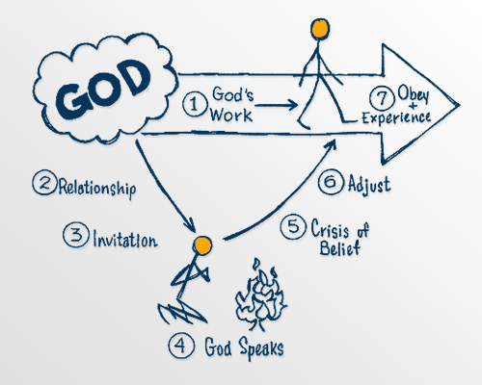
The Crisis of Belief

Slide 2
Reality No. 5
God’s invitation for you to work with Him, always leads to a crisis of belief that requires faith and action.

Slide 3
³⁵ That day when evening came, he said to his disciples, “Let us go over to the other side.” ³⁶ Leaving the crowd behind, they took him along, just as he was, in the boat. There were also other boats with him. ³⁷ A furious squall came up, and the waves broke over the boat, so that it was nearly swamped. ³⁸ Jesus was in the stern, sleeping on a cushion. The disciples woke him and said to him, “Teacher, don’t you care if we drown?”
³⁹ He got up, rebuked the wind and said to the waves, “Quiet! Be still!”Then the wind died down and it was completely calm.
Mark 4:35-41 (NIV)

Slide 4
⁴⁰ He said to his disciples, “Why are you so afraid? Do you still have no faith?”
⁴¹ They were terrified and asked each other, “Who is this? Even the wind and the waves obey him!”
Mark 4:35-41 (NIV).
But without Faith it is impossible to please Him, for he who comes to God must believe that He is, and that He is a rewarder of those who diligently seek Him.
Hebrews 11:6 (NKJV)

Slide 5
Let’s pray…

Slide 6
Persuasion,
being persuaded,
being fully persuaded, convinced.
Without being convinced, we cannot please God.

Slide 7
But without Faith it is impossible to please Him, for he who comes to God must believe that He is, …Hebrews 11:6 (NKJV)
…for he who comes to God must believe that He is, and that He is a rewarder of those who diligently seek Him.
Hebrews 11:6 (NKJV)

Slide 8
REWARDER
A WAGE PAYER

Slide 9
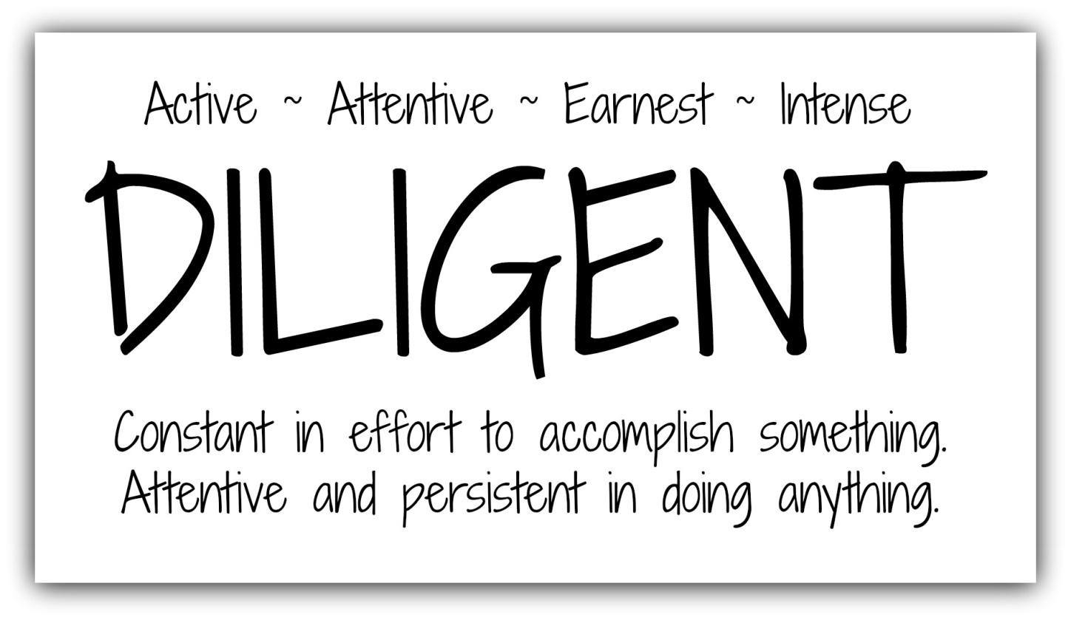
…for he who comes to God must believe that He is, and that He is a rewarder of those who diligently seek Him.
Hebrews 11:6 (NKJV)

Slide 10
The Crisis of Belief
³⁷ A furious squall came up, and the waves broke over the boat, so that it was nearly swamped. ³⁸ Jesus was in the stern, sleeping on a cushion. The disciples woke him and said to him, “Teacher, don’t you care if we drown?”
Where is God?
Is He sleeping?
Does He care?

Slide 11
We need to act in the middle of the crisis.
Jesus got up, rebuked the wind and said to the waves, “Quiet! Be still!”Then the wind died down and it was completely calm.
He said to his disciples, “Why are you so afraid? Do you still have no faith?”
Mark 4:39-40 (NIV).
FAITH engages every department of your personality.

Slide 12
With your mind you hear about God, your creator, your Lord, the eternal God, Holy, you hear about His great kindness, if we trust in Him you have access to Him. You understand this with your mind and you embrace it.
With your heart, in your affection you say, this is what I need, I cannot rest until I have Him, you feel it.
With your will, you say I will arise and I will go to my Father as the prodigal Son.

Slide 13
But without Faith it is impossible to please Him, …Hebrews 11:6 (NKJV)
What was Jesus expectation in the middle of the disciples’ crisis?
He wanted their trust
Jesus wants all our trust so He can give us a new life.

Slide 14
Rejoice in the Lord always. I will say it again: Rejoice!... The Lord is near. Do not be anxious about anything, but in every situation, by prayer and petition, with thanksgiving, present your requests to God. And the peace of God, which transcends all understanding, will guard your hearts and your minds in Christ Jesus.
Philippians 4:4-7 (NIV)

Slide 15
The Crisis of Belief
But without Faith it is impossible to please Him, for he who comes to God must believe that He is, and that He is a rewarder of those who diligently seek Him.
Hebrews 11:6 (NKJV)

