Slide 1
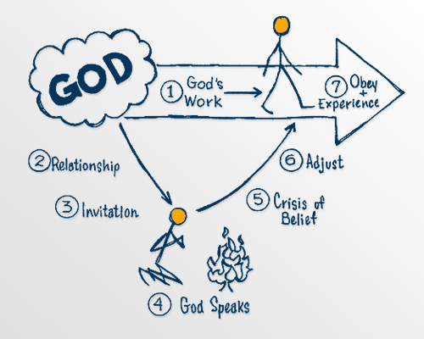
God speaks to us

Slide 2
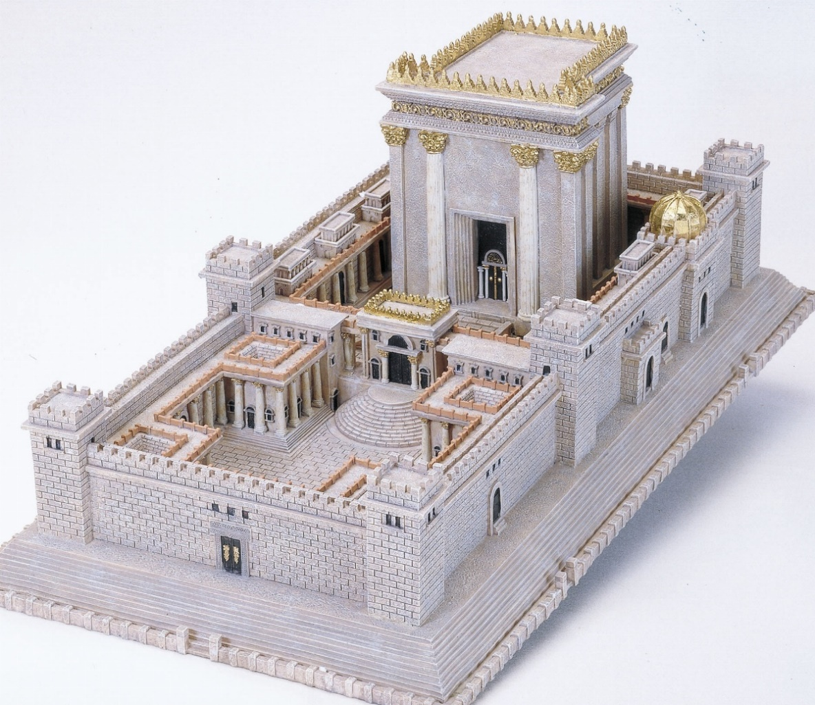
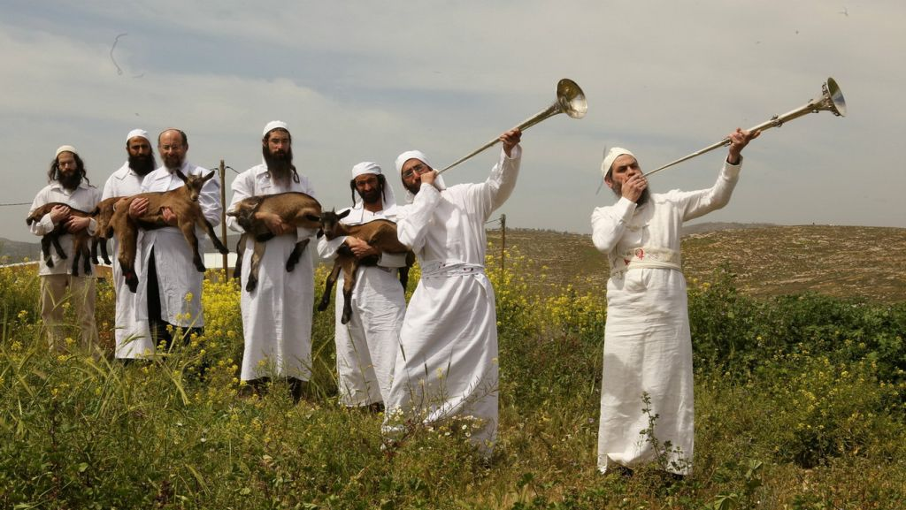
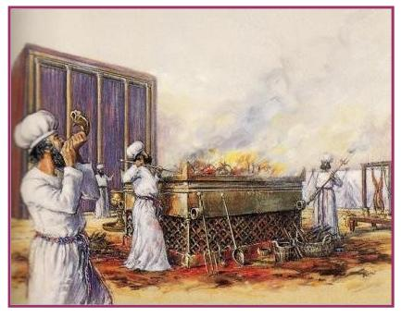
“…without the shedding of blood there is no forgiveness. Hebrews 9:22

Slide 3
God speaks to us (Experiencing God #9)
In the past God spoke to our ancestors through the prophets at many times and in various ways, ² but in these last days he has spoken to us by his Son, whom he appointed heir of all things, and through whom also he made the universe.
Hebrews 1:1-2 (NIV)

Slide 4
Let’s pray…

Slide 5
God speaks to us.
“How does God speak?”
In the past God spoke to our ancestors through the prophets at many times and in various ways

Slide 6
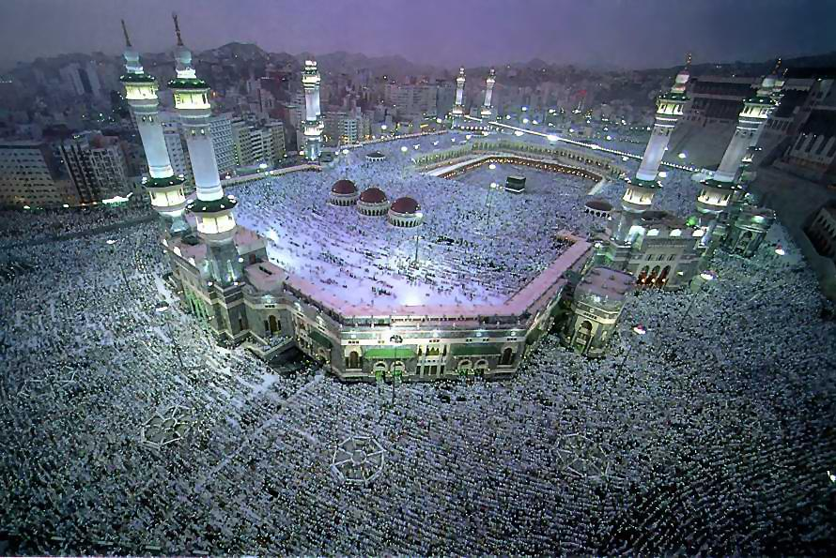
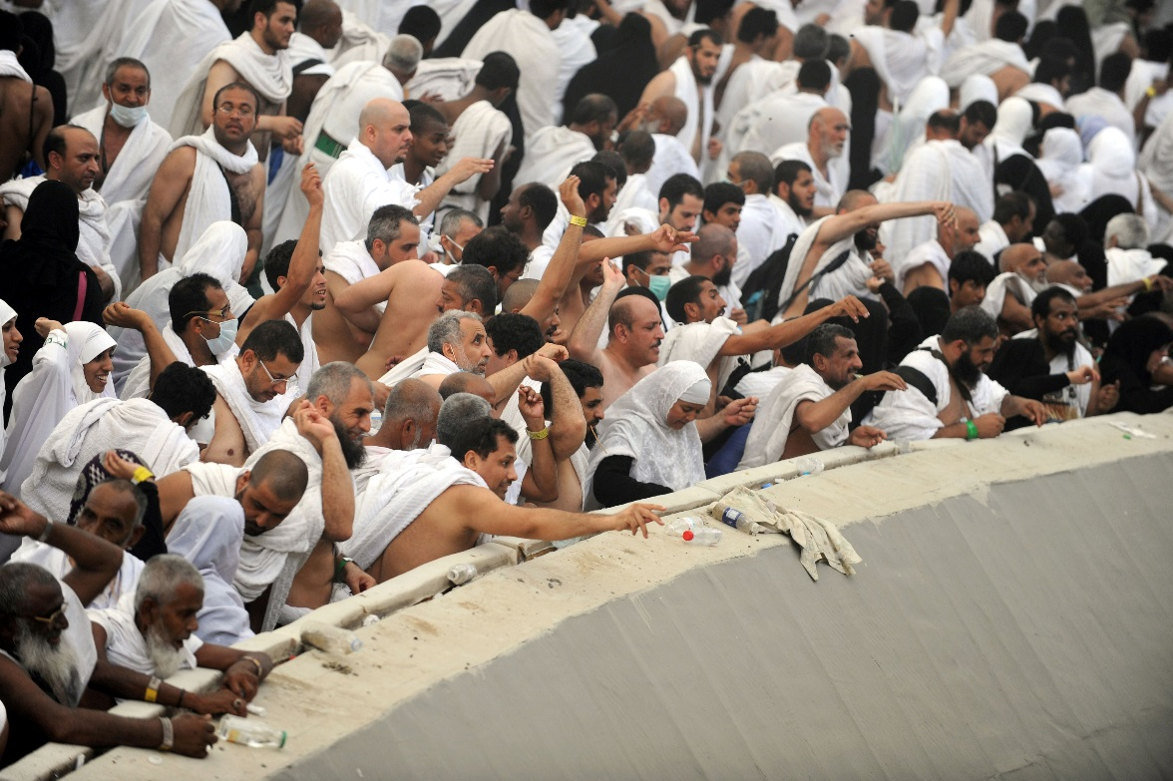
Hajj pilgrimage:
The Hajj is an annual Islamic pilgrimage to Mecca, Saudi Arabia.
The millions of people must perform a litany of rituals in five days, including the symbolic stoning of the devil in Mina, about 2 miles away from the Mecca holy site.

Slide 7
In the past God spoke to our ancestors through the prophets at many times and in various ways,
² but in these last days he has spoken to us by his Son,
whom he appointed heir of all things, and through whom also he made the universe.

Slide 8
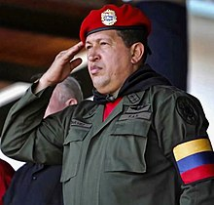
“How does God speak today?”
I. God speaks through history.
“Down they come, one after another, and all for the lack of righteousness.”
Thomas Arnold
“Do not be deceived: God cannot be
mocked. A man reaps what he sows.”
Galatians 6:7.

Slide 9
II. God speaks through nature.
¹ The heavens declare the glory of God; the skies proclaim the work of his hands. ² Day after day they pour forth speech; night after night they reveal knowledge. ³ They have no speech, they use no words; no sound is heard from them. ⁴ Yet their voice goes out into all the earth, their words to the ends of the world.
Psalm 19:1-4 (NIV).

Slide 10
III. God speaks through conscience.
The Bible speaks of a seared conscience in 1 Timothy 4:2.
The conscience is the God-given moral consciousness within each of us
¹⁴ (Indeed, when Gentiles, who do not have the law, do by nature things required by the law, they are a law for themselves, even though they do not have the law. ¹⁵ They show that the requirements of the law are written on their hearts, their consciences also bearing witness, and their thoughts sometimes accusing them and at other times even defending them.)
Romans 2:14-15 (NIV)

Slide 11
IV. God speaks through humans.
“The fruit of the righteous is a tree of life, and the one who is wise saves lives.” Proverbs 11:30 (NIV).
“You yourselves are our letter, written on our hearts, known and read by everyone.”
2 Corinthians 3:2 (NIV).

Slide 12
V. God speaks through the Bible.
¹⁶ All Scripture is God-breathed and is useful for teaching, rebuking, correcting and training in righteousness,¹⁷ so that the servant of God may be thoroughly equipped for every good work.
2 Timothy 3:16-17 (NIV)

Slide 13
VI. God speaks through prayer.
“Call to me and I will answer you and tell you great and unsearchable things you do not know.”
Jeremiah 33:3 (NIV).
“Ask, and it shall be given you; seek, and ye shall find; knock, and it shall be opened unto you”
Matthew 7:7 (NIV).

Slide 14
VII. God speaks through His Son Jesus Christ.
“The Son is the radiance of God’s glory and the exact representation of his being, sustaining all things by his powerful word.”
Hebrews 1:3 (NIV)
…Sustaining all things by his powerful word.
“So he became as much superior to the angels as the name he has inherited is superior to theirs”.
Hebrews 1:4 (NIV)

Slide 15
The Bible teaches that “In the past God spoke to our ancestors through the prophets at many times and in various ways, but in these last days he has spoken to us by his Son, ” (Hebrews. 1:1–2).

Slide 16
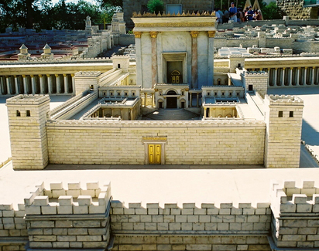
“…without the shedding of blood there is no forgiveness. Hebrews 9:22

Slide 17
“What man needed was a Perfect priest and a perfect Sacrifice to open the way once for all—a sacrifice that was not just a picture and did not deal just with one sin at a time, over and over again, but one that took it all away once and for all. That, says the writer of Hebrews, is exactly what Jesus was and what he did.”
The MacArthur New Testament Commentary, Hebrews, pxvii

Slide 18
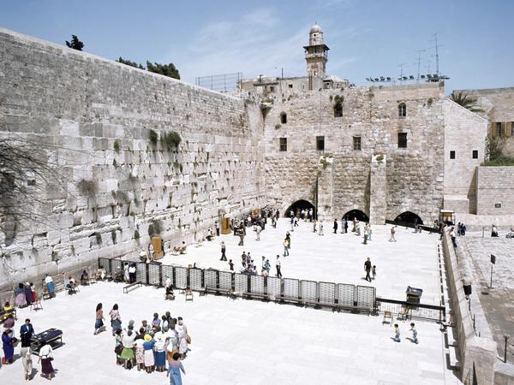
“But when this priest had offered for all time one sacrifice for sins, he sat down at the right hand of God,”
Hebrews 10:12 (NIV)
God’s anointed PRIEST

Slide 19
“Every religion is but man’s attempt to discover God. Christianity is God bursting into man’s world and showing and telling man what He is like.”
[John McArthur. McArthur New Testament Commentary – Hebrews. (Chicago: Moody Press, 1983) p. 3]
A. God speaks through his Son’s character.
B. God speaks through his Son’s sacrifice.
C. God speaks through his Son’s love.

Slide 20
God speaks to us.
“I am the Good Shepherd. The good shepherd lays down his life for the sheep…I know my sheep and my sheep know me…they will listen to my voice”
John 10:11, 14, 16

