Slide 1
Lessons from Psalms #14:
A Call to Be Thankful
Psalm 118

Slide 2
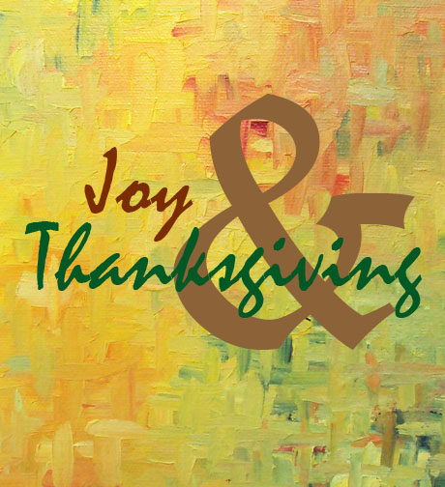
Essentials to grow in the spiritual life #5:
Joy and Thanksgiving
Psalm 118

Slide 3
“Give thanks to the Lord, for he is good; his love endures for ever”
(Psalm 118:1).
Let’s pray…

Slide 4

Psalm 118
Is one of those used when God’s people
met together in corporate worship.
It is while thanking God that
we realize how blessed we are.
There is a call to be thankful

Slide 5
I. The first is that God is good.
¹ Give thanks to the LORD, for he is good; his love endures forever.
² Let Israel say: “His love endures forever.” ³ Let the house of Aaron say: “His love endures forever.” ⁴ Let those who fear the LORD say: “His love endures forever.”

Slide 6
⁵ When hard pressed, I cried to the LORD; he brought me into a spacious place. ⁶ The LORD is with me; I will not be afraid. What can mere mortals do to me?

Slide 7
Turn your eyes upon Jesus Look full, in his wonderful face And the things of earth will grow strangely dim In the light of his glory and grace

Slide 8
II. God is not only good but He is merciful.
God’s mercy is unlimited
Psalm 108:4
For great is your love, higher than the heavens; your faithfulness reaches to the skies.

Slide 9
God’s mercy is undeserved
Psalm 103:8-13 (NIV)
⁸ The LORD is compassionate and gracious, slow to anger, abounding in love. ⁹ He will not always accuse, nor will he harbor his anger forever; ¹⁰ he does not treat us as our sins deserve or repay us according to our iniquities. ¹¹ For as high as the heavens are above the earth, so great is his love for those who fear him;

Slide 10
God’s mercy is undeserved
Psalm 103:8-13 (NIV)
¹² as far as the east is from the west, so far has he removed our transgressions from us.
¹³ As a father has compassion on his children, so the Lord has compassion on those who fear him;

Slide 11
God’s mercy Provides Salvation
Titus 3:5
“He saved us, not because of righteous things we had done, but because of His mercy. He saved us through the washing of rebirth and renewal by the Holy Spirit,”

Slide 12
We read about the promised Messiah - GOD’S MATCHLESS SON.
Here the Psalmist is saying far more than ever he
may have realised
Jesus said to them, “Have you never read in the Scriptures:
“‘The stone the builders rejected has become the cornerstone; the Lord has done this, and it is marvelous in our eyes” Matthew:21:42

Slide 13
⁶ For in Scripture it says:
“See, I lay a stone in Zion, a chosen and precious cornerstone, and the one who trusts in him will never be put to shame.”
⁷ Now to you who believe, this stone is precious. But to those who do not believe, “The stone the builders rejected has become the cornerstone,” ⁸ and, “A stone that causes people to stumble and a rock that makes them fall.”
They stumble because they disobey the message—which is also what they were destined for.
1 Peter 2 :6-8 (NIV)

Slide 14
“Give thanks to the Lord, for he is good; his love endures for ever”
(Psalm 118:1).
²⁸ You are my God, and I will praise you; you are my God, and I will exalt you.
²⁹ Give thanks to the Lord, for he is good; his love endures forever.
Thanksgiving
is an essential dimension of Christian growth.

Slide 15
Lessons from Psalms
A Call to Be Thankful
Psalm 118
In singing this psalm we must glorify God for His goodness, His goodness to us, and especially His goodness to us in Jesus Christ.

