Slide 1
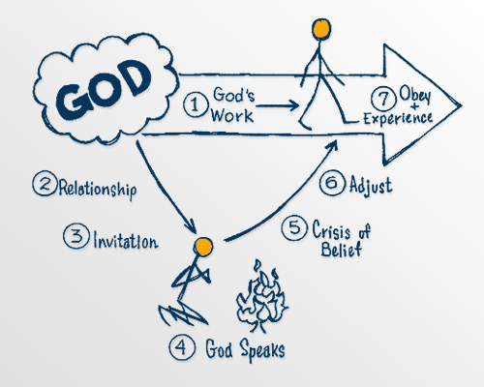
God invites you to become involved with Him
in His work

Slide 2
“My Father is always at his work to this very day, and I too am working.”
John 5:17 (NIV)
¹⁹ Jesus gave them this answer: “Very truly I tell you, the Son can do nothing by himself; he can do only what he sees his Father doing, because whatever the Father does the Son also does. ²⁰ For the Father loves the Son and shows him all he does. Yes, and he will show him even greater works than these, so that you will be amazed. John 5:19-20 (NIV)

Slide 3
God invites you to become involved with Him
in His work
The LORD came and stood there, calling as at the other times, “Samuel! Samuel!”
Then Samuel said, “Speak, for your servant is listening.”
1 Samuel 3:10 (NIV)

Slide 4
Let’s Pray…

Slide 5
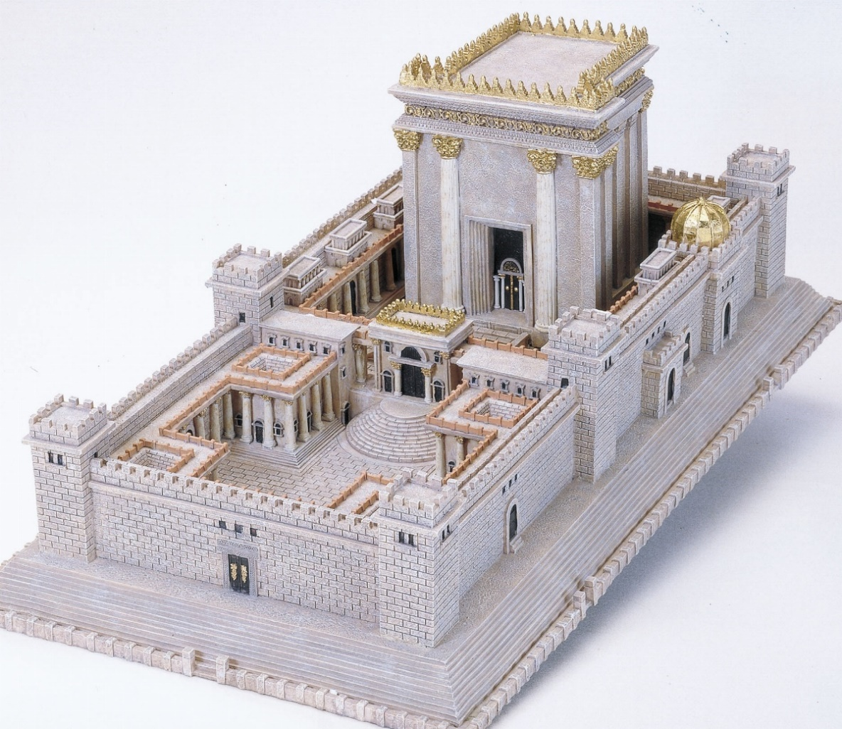
The Lord Calls Samuel

Slide 6
The boy Samuel ministered before the Lord under Eli. In those days the word of the Lord was rare; there were not many visions.
1 Samuel 3:1 (NIV)
In those days the Word of the Lord was rare.

Slide 7
² One night Eli, whose eyes were becoming so weak that he could barely see, was lying down in his usual place.
³ The lamp of God had not yet gone out, and Samuel was lying down in the house of the LORD, where the ark of God was.
1 Samuel 3:2-3 (NIV)

Slide 8
⁴ Then the LORD called Samuel.
Samuel answered, “Here I am.”
1 Samuel 3:4 (NIV)
⁵ And he ran to Eli and said, “Here I am; you called me.”
But Eli said, “I did not call; go back and lie down.” So he went and lay down.
1 Samuel 3:5 (NIV)

Slide 9
⁷ Now Samuel did not yet know the Lord: The word of the Lord had not yet been revealed to him.
1Samuel 3:7 (NIV)
“Yada” means to perceive, to know intimately, to understand, to experience.
Now the sons of Eli were corrupt; they did not know the LORD. 1Samuel 2:12 (NIV)
In those days the Word of the Lord was rare.

Slide 10
⁴ Then the LORD called Samuel.
Samuel answered, “Here I am.” ⁵ And he ran to Eli and said, “Here I am; you called me.”
But Eli said, “I did not call; go back and lie down.” So he went and lay down.
1 Samuel 3:4-5 (NIV)

Slide 11
⁶ Again the LORD called, “Samuel!” And Samuel got up and went to Eli and said, “Here I am; you called me.”
“My son,” Eli said, “I did not call; go back and lie down.”
1 Samuel 3:6 (NIV)

Slide 12
No one in history ever survived a full Roman crucifixion. The Romans designed it to be a humiliating, torturous , surefire method of execution. “The Romans used what’s called a flagrum, a whip that was designed to rip the skin off the body and cause excessive bleeding. After just a few lashes, the victim’s skin began to come off in ribbons and their muscle tore. After a few more lashes, the muscles became like pulp. Arteries and veins were laid bare. Sometimes the flagrum would reach around the abdomen and the abdominal wall would give way, causing the victim’s intestines to spill out. Obviously, many people died during the flogging alone”.
Nabeel Qureshi, “Seeking Alah, Finding Jesus”, p266

Slide 13
⁸ A third time the Lord called, “Samuel!” And Samuel got up and went to Eli and said, “Here I am; you called me.” Then Eli realized that the Lord was calling the boy. ⁹ So Eli told Samuel, “Go and lie down, and if he calls you, say, ‘Speak, Lord, for your servant is listening.’” So Samuel went and lay down in his place.
1 Samuel 3:8-9 (NIV)

Slide 14
The LORD came and stood there, calling as at the other times, “Samuel! Samuel!”
Then Samuel said, “Speak, for your servant is listening.”
1 Samuel 3:10 (NIV)
“Speak, for your servant is listening.”

Slide 15
Nabeel Qureshi describes his dramatic journey from Islam to Christianity, ...

Slide 16
So Eli told Samuel, “Go and lie down, and if he calls you, say, ‘Speak, LORD, for your servant is listening.’” So Samuel went and lay down in his place.
‘Effectual calling is the work of God’s Spirit, whereby, convincing us of our sin and misery, enlightening our minds in the knowledge of Christ, and renewing our wills, he doth persuade and enable us to embrace Jesus Christ, freely offered to us in the gospel’.
The Westminster Shorter Catechism

Slide 17
“He has saved us and called us to a holy life—not because of anything we have done but because of his own purpose and grace. This grace was given us in Christ Jesus before the beginning of time,”
2 Timothy 1:9
The effectual calling is more commonly known as “irresistible grace,
If he calls you, say,
‘Speak, LORD, for your servant is listening.’”

