Slide 1
Lessons from Psalms #13
A Call to Praise the Lord
Psalm 117

Slide 2
Psalm 117 (NIV)
¹ Praise the Lord, all you nations; extol him, all you peoples. ² For great is his love toward us, and the faithfulness of the Lord endures forever.
Praise the Lord.

Slide 3
Psalm 117 (NIV)
O praise the Lord, all ye nations: praise him, all ye people.
² For his merciful kindness is great toward us: and the truth of the Lord endureth for ever. Praise ye the Lord.

Slide 4
Let’s Pray…

Slide 5
Psalm 117
This small Psalm
is a call to evangelism and praise.
I. A Call to Praise, an Invitation to Praise (verse 1):
Praise the Lord, all you nations; extol him, all you peoples.

Slide 6
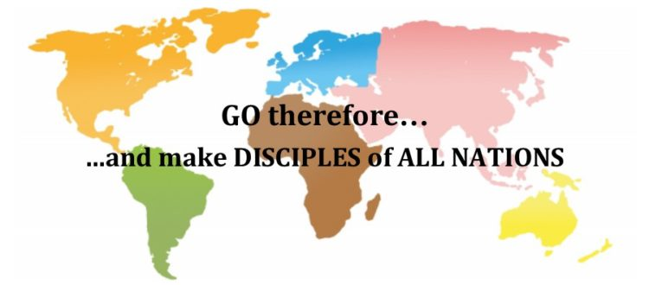
Matthew 28:19-20
All authority in heaven and on earth has been given to me….

Slide 7
Romans 10:12-21
¹² For there is no difference between Jew and Gentile—the same Lord is Lord of all and richly blesses all who call on him, ¹³ for, “Everyone who calls on the name of the Lord will be saved.”

Slide 8
Romans 10:12-21
¹⁴ How, then, can they call on the one they have not believed in? And how can they believe in the one of whom they have not heard? And how can they hear without someone preaching to them? ¹⁵ And how can anyone preach unless they are sent? As it is written: “How beautiful are the feet of those who bring good news!”

Slide 9
Extol Him, all you peoples.
This is God's purpose:
that He be praised by all the peoples;
that he be seen and treasured and shown to be great.
Praise the Lord.
How good it is to sing praises to our God, how pleasant and fitting to praise him!
Psalm 147:1

Slide 10
Worship is an aspect of religion that I always found difficult
to understand. Suppose we postulate an omnipotent being who, for reasons inscrutable to us, decided to create something other than himself. Why should he . . . expect us to worship him?
We didn't ask to be created. Our lives are often troubled.
We know that human tyrants, puffed up with pride, crave adulation and homage. But a morally perfect God would surely have no character defects. So why are all those people on their knees every Sunday?
(Financial Times, March 30/March 31, 2002, p. 2.)

Slide 11
How pleasant and fitting to praise Him!
I had not noticed either that just as men spontaneously praise whatever they value, so they spontaneously urge us to join them in praising it: "Isn't she lovely? Wasn't it glorious? Don't you think that magnificent?" The Psalmists in telling everyone to praise God are doing what all men do when they speak of what they care about. My whole, more general, difficulty about the praise of God depended on my absurdly denying to us, as regards the supremely Valuable, what we delight to do, what indeed we can't help doing, about everything else we value. I think we delight to praise what we enjoy because the praise not merely expresses but completes the enjoyment; it is its appointed consummation.
(C. S. Lewis, Reflections on the Psalms (New York: Harcourt, Brace and World, 1958, pp. 93-95)

Slide 12
God is seeking our praise because we won't be happy until we give it.
Praise the Lord.
How good it is to sing praises to our God, how pleasant and fitting to praise him!
Psalm 147:1

Slide 13
II. The Reason for Praise (Verse 2):
¹ Praise the LORD, all you nations; extol him, all you peoples. ² For great is his love toward us,…
a) God is loving and faithful to Israel!
Therefore praise Him all nations and all peoples
outside Israel!

Slide 14
² “I will make you into a great nation, and I will bless you; I will make your name great, and you will be a blessing.
³ I will bless those who bless you, and whoever curses you I will curse; and all peoples on earth will be blessed through you.”
Genesis 12:2-3 (NIV)

Slide 15
And I will put enmity between you and the woman, and between your offspring and hers; he will crush your head, and you will strike his heel.”
Genesis 3:15 (NIV)
This is known as the protoevangelium—the first gospel.

Slide 16
The promises were spoken to Abraham and to his seed. Scripture does not say “and to seeds,” meaning many people, but “and to your seed,” meaning one person, who is Christ.
Galatians 3:16 (NIV)
For God so loved the world that he gave his one and only Son, that whoever believes in him shall not perish but have eternal life.
John 3:16 (NIV)

Slide 17
“Come to me, all you who are weary and burdened, and I will give you rest.”
Matthew 11:28 (NIV)

Slide 18
Matthew 28:19-20
All authority in heaven and on earth has been given to me….

Slide 19
II. The Reason for Praise (Verse 2):
¹ Praise the LORD, all you nations; extol him, all you peoples. ² For great is his love toward us,…
and the truth of the LORD endureth for ever.
b) His Truth endures forever.

Slide 20
A Call to Praise the Lord
O praise the Lord, all ye nations: praise him, all ye people.
² For his merciful kindness is great toward us: and the truth of the Lord endureth for ever. Praise ye the Lord.

