Slide 1
Lessons from Psalms #12:
A call to thanksgiving
Psalm 116

Slide 2
I love the LORD, for he heard my voice; He heard my cry for mercy.² Because he turned his ear to me, I will call on him as long as I live…¹³ I will lift up the cup of salvation and call on the name of the LORD.¹⁴ I will fulfil my vows to the LORD in the presence of all his people…¹⁶ Truly I am your servant, LORD;…¹⁷ I will sacrifice a thank offering to you and call on the name of the LORD.¹⁸ I will fulfil my vows to the LORD in the presence of all his people, ¹⁹ in the courts of the house of the LORD— in your midst, Jerusalem. Praise the LORD.
Psalm 116:1-2, 13-14, 16-19.(NIV)

Slide 3
Let’s Pray…

Slide 4
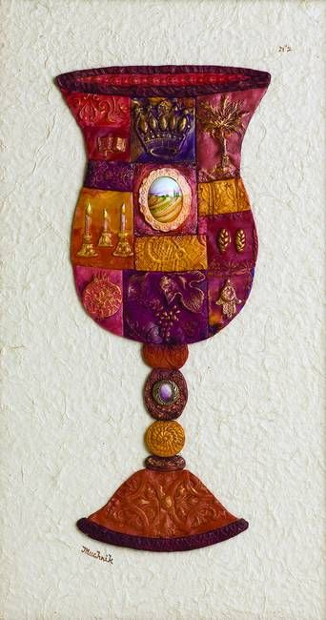
Psalm 116
A call to thanksgiving
I. I will take the cup of salvation (Psalm 116:13).

Slide 5
²⁶ While they were eating, Jesus took bread, and when he had given thanks, he broke it and gave it to his disciples, saying, “Take and eat; this is my body.”
²⁷ Then he took a cup, and when he had given thanks, he gave it to them, saying, “Drink from it, all of you. ²⁸ This is my blood of the covenant, which is poured out for many for the forgiveness of sins. ²⁹ I tell you, I will not drink from this fruit of the vine from now on until that day when I drink it new with you in my Father’s kingdom.”
³⁰ When they had sung a hymn, they went out to the Mount of Olives.
Matthew 26:26-30 (NIV)

Slide 6
I will take the cup of salvation
“For the wages of sin is death, but the gift of God is eternal life in Christ Jesus our Lord”.
Romans 6:23 (NIV)

Slide 8
II. I will pay my vows (Psalm 116:14).
“Sacrifice thank offerings to God, fulfill your vows to the Most High,”
Psalm 50:14 (NIV)

Slide 9
⁸ I bring no charges against you concerning your sacrifices or concerning your burnt offerings, which are ever before me. ⁹ I have no need of a bull from your stall or of goats from your pens, ¹⁰ for every animal of the forest is mine, and the cattle on a thousand hills. ¹¹ I know every bird in the mountains, and the insects in the fields are mine. ¹² If I were hungry I would not tell you, for the world is mine, and all that is in it. ¹³ Do I eat the flesh of bulls or drink the blood of goats?
GOD’S DESIRE IS SPIRITUAL WORSHIP FROM THE HEART!

Slide 10
III. I will assume the role of the servant (Psalm 116:16).
When we assume the role of the servant, we are most like our Lord.

Slide 11
A call to thanksgiving
Let’s consider the Generous Blessings we have received from the Lord.
Psalm 68:19 (NIV)
Blessed be the Lord, Who daily loads us with benefits, The God of our salvation!
Selah
1. Consider the daily material blessings we enjoy

Slide 12
1. Think of the blessings of your home.
2. Think of the clothing you wear
3. Think of the food you enjoy.
Psalm 68:19 (NIV)
Blessed be the Lord, Who daily loads us with benefits, The God of our salvation!
Selah

Slide 13
Consider the daily spiritual blessings
1. Access to the Written Word of God
2. Right of Corporate Assembly and Worship
Psalm 68:19 (NIV)
Blessed be the Lord, Who daily loads us with benefits, The God of our salvation!
Selah

Slide 14
Lessons from Psalms #12:
A call to thanksgiving
Psalm 116

