Slide 1
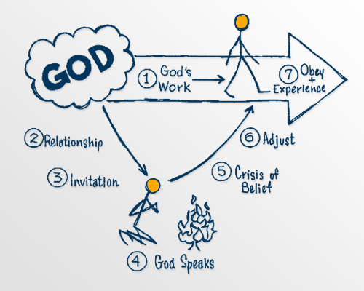
God pursues a love relationship (Part 2)

Slide 2
Jesus entered Jericho and was passing through. ² A man was there by the name of Zacchaeus; he was a chief tax collector and was wealthy.³ He wanted to see who Jesus was, but because he was short he could not see over the crowd. ⁴ So he ran ahead and climbed a sycamore-figtree to see him, since Jesus was coming that way.
⁵ When Jesus reached the spot, he looked up and said to him, “Zacchaeus, come down immediately. I must stay at your house today.”⁶ So he came down at once and welcomed him gladly.
Luke 19:1-10 (NIV).

Slide 3
⁷ All the people saw this and began to mutter, “He has gone to be the guest of a sinner.”
⁸ But Zacchaeus stood up and said to the Lord, “Look, Lord! Here and now I give half of my possessions to the poor, and if I have cheated anybody out of anything, I will pay back four times the amount.”
⁹ Jesus said to him, “Today salvation has come to this house, because this man, too, is a son of Abraham.
¹⁰ For the Son of Man came to seek and to save the lost.”
Luke 19:1-10 (NIV).

Slide 4
Let’s pray…

Slide 5
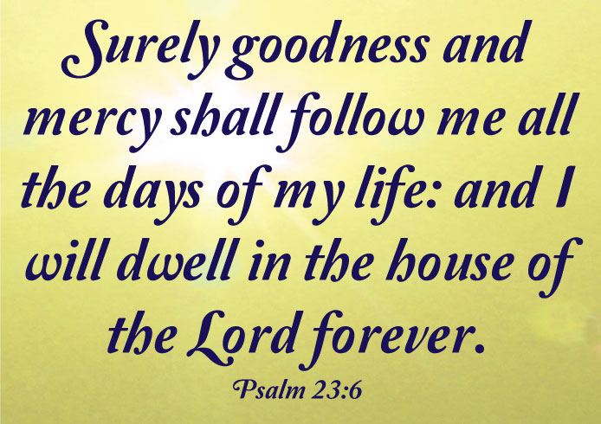
The second reality in Experiencing God is that
God pursues a continual love relationship with you
that is real and personal.

Slide 6
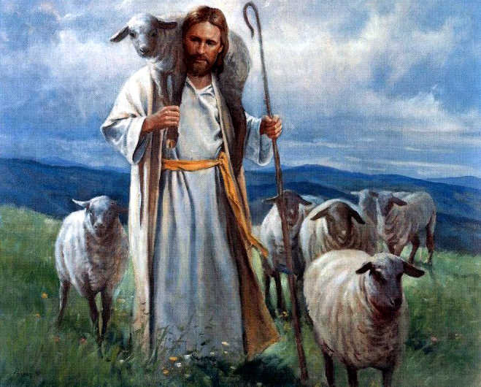
The Good Shepherd

Slide 7
³ Then Jesus told them this parable: ⁴ “Suppose one of you has a hundred sheep and loses one of them. Doesn’t he leave the ninety-nine in the open country and go after the lost sheep until he finds it? ⁵ And when he finds it, he joyfully puts it on his shoulders ⁶ and goes home. Then he calls his friends and neighbours together and says, ‘Rejoice with me; I have found my lost sheep.’ ⁷ I tell you that in the same way there will be more rejoicing in heaven over one sinner who repents than over ninety-nine righteous persons who do not need to repent.
Luke 15:3-7 NIV).

Slide 8
⁴ Surely he took up our pain and bore our suffering,
yet we considered him punished by God, stricken by him, and afflicted.
⁵ But he was pierced for our transgressions,
he was crushed for our iniquities;
the punishment that brought us peace was on him,
and by his wounds we are healed.
⁶ We all, like sheep, have gone astray, each of us has turned to our own way; and the Lord has laid on him
the iniquity of us all.
Isaiah 53:4-6 (NIV)

Slide 9
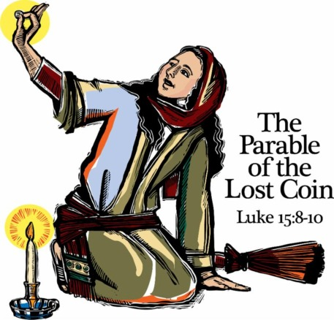

Slide 10
⁸ “Or suppose a woman has ten silver coins and loses one. Doesn’t she light a lamp, sweep the house and search carefully until she finds it?⁹ And when she finds it, she calls her friends and neighbours together and says, ‘Rejoice with me; I have found my lost coin.’ ¹⁰ In the same way, I tell you, there is rejoicing in the presence of the angels of God over one sinner who repents.”
Luke 15:8-10 (NIV)

Slide 11
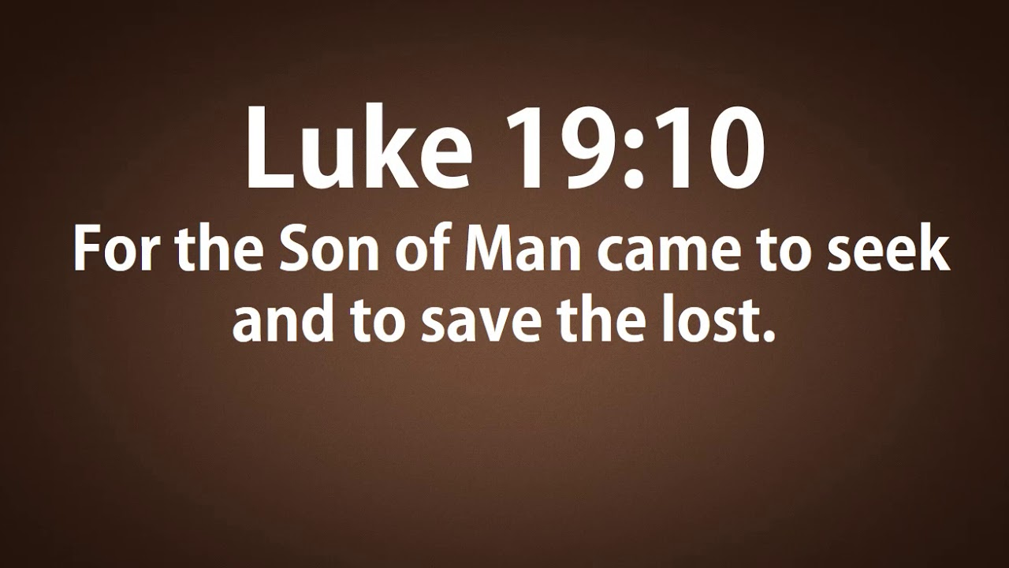

Slide 12
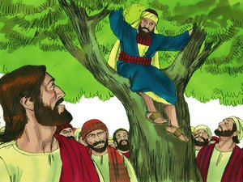
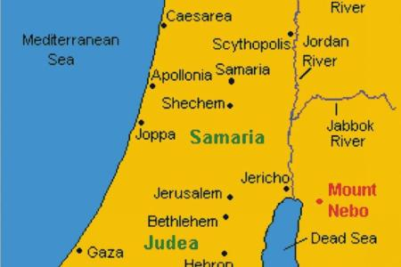
“Zacchaeus, come down immediately.
I must stay at your house today.”

Slide 14
William Barclay said:
“We must always be careful how we take the meaning of this word lost. In the New Testament it does not mean dammed or doomed.
It simply means in the wrong place.”

Slide 15
“For the wages of sin is death, but the gift of God is eternal life in Christ Jesus our Lord”.
Romans 6:23 (NIV)
⁴ Surely he took up our pain and bore our suffering, yet we considered him punished by God, stricken by him, and afflicted. ⁵ But he was pierced for our transgressions, he was crushed for our iniquities; the punishment that brought us peace was on him, and by his wounds we are healed.
Isaiah 53:4-5 (NIV)

Slide 16
God pursues a continual love relationship with you
that is real and personal.
The happiness which God designs for His higher creatures is the happiness of being freely, voluntarily united to Him and to each other in an ecstasy of love and delight…God is an aggressive pursuer of man but never at the expense of the freedom that we have to say no.
C. S. Lewis

