Slide 1
God pursues a continuing love relationship with you
that is real and personal.

Slide 2
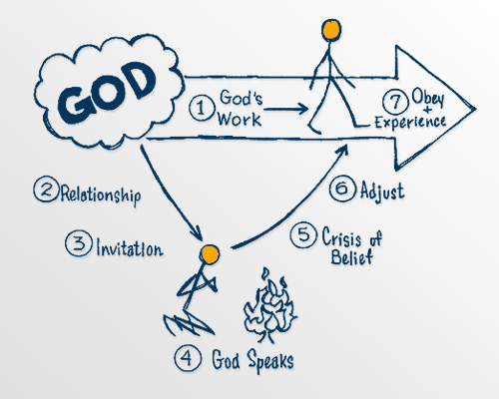
God pursues a continuing love relationship with you
that is real and personal.

Slide 3
³⁷ Jesus replied: “‘Love the Lord your God with all your heart and with all your soul and with all your mind.’ ³⁸ This is the first and greatest commandment.
Matthew 22:37-38 (NIV)

Slide 4
Let’s Pray…

Slide 5
How to love the Lord?
“Love the LORD your God with all your heart and with all your soul and with all your strength”.
Deuteronomy 6:5 (NIV)
Moses summoned all Israel and said:
Hear, Israel, the decrees and laws I declare in your hearing today. Learn them and be sure to follow them.
Deuteronomy 5:1 (NIV)

Slide 6
I. The first lesson or instruction is WORSHIP.
⁷ “You shall have no other gods before me.
⁸ “You shall not make for yourself an image in the form of anything in heaven above or on the earth beneath or in the waters below.
Deuteronomy 5:7-8 (NIV)

Slide 7
“You shall not misuse the name of the LORD your God, …”
Deuteronomy 5:11 (NIV)
The Hebrew language says:
“You shall not lift up my name in vain”.

Slide 8
“Observe the Sabbath day by keeping it holy, as the Lord your God has commanded you.
Deuteronomy 5:12 (NIV)

Slide 9
II. Second lesson or instruction is OBEDIENCE.
“so that you, your children and their children after them may fear the LORD your God as long as you live by keeping all his decrees and commands that I give you, and so that you may enjoy long life”.
Deuteronomy 6:2 (NIV)

Slide 10
Whoever has my commands and keeps them is the one who loves me. The one who loves me will be loved by my Father, and I too will love them and show myself to them.”
John 14:21 (NIV)
Jesus replied, “Anyone who loves me will obey my teaching. My Father will love them, and we will come to them and make our home with them”
John 14:23 (NIV)

Slide 11
Do not put the Lord your God to the test as you did at Massah.
Deuteronomy 6:16 (NIV)
Ye shall not tempt the Lord your God, as ye tempted him in Massah.
Deuteronomy 6:16 (KJV)
Tempted = Challenged Him.

Slide 12
“Do what is right and good in the LORD’s sight, so that it may go well with you …”
Deuteronomy 6:18 (NIV)
“and when the Lord your God has delivered them over to you and you have defeated them, then you must destroy them totally. Make no treaty with them, and show them no mercy. ³ Do not intermarry with them. Do not give your daughters to their sons or take their daughters for your sons,
Deuteronomy 7:2-3 (NIV)

Slide 13
III. The Lord must be our concern, and goal.
⁷ Impress them on your children. Talk about them when you sit at home and when you walk along the road, when you lie down and when you get up. ⁸ Tie them as symbols on your hands and bind them on your foreheads. ⁹ Write them on the doorframes of your houses and on your gates.
Deuteronomy 6:7-9 (NIV)

Slide 14
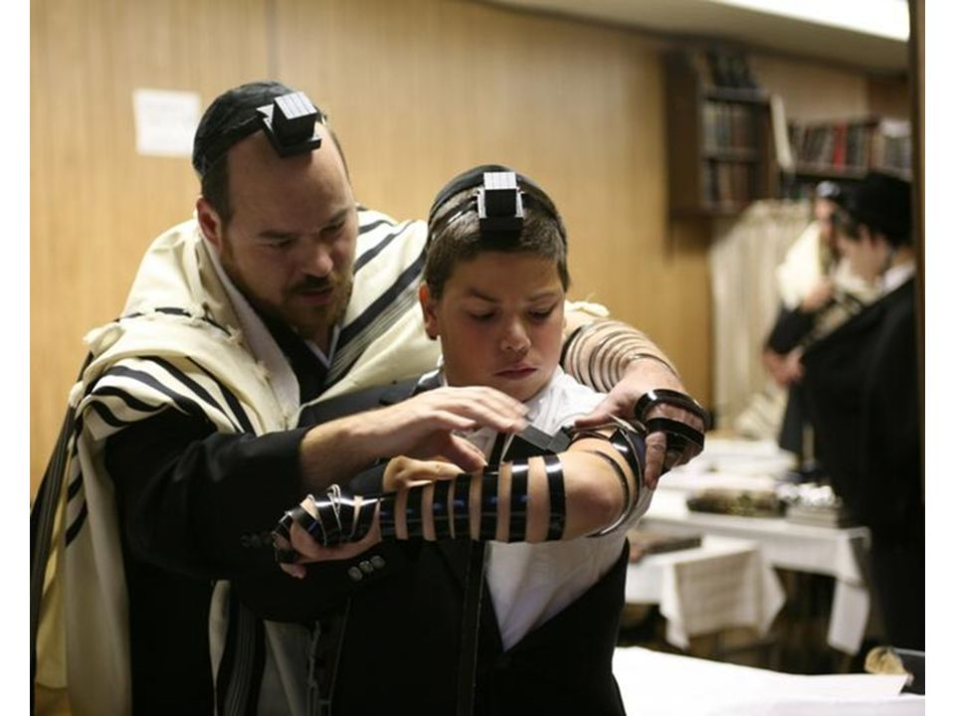
These commandments that I give you today are to be on your hearts.

Slide 15
IV. We are called to remember the Lord’s mercy
²⁰ In the future, when your son asks you, “What is the meaning of the stipulations, decrees and laws the LORD our God has commanded you?”²¹ tell him: “We were slaves of Pharaoh in Egypt, but the LORD brought us out of Egypt with a mighty hand.
Deuteronomy 6:20-21 (NIV)

Slide 16
⁷ The Lord did not set his affection on you and choose you because you were more numerous than other peoples, for you were the fewest of all peoples. ⁸ But it was because the Lord loved you and kept the oath he swore to your ancestors that he brought you out with a mighty hand and redeemed you from the land of slavery, from the power of Pharaoh king of Egypt.
Deuteronomy 7:7-8 (NIV)

Slide 17
³⁷ Jesus replied: “‘Love the Lord your God with all your heart and with all your soul and with all your mind.’ ³⁸ This is the first and greatest commandment.
Matthew 22:37-38 (NIV)
Love the LORD your God with all your heart and with all your soul and with all your strength.
Deuteronomy 6:5 (NIV)

Slide 18
Whoever has my commands and keeps them is the one who loves me. The one who loves me will be loved by my Father, and I too will love them and show myself to them.”
John 14:21 (NIV)
Jesus replied, “Anyone who loves me will obey my teaching. My Father will love them, and we will come to them and make our home with them”
John 14:23 (NIV)

Slide 19
‘Genuine love of the Lord is intelligent, feeling, willing, and serving. It involves thought, sensitivity, intent, and even action where that is possible and appropriate. God has never sought either empty words or empty rituals.’
John Macarthur

Slide 20
How to love the Lord?
I. The first lesson or instruction is WORSHIP
II. Second lesson or instruction is OBEDIENCE
III. The Lord must be our concern, and goal
IV. We are called to remember the Lord’s mercy

