Slide 1
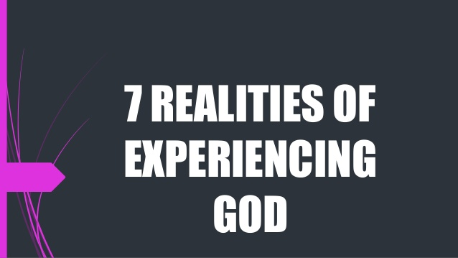
Looking to God.

Slide 2
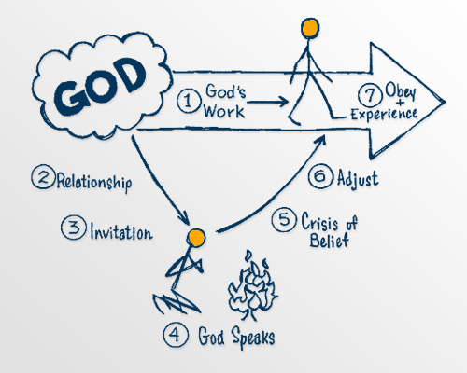
What is God’s will?

Slide 3
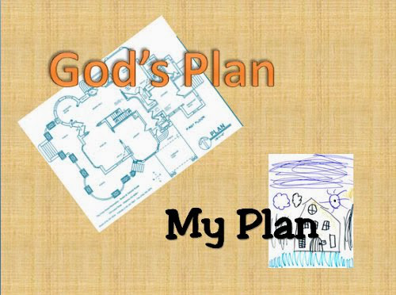
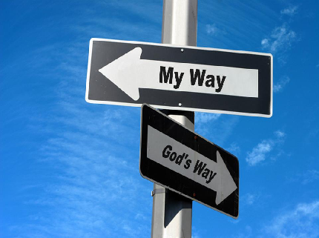
GOD'S PLANS VERSUS OUR PLANS

Slide 4
10 property Laws of a Toddler.
1. If I like it, it’s mine. 2. If it’s in my hand, it’s mine. 3. If I can take it from you, it’s mine. 4. If I had it a little while ago, it’s mine. 5. If it’s mine, it must never appear to be yours in any way. 6. If I’m doing or building something, all the pieces are mine. 7. If it looks just like mine, it’s mine. 8. If I saw it first, it’s mine. 9. If you are playing with something and you put it down, it automatically becomes mine. 10. If it’s broken, it’s yours. (by Deb Lawrence)

Slide 5
Self-centered vs God-centered life
The important thing of living a God-centered life is that we must focus our lives on God's purposes not our own plans.

Slide 6
²³ And Jesus answered them, saying, The hour is come, that the Son of man should be glorified.
²⁴ Verily, verily, I say unto you, Except a corn of wheat fall into the ground and die, it abideth alone: but if it die, it bringeth forth much fruit.
²⁵ He that loveth his life shall lose it; and he that hateth his life in this world shall keep it unto life eternal.
John 12:23-25 (KJV)

Slide 7
Let’s Pray…

Slide 8
The hour is come, that the Son of man should be glorified.
‘The attractive power was to be His cross. The lifting up of Christ has no reference to preaching. He was to be “lifted up,” not by testimony nor by imitating His life; but in His death:…The cross is still the supreme moral magnet of the world. It is not the teachings of Christ, nor his example, unrelated to His death, but His cross that is attracting multitudes and making them willing, as devoted followers, to take up the cross after Him.’
Charles R. Erdman

Slide 9
I. A picture that describes Salvation.
Verily, verily, I say unto you, Except a corn of wheat fall into the ground and die, it abideth alone: but if it die, it bringeth forth much fruit.
John 12:24 (KJV)

Slide 10
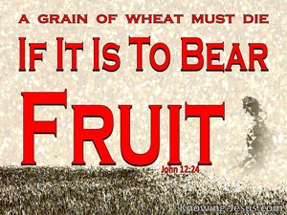
Except a corn of wheat fall into the ground and die,…

Slide 11
II. A picture that describes people’s response .
²⁵ He that loveth his life shall lose it; and he that hateth his life in this world shall keep it unto life eternal.

Slide 12
a) He that loveth his life shall lose it.
I don’t need a new start. I like myself. I like my viewpoints, I like my opinions. I like my background. I am not a bad person. I am very satisfied with my life.
Thank you very much.

Slide 13
b) He that hateth his life
To hate it is when we meditate about the wrong things we have done.
We are conscious of our weakness, and our sins
To hate your life is to be ready to repent and to ask God’s forgiveness.
he that hateth his life in this world
shall keep it unto life eternal.

Slide 14
O love that will not let me go,
I rest my weary soul in Thee.
I give Thee back the life I owe,
That in Thine ocean depths its flow,
May richer fuller be.

Slide 15
"…if my people, who are called by my name, will humble themselves and pray and seek my face and turn from their wicked ways, then will I hear from heaven and will forgive their sin and will heal their land."
2 Chronicles 7:14.

Slide 16
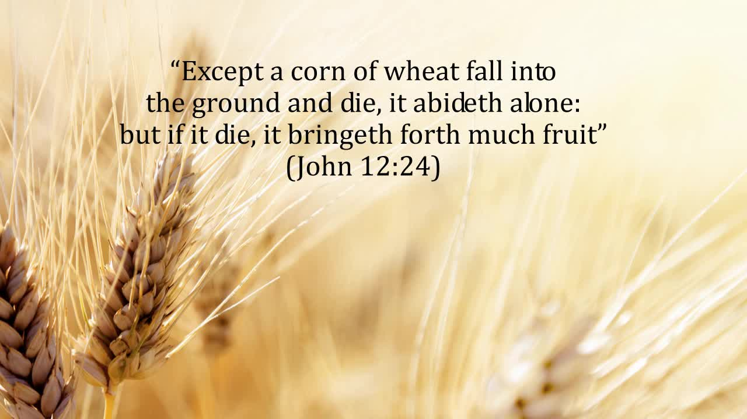

Slide 17
John 12:25
He that loveth his life shall lose it;
and he that hateth his life in this world shall keep it unto life eternal.

