Slide 1
Lessons from Psalms #9:
God’s blessings to the righteous
Psalm 92

Slide 2
Psalm 92
¹ It is good to praise the LORD and make music to your name, O Most High, ² proclaiming your love in the morning and your faithfulness at night,..
⁵ How great are your works, LORD, how profound your thoughts!
⁶ Senseless people do not know, fools do not understand,
⁷ that though the wicked spring up like grass and all evildoers flourish, they will be destroyed forever. ⁸ But you, LORD, are forever exalted.

Slide 3
Psalm 92
¹² The righteous will flourish like a palm tree,
they will grow like a cedar of Lebanon;
¹³ planted in the house of the LORD,
they will flourish in the courts of our God.
¹⁴ They will still bear fruit in old age,
they will stay fresh and green,
¹⁵ proclaiming, “The LORD is upright;
he is my Rock, and there is no wickedness in him.”

Slide 4
Let’s Pray…

Slide 5
Psalm 92
God’s blessings to the righteous
It is good to praise the LORD
⁵ How great are your works, Lord, how profound your thoughts!

Slide 6
⁶ Senseless people do not know, fools do not understand,
⁷ that though the wicked spring up like grass and all evildoers flourish, they will be destroyed forever.
In the morning it springs up new, but by evening it is dry and withered.
Psalm 90:6 (NIV)

Slide 7
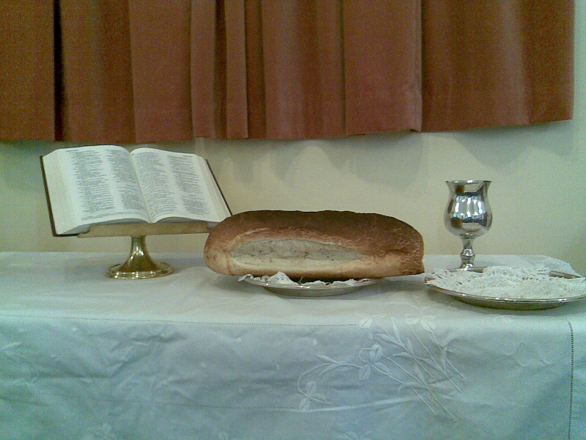
God’s blessings to the righteous

Slide 8
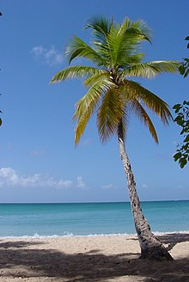
I. The Righteous Shall Flourish Like The Palm Tree.
a) It has stature: great height
b) It has strength:
to withstand storms
c) It has spring: snaps back
d) It will only grow in warm climates. Dies in cold places.

Slide 9

Palms are often associated with a tropical paradise.
The house of God is our paradise.

Slide 10
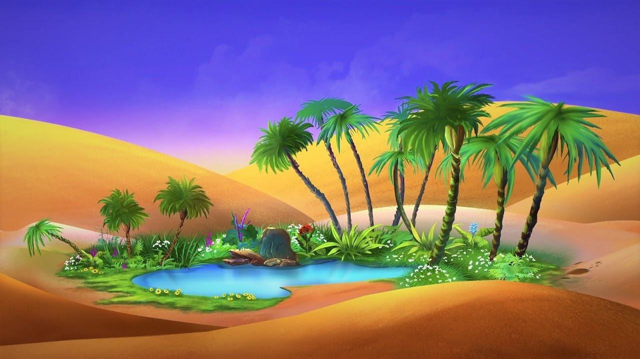
A GROUP OF PALM TREES FORMS AN OASIS.
“not giving up meeting together, as some are in the habit of doing, but encouraging one another—and all the more as you see the Day approaching.” Hebrews 10:25 (NIV)

Slide 11
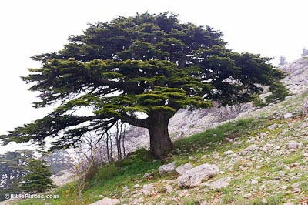
II. He Shall Grow Like A Cedar In Lebanon.
a) Very strong.
b) Very beautiful.
c) An evergreen.
d) Its wood is expensive, fragrant, sweet and insect repellent

Slide 12
II. He Shall Grow Like A Cedar In Lebanon.
e) It lives many years. It is an ancient tree, and it grows as long as it lives.

Slide 13
III. Why and How –
The righteous is supposed to grow.
¹³ planted in the house of the LORD,
they will flourish in the courts of our God.
The soil for us is to be in the house of the Lord.

Slide 14
They will still bear fruit in old age,
they will stay fresh and green,
Are you satisfied with where you are with God?
Are you satisfied to grow no more?
What’s hindering your growth?

Slide 15
Let us ponder ourselves and think if God is happy
with our doings and living.

Slide 16
Five missionaries sang this song before entering the Ecuadorian jungle. In January of 1956 they were murdered
by Huaorani warriors.
We rest on Thee, our Shield and our Defender!
We go not forth alone against the foe;
Strong in Thy strength, safe in Thy keeping tender,
We rest on Thee, and in Thy Name we go.
It is good to praise the LORD

Slide 17
Psalm 92
¹² The righteous will flourish like a palm tree,
they will grow like a cedar of Lebanon;
¹³ planted in the house of the LORD,
they will flourish in the courts of our God.
¹⁴ They will still bear fruit in old age,
they will stay fresh and green,
¹⁵ proclaiming, “The LORD is upright;
he is my Rock, and there is no wickedness in him.”

