Slide 1
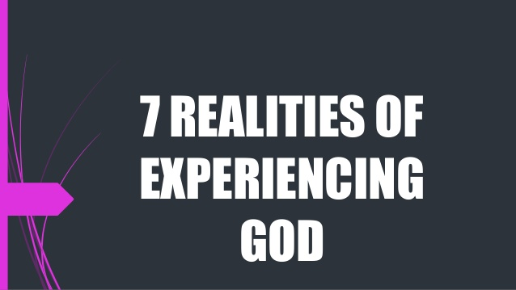
God works through His servants.

Slide 2
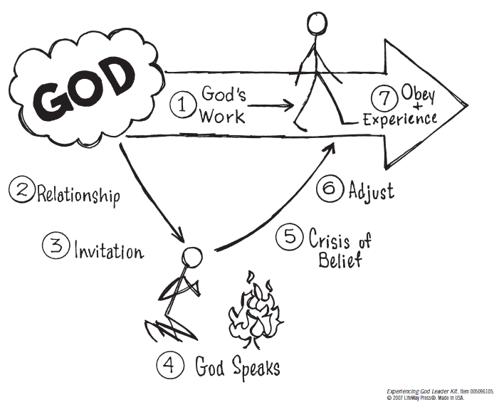

Slide 3
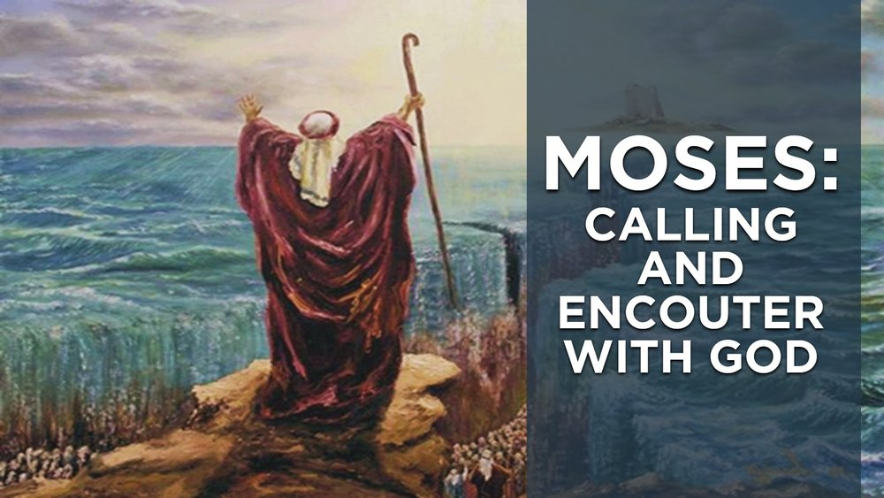
God works through His servants.

Slide 4
Let’s Pray…

Slide 5
Reality 1: God was already at work around Moses.
²³ During that long period, the king of Egypt died. The Israelites groaned in their slavery and cried out, and their cry for help because of their slavery went up to God. ²⁴ God heard their groaning and he remembered his covenant with Abraham, with Isaac and with Jacob. ²⁵ So God looked on the Israelites and was concerned about them.
Exodus 2:23-25 (NIV)
God heard their calling.

Slide 6
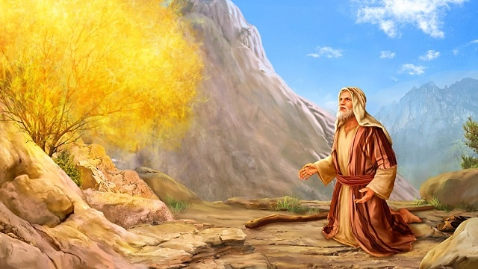
Reality 2: God pursued a continuing love relationship with Moses that was real and personal.
God told Moses He would go with him into Egypt.

Slide 7
Reality 2: God pursued a continuing love relationship with Moses that was real and personal.
¹² The LORD said to Moses, “Come up to me on the mountain and stay here, and I will give you the tablets of stone with the law and commandments I have written for their instruction.” …¹⁵ When Moses went up on the mountain, the cloud covered it, ¹⁶ and the glory of the LORD settled on Mount Sinai. For six days the cloud covered the mountain, and on the seventh day the LORD called to Moses from within the cloud…¹⁸ Then Moses entered the cloud as he went on up the mountain. And he stayed on the mountain forty days and forty nights.
Exodus 24:12, 15-16, 18 (NIV)

Slide 8
Reality 3: God invited Moses to become involved with Him in His work.
I have come down to rescue them from the hand of the Egyptians and to bring them up out of that land into a good and spacious land, a land flowing with milk and honey—the home of the Canaanites, Hittites, Amorites, Perizzites, Hivites and Jebusites… ¹⁰ So now, go. I am sending you to Pharaoh to bring my people the Israelites out of Egypt.”
Exodus 3:8, 10 (NIV)

Slide 9
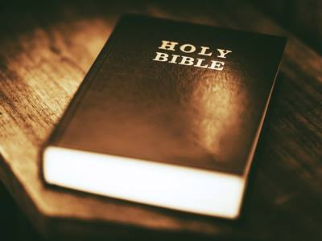
God accomplishes His work through his people.
The Bible is designed to help you understand God’s way.

Slide 10
Reality 4: God spoke to reveal Himself, His purposes, and his ways.
² There the angel of the LORD appeared to him in flames of fire from within a bush. Moses saw that though the bush was on fire it did not burn up. ³ So Moses thought, “I will go over and see this strange sight—why the bush does not burn up.” ⁴ When the LORD saw that he had gone over to look, God called to him from within the bush, “Moses! Moses!” And Moses said, “Here I am.” ⁵ “Do not come any closer,” God said. “Take off your sandals, for the place where you are standing is holy ground.”
Exodus 3:2-8 (NIV)

Slide 11
⁶ Then he said, “I am the God of your father, the God of Abraham, the God of Isaac and the God of Jacob.” At this, Moses hid his face, because he was afraid to look at God.
⁷ The LORD said, “I have indeed seen the misery of my people in Egypt. I have heard them crying out because of their slave drivers, and I am concerned about their suffering. ⁸ So I have come down to rescue them from the hand of the Egyptians and to bring them up out of that land into a good and spacious land, a land flowing with milk and honey...
Exodus 3:2-8 (NIV)

Slide 12

Reality 5: God’s invitation for Moses to work with Him led to a crisis of belief that required faith and action.
¹¹ But Moses said to God, “Who am I that I should go to Pharaoh and bring the Israelites out of Egypt?”… ¹³ Moses said to God, “Suppose I go to the Israelites and say to them, ‘The God of your fathers has sent me to you,’ and they ask me, ‘What is his name?’ Then what shall I tell them?”

Slide 13
Moses answered, “What if they do not believe me or listen to me and say, ‘The LORD did not appear to you’?”… ¹⁰ Moses said to the LORD, “Pardon your servant, Lord. I have never been eloquent, neither in the past nor since you have spoken to your servant. I am slow of speech and tongue.”… ¹³ But Moses said, “Pardon your servant, Lord. Please send someone else.”

Slide 14
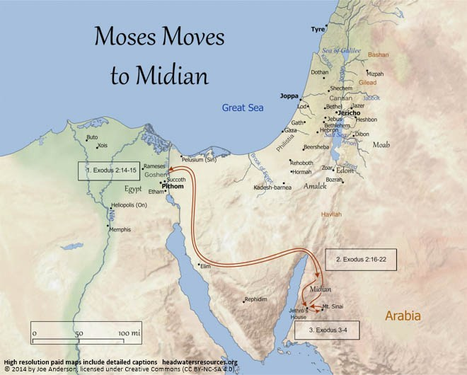
Reality 6: Moses had to make major adjustments in his life to join God in what He was doing.
Moses made necessary adjustments to orient his life to God. Moses had to come to the place where he believed God could do everything He said he would do.

Slide 15
God accomplished His purpose through Moses.
¹⁹ Now the LORD had said to Moses in Midian, “Go back to Egypt, for all those who wanted to kill you are dead.” ²⁰ So Moses took his wife and sons, put them on a donkey and started back to Egypt. And he took the staff of God in his hand.
Exodus 4:19-20 (NIV)

Slide 16
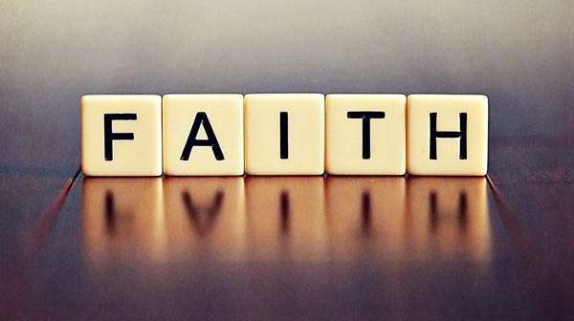
²⁴ By faith Moses, when he had grown up, refused to be known as the son of Pharaoh’s daughter. ²⁵ He chose to be mistreated along with the people of God rather than to enjoy the fleeting pleasures of sin. ²⁶ He regarded disgrace for the sake of Christ as of greater value than the treasures of Egypt, because he was looking ahead to his reward. ²⁷ By faith he left Egypt, not fearing the king’s anger; he persevered because he saw him who is invisible. ²⁸ By faith he kept the Passover and the application of blood, so that the destroyer of the firstborn would not touch the firstborn of Israel. ²⁹ By faith the people passed through the Red Sea as on dry land; but when the Egyptians tried to do so, they were drowned.
Hebrews 11:24-29 (NIV)

Slide 17
Reality 7: Moses came to know God by experience as he obeyed God, and God accomplished His work through Moses.
²¹ Then Moses stretched out his hand over the sea, and all that night the LORD drove the sea back with a strong east wind and turned it into dry land. The waters were divided, ²² and the Israelites went through the sea on dry ground, with a wall of water on their right and on their left.
²³ The Egyptians pursued them, and all Pharaoh’s horses and chariots and horsemen followed them into the sea…
Exodus 14:21-23 (NIV)

Slide 18
²⁶ Then the LORD said to Moses, “Stretch out your hand over the sea so that the waters may flow back over the Egyptians and their chariots and horsemen.” ²⁷ Moses stretched out his hand over the sea, and at daybreak the sea went back to its place. The Egyptians were fleeing toward it, and the LORD swept them into the sea… ²⁹ But the Israelites went through the sea on dry ground, with a wall of water on their right and on their left. ³⁰ That day the LORD saved Israel from the hands of the Egyptians, and Israel saw the Egyptians lying dead on the shore. ³¹ And when the Israelites saw the mighty hand of the LORD displayed against the Egyptians, the people feared the LORD and put their trust in him and in Moses his servant.
Exodus 14:26-27, 29-31 (NIV)

Slide 19
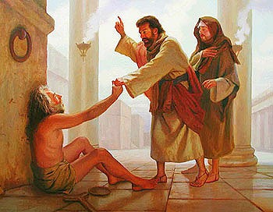
What can one ordinary person do?
God healed the crippled beggar through Peter.
Peter and John were called before the Sanhedrin (The highest Jewish court in the land) to give account of their actions.

Slide 20
“When they saw the courage of Peter and John and realized that they were unschooled, ordinary men, they were astonished and they took note that these men had been with Jesus.”
Acts 4:13 (NIV)
What can one ordinary person do?

Slide 21
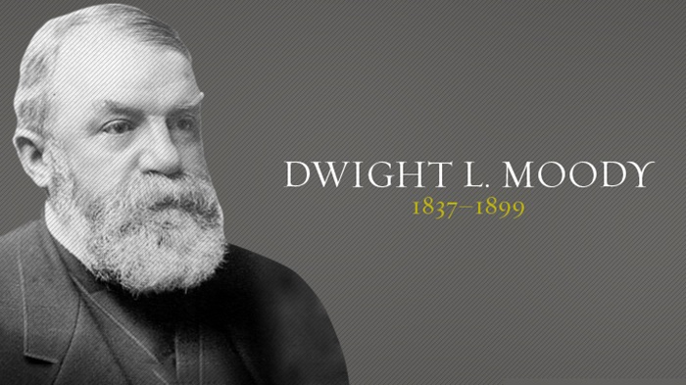

Slide 22
Dwight L. Moody and his friends heard Henry Varley say,
“The world has yet to see what God can do with and for and through the man who is fully and wholly consecrated to Him”.
Moody thought:
“The world had yet to see! With and for and through and in! A man!”
Varley meant any man! Varley didn’t say he had to be educated, or brilliant, or anything else! Just a man! Well, by the Holy Spirit in him, he’d [Moody] be one of those men.

Slide 23
²⁶ Brothers and sisters, think of what you were when you were called. Not many of you were wise by human standards; not many were influential; not many were of noble birth. ²⁷ But God chose the foolishthings of the world to shame the wise; God chose the weak things of the world to shame the strong. ²⁸ God chose the lowly things of this world and the despised things—and the things that are not—to nullify the things that are, ²⁹ so that no one may boast before him.
1 Corinthians 1:26-31 (NIV)

Slide 24
³⁰ It is because of him that you are in Christ Jesus, who has become for us wisdom from God—that is, our righteousness, holiness and redemption. ³¹ Therefore, as it is written: “Let the one who boasts boast in the Lord.”
1 Corinthians 1:26-31 (NIV)

Slide 25
‘The world measures greatness by many standards. At the top are intelligence, wealth, prestige, and position – things which God has determined to put at the bottom. God reveals the greatness of His power by demonstrating that it is the world’s nobodies that are His somebodies’
John MacArthur, The MacArthur New Testament Commentary, 1 Corinthians, p51
God is able to do anything he pleases with one ordinary person who is fully consecrated to Him.

Slide 26
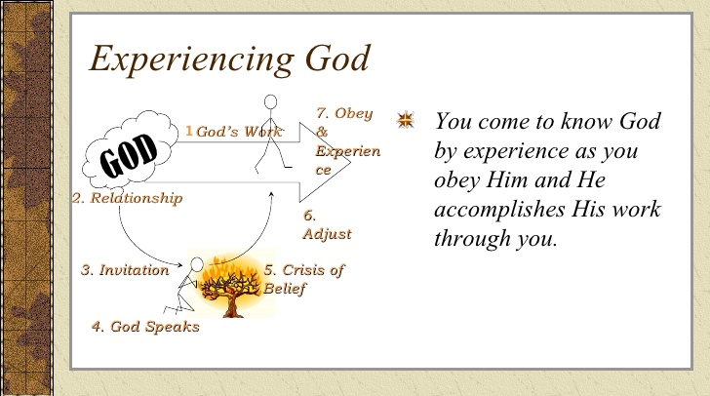

Slide 27
God works through His servants.
God is able to do anything he pleases with one ordinary person who is fully consecrated to Him.

