Slide 1
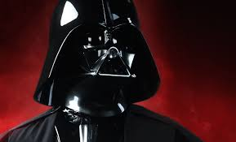
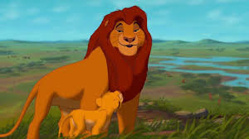
The Fatherless Generation

Slide 2
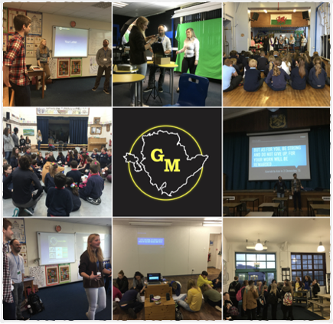
Gobaith Môn
Gobaith Môn aims to bring together Christians from all denominations to bring Hope to the youth of the Island by encouraging and developing youth work in schools, churches and communities.

Slide 3
To the fatherless he is a father.
To the widow He is a champion friend. To the lonely He makes them part of a family. To the prisoners He leads into prosperity until they sing for joy. This is our Holy God in his Holy Place!
But for the rebels there is heartache and despair.
–Psalm 68 verse 5-6 (TPT)
Notes:
What does the bible say about fatherless? It is evident that God has a heart for the fatherless as he
Fatherless is evidence that when we don’t function in the way that God designed us to, if we don’t do family the way he advices us to, there are negative consequences.

Slide 4
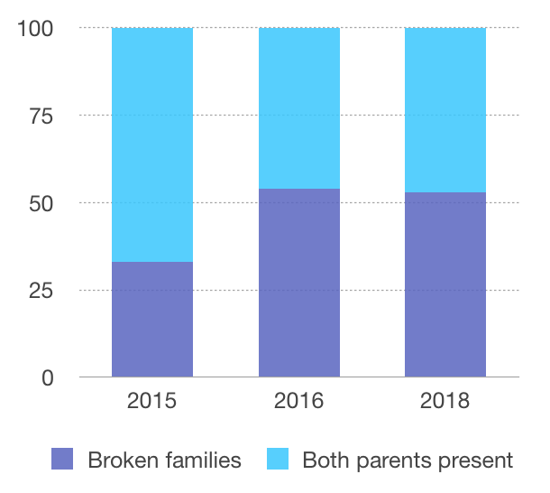
Notes:
Britain is facing a “crisis of fatherlessness” in which almost half of all children born today will not be living with both parents by the time they are 15,
2015- 33% identified as being from a broken home
2016- 54% identified as being from a broken home
2018- 53% identified as being from a broken home
They understand the need for both parents and they are hurt by their experience

Slide 5
“Fatherlessness is the most harmful demographic trend of this generation. It is the leading cause of declining child well-being in our society. It is also the engine driving our most urgent social problems, from crime to adolescent pregnancy to child sexual abuse to domestic violence against women. Yet despite its scale and social consequences, fatherlessness is a problem that is frequently ignored or denied.”
-David Blankenhorn
Notes:
John sowers says “Fatherless creates an appetite in the soul that demand fulfilment”

Slide 6
Children from fatherless homes account for
63% of youth suicides
71% of teenage pregnancies
90% of all homeless/ runaway children
85% of youth who exhibit behaviour disorders
80% of rapists motivated with displaced anger
71% of high school dropouts

Slide 7
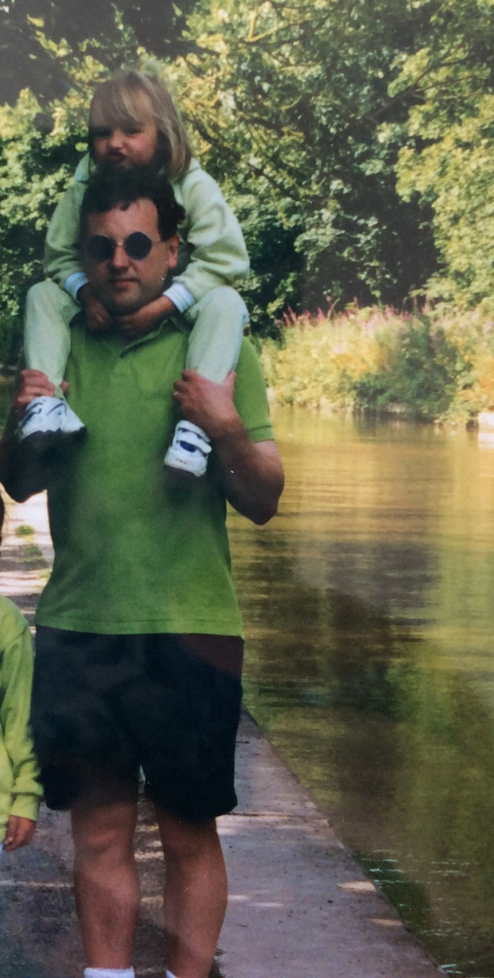
Notes:
My dad
Picking up story
Dad in prison story

Slide 8

Notes:
I have been looking for my father since I was ten years old.
My mom was 17 years old and still at school when she fell pregnant with me. I grew up with my mother and grandmother. I had the phone number for him written on a folded piece of paper, which I used to keep on me in the pocket of my school uniform every day of my life.
I saw him for the first time face to face when I was eight years old. My mom and I bumped into him at a shop where we lived. He had always been there. I saw then I am the splitting image of my dad. There is no way he did not know I was his child.
In grade four I tried to call him for the first time. When he picked up the phone I told him who I was. I asked him how he is doing. He replied: “Hi, I’m fine. Bye.”
And put the phone down.
When I got home my mom asked me whether I had called my father that day. I told her I did. She said she thought as much because he paid money into her account.
But I never wanted his money. I just wanted to talk to him. I wanted to hear his voice.
One day, once I finished school and started working in Cape Town, I called him again. I wanted to tell him I managed to get a decent job. I was about to turn 21 years and I wanted to invite him. “I’m not in South Africa,” is all he said before putting the phone down. I was devastated.
Over the years on Fathers' Day, or when I celebrated Christmas, I’d disappear into the bathroom. I would go on my knees and ask God to please send a message to my father that I was thinking about him. To this day he is on my mind 24 hours a day. I don’t know why that is. I don’t know why he can’t just say yes once.
I see on Facebook he is happy with his second wife and he takes her and their dogs on holiday.
If only I could ask him a few questions: How did he meet my mother? I never asked her much because I can see in her face it hurts too much. I only have one dream and that is to get to know him, to know where he comes from, his interests.
After 25 years I still feel he is hiding me. My son is now two years and nine months old. He has never met his grandfather.

Slide 9
The LORD passed in front of Moses, calling out, "Yahweh! The LORD! The God of compassion and mercy! I am slow to anger and filled with unfailing love and faithfulness.
Exodus 34:6 (NLT)
Notes:
Who is father God? This is what he says about himself.
God says he is loving…

Slide 10
Hear my voice when I call, Lord; be merciful to me and answer me.
My heart says of you, “Seek his face!” Your face, Lord, I will seek.
Do not hide your face from me, do not turn your servant away in anger; you have been my helper.
Do not reject me or forsake me, God my Saviour.
Though my father and mother forsake me,
the Lord will receive me.
Psalm 27 Verse 7-10 (NIV)
Notes:
God does not reject those who turn to him
The prodigal son

Slide 11
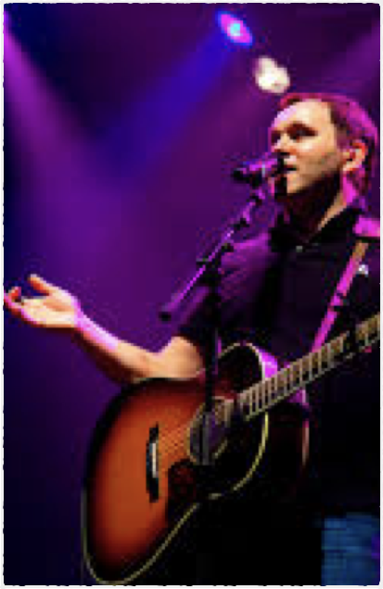
Matt Redman
“Scripture tells us that he is a father to the fatherless, and I knew a massive measure of that as I grew up.”
Notes:
"My dad died suddenly when I was 7 years old. I found out a few years later that he had actually taken his own life. I guess in some ways it was a double shock, and that brings up a whole lot of new questions: did it have anything to do with me? Didn’t he love us enough to stay around? The older I’ve become the more I understood some of the reasons, the main one is depression, which is a very toxic affliction that pollutes a persons outlook, even the good things.
My mum remarried, and things took a turn for the worst- that guy abused our trust as a family, and things stayed very rocky for a few years.
There were deffinetly a few years of pain and struggle there in my childhood and early teenage years- but to be truthful I never felt fatherless. I think it had a lot to do with God being true to his word. Scripture tells us that he is a father to the fatherless, and I knew a massive measure of that as I grew up. In fact, so many of the painful things in my childhood , by his grace, propelled me toward God and not away from him. I would go so far as to say that these times of turmoil were were actually the things that solidified my walk with God and made me want to walk and talk with him. Throughout that whole season, somehow, I had a very real sense of God being my father- and very strong and compassionate one at that.”

Slide 12
Mentoring as redeeming the story
Children with mentors are:
46% less likely to do drugs
33% less likely to resort to violence
53% less likely to dropout of school
59% more likely to improve their grades
Notes:
Lower rates in teen pregnancy, suicide and gang involvement
Matt redman also said “The other thing that really helped me was seeing God provide many great mentor figures along the way- all throughout my teen years and beyond. In 1 corinthians 4.15 Paul comments that the corinthians have had many teachers in Christ- but not many fathers. I am grateful that this has never been my experience. Though I grew up without a father I was blessed with abundance of older guys who invested in my life with words of encouragement and direction, and they set an example for me in the faith.”

Slide 13
Love is patient and kind; love does not envy or boast; it is not arrogant or rude. It does not insist on its own way; it is not irritable or resentful; it does not rejoice at wrongdoing, but rejoices with the truth. Love bears all things, believes all things, hopes all things, endures all things.
Love never ends.
1 Corinthians 13 Verses 4-8 (ESV)
Notes:
These are the characteristics of God and he operates in these ways, he fathers in these ways

Slide 14
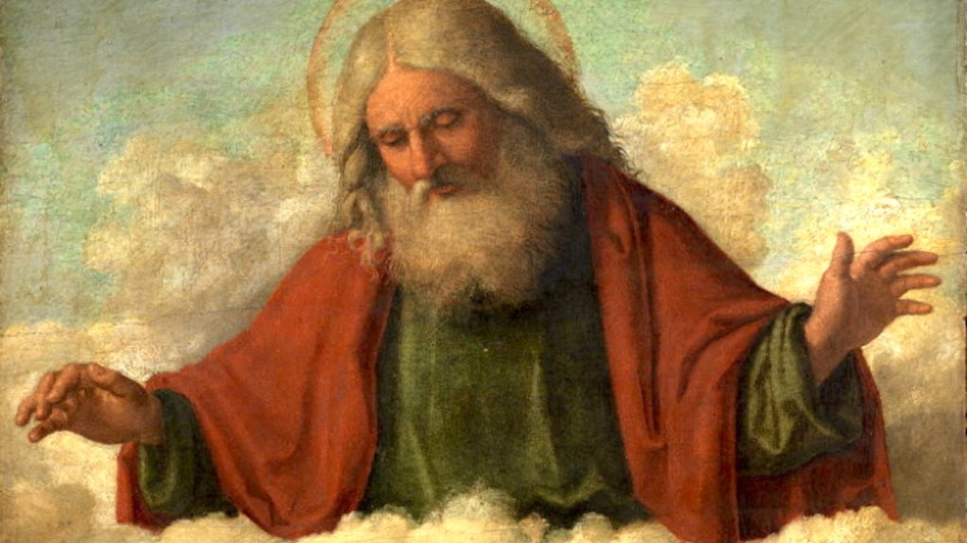
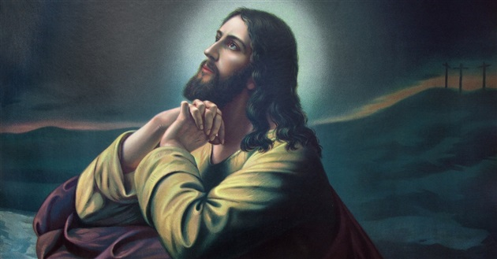
“So God created mankind in his own image,
in the image of God he created them;
male and female he created them.”
Genesis 1:27
Notes:
Being made in the image of God isn’t about physically ‘looking like’ him. It’s about reflecting his characteristics. The Bible says that God is loving, forgiving, creative, caring and so much more. I believe this gives us a glimpse of what it means to be created in his image. He intended for us to be loving, forgiving, creative, caring and so much more too! I believe he created each one of us for a purpose.

Slide 15
Yet to all who did receive him, to those who believed in his name, he gave the right to become children of God
John 1:12

Slide 16
Who shall separate us from the love of Christ? Shall trouble or hardship or persecution or famine or nakedness or danger or sword? As it is written:
“For your sake we face death all day long;
we are considered as sheep to be slaughtered.”[j]
No, in all these things we are more than conquerors through him who loved us. 38 For I am convinced that neither death nor life, neither angels nor demons,[k] neither the present nor the future, nor any powers, 39 neither height nor depth, nor anything else in all creation, will be able to separate us from the love of God that is in Christ Jesus our Lord.
Romans 8 verse 35-39
Notes:
Whatever circumstance you have come from. Whatever your family looks like, you are not separated from Gods love.

Slide 17

Notes:
I once saw a Childs prayer asking God “do you like me”
Does God like you?
For the fatherless who have been rejected or neglected by their own dads it may be difficult to not view God that way…
It is important to know the truth about who God is. And then the truth about who we are because we have been created

