Slide 1
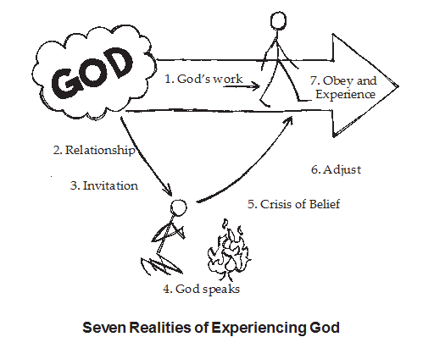
Experiencing God

Slide 2
Experiencing God #3:
Learning to be a Servant of God.
⁵ In your relationships with one another, have the same mindset as Christ Jesus: ⁶ Who, being in very nature God, did not consider equality with God something to be used to his own advantage; ⁷ rather, he made himself nothing by taking the very nature of a servant, being made in human likeness. ⁸ And being found in appearance as a man, he humbled himself by becoming obedient to death—even death on a cross! Philippians 2:5-8 (NIV)

Slide 3
^{Let’s Pray……}

Slide 4

Learning to be a Servant of God.
To Paul, two things characterized a church that was pleasing to Christ.
First, the church should be in a spirit of unity.
Second, the members should act from proper motivation…
(A servant heart is required).

Slide 5
(Philippians 4:2 – 3).
The names of these two women are significant. Euodia means “prosperous journey” or “sweet fragrance,” and Syntyche means “good luck.”
Paul writes to the Philippian Church:
“I plead with Eudodia and I plead with Syntyche to agree with each other in the Lord.”

Slide 6
Learning to be a Servant of God.
I. Paul appeals to their relationship with Jesus Christ.
Therefore if you have any encouragement from being united with Christ, if any comfort from his love, if any common sharing in the Spirit, if any tenderness and compassion,
Philippians 2:1 (NIV)
“If there be therefore any consolation in Christ…”(KJV)

Slide 7
‘the Holy Spirit is the Comforter, Christ is the comfort. The Holy Spirit consoles, but Christ is the consolation. If I may use the figure, the Holy Spirit is the Physician, but Christ is the medicine. He heals the wound, but it is by applying the holy ointment of Christ's name and grace. He takes not of his own things, but of the things of Christ.’
Charles Spurgeon

Slide 8
²⁷ Whatever happens, conduct yourselves in a manner worthy of the gospel of Christ. Then, whether I come and see you or only hear about you in my absence, I will know that you stand firm in the one Spirit, striving together as one for the faith of the gospel.
Philippians 1:27 (NIV)
²⁸ without being frightened in any way by those who oppose you. This is a sign to them that they will be destroyed, but that you will be saved—and that by God.

Slide 9
²⁹ For it has been granted to you on behalf of Christ not only to believe in him, but also to suffer for him,
Philippians 1:29 (NIV)
² then make my joy complete by being like-minded, having the same love, being one in spirit and of one mind.
Philippians 2:2 (NIV)
Fulfil my joy so you can be like Christ.

Slide 10
How to be like minded?
a) We should put the Word of God first.
b) We should pursue Holiness.
c) We should look for the welfare of our neighbour.
d) We should be Humble.

Slide 11
“Do nothing out of selfish ambition or vain conceit. Rather, in humility value others above yourselves,” Philippians 2:3 (NIV)
“Let nothing be done through strife or vainglory,…”
(KJV)
Strife means competition

Slide 12
⁴ not looking to your own interests but each of you to the interests of the others.
And then Paul says; examine your attitude…
This is about Christian attitude.
⁵ In your relationships with one another, have the same mindset as Christ Jesus:

Slide 13
Learning to be a Servant of God.
II. “…have the same mindset as Christ Jesus:
“Your attitude should be the same as that of Christ Jesus.”
A new command I give you: Love one another. As I have loved you, so you must love one another. ³⁵ By this everyone will know that you are my disciples, if you love one another.”
John 13:34-35 (NIV)

Slide 14
How are we to do it?
By following:
The Humble Obedience modelled by Jesus
“…whoever wants to become great among you must be your servant, ²⁷ and whoever wants to be first must be your slave— ²⁸ just as the Son of Man did not come to be served, but to serve, and to give his life as a ransom for many.”
Matthew 20:26-28 (NIV)

Slide 15
We are to be like Christ.
Who, being in very nature God, did not consider equality with God something to be used to his own advantage;
Philippians 2:6 (NIV)
Who, being in the form of God, thought it not robbery to be equal with God:
Philippians 2:6 (KJV)

Slide 16
What shall we do to learn to be servants of God?
How are we to do it?
b) By showing the same Compassion Jesus had for us all.
Christ calls for compassion.
For God did not send his Son into the world to condemn the world, but to save the world through him. John 3:17 (NIV)

Slide 17
Jesus had compassion for us
But made himself of no reputation, and took upon him the form of a servant, and was made in the likeness of men:
Philippians 2:7 (KJV)
And being found in fashion as a man, he humbled himself, and became obedient unto death, even the death of the cross.
Philippians 2:8 (KJV)

Slide 18
⁶ Seek the LORD while he may be found;
call on him while he is near.
⁷ Let the wicked forsake their ways
and the unrighteous their thoughts.
Let them turn to the LORD,
and he will have mercy on them,
and to our God, for he will freely pardon.
⁸ “For my thoughts are not your thoughts,
neither are your ways my ways,”
declares the LORD.
Isaiah 55:6-8 (NIV)

Slide 19
Experiencing God #3:
Learning to be a Servant of God.
⁵ In your relationships with one another, have the same mindset as Christ Jesus: ⁶ Who, being in very nature God, did not consider equality with God something to be used to his own advantage; ⁷ rather, he made himself nothing by taking the very nature of a servant, being made in human likeness. ⁸ And being found in appearance as a man, he humbled himself by becoming obedient to death—even death on a cross! Philippians 2:5-8 (NIV)

