Slide 1
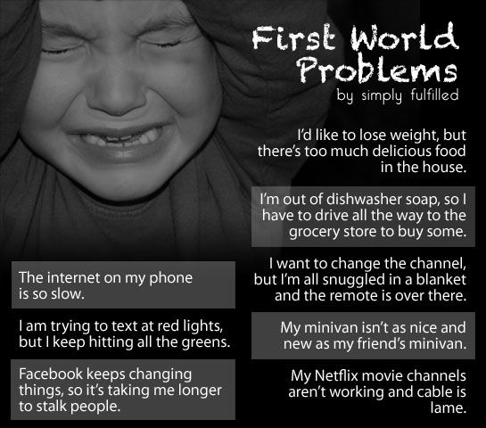

Slide 2
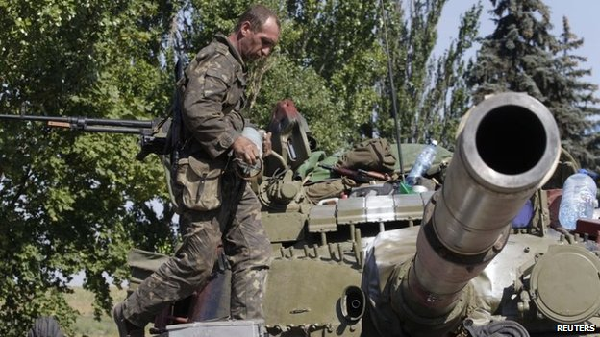
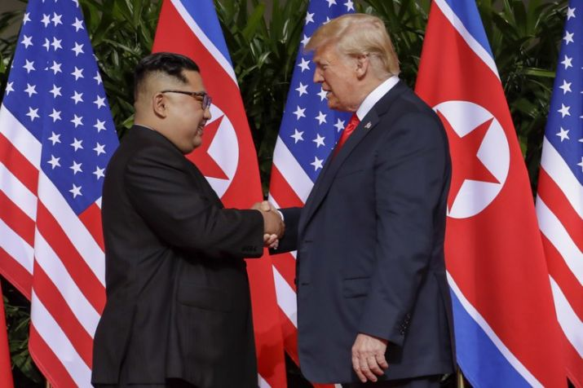
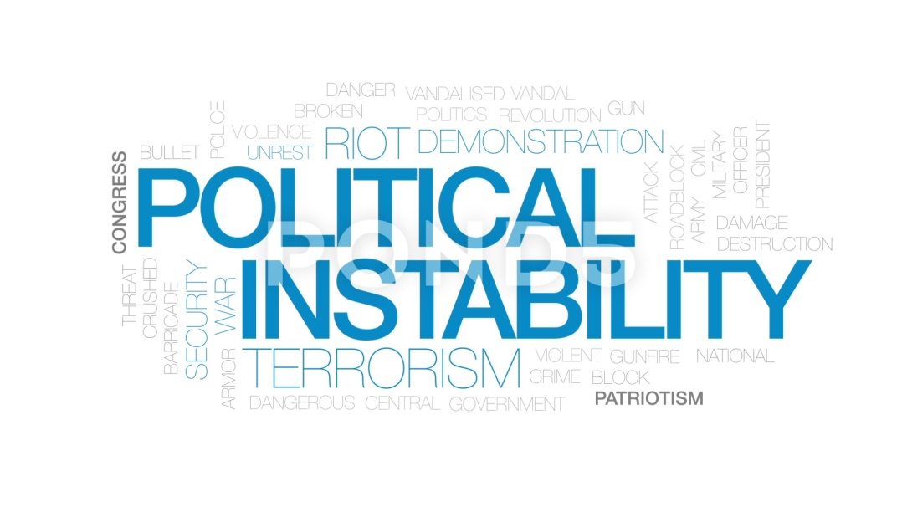
How can we be secure living in an unsafe world?

Slide 3
In Psalm 46; the psalmist tells us through his own experience:
“God is our refuge and strength, an ever-present help in trouble.” That’s where we can find true security and peace.
“Selah”.
We’re called to pause and meditate three different times so that we can comprehend what God is saying to us.

Slide 4
Psalm 46:1-3 (NIV)
“God is our refuge and strength, an ever-present help in trouble. Therefore we will not fear, though the earth give way and the mountains fall into the heart of the sea, though its waters roar and foam and the mountains quake with their surging. Selah.”
Let’s pray…

Slide 5
His Protection:
“Our Security is in God, not in this World”
The phrase “ever-present help” means that God is quick to give assistance.
The word “trouble” can mean, “affliction, distress, or tribulation.” God is calling us today to not live in fear because He is our refuge, strength and help.

Slide 6
“Roaring,” means to “be in great commotion, to rage, or be at war.” When we face difficult situations in our lives, commotion is present as we wonder what will happen next.
2 Chronicles 7:14 (NIV)
“If my people, who are called by my name, will humble themselves and pray and seek my face and turn from their wicked ways, then will I hear from heaven and will forgive their sin and will heal their land.”

Slide 7
Psalm 46:1-3 (NIV)
“God is our refuge and strength, an ever-present help in trouble. Therefore we will not fear, though the earth give way and the mountains fall into the heart of the sea, though its waters roar and foam and the mountains quake with their surging.
Selah.”
Let’s pause here and reflect silently upon God’s protection and our need to seek refuge in Him. Confess any personal sins, any sins in our church, and the sins of our nation right now.

Slide 8
II. His Presence:
Our Security comes from our Faith, not from our Circumstance
Psalm 46:4-7 (NIV)
“There is a river whose streams make glad the city of God, the holy place where the Most High dwells. God is within her, she will not fall; God will help her at break of day. Nations are in uproar, kingdoms fall; he lifts his voice, the earth melts. The LORD Almighty is with us; the God of Jacob is our fortress. Selah.”
God protects us when we seek refuge in Him.

Slide 9
Jesus said, John 14:27
“Peace I leave with you; my peace I give you. I do not give to you as the world gives. Do not let your hearts be troubled and do not be afraid)
Security is not the absence of trouble, but the confidence and courage we have in the midst of trouble - this comes from a faith in God

Slide 10
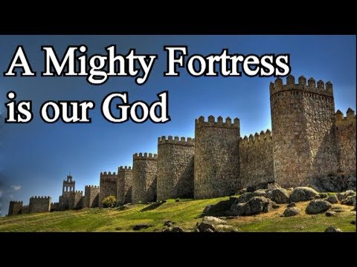
Verse 7 concludes by saying that the
“God of Jacob is our fortress.”
A stronghold never failing;

Slide 11
⁷ The Lord Almighty is with us;
⁷ The Lord of hosts is with us;…(KJV)
Let’s pause at this second “Selah” and thank God for His presence with us.

Slide 12
III. His Position:
Our Security is in Eternity, not in the Present
Psalm 46:8-11 (NIV)
Come and see the works of the LORD, the desolations he has brought on the earth. He makes wars cease to the ends of the earth; he breaks the bow and shatters the spear, he burns the shields with fire. ‘Be still, and know that I am God; I will be exalted among the nations, I will be exalted in the earth.’ The LORD Almighty is with us; the God of Jacob is our fortress. Selah.”

Slide 13
Verse 9 shows us that in His position as the Almighty God, He can make “wars cease to the ends of the earth; he breaks the bow and shatters the spear, he burns the shields with fire.”
Verse 10 calls us to bow before His position as sovereign ruler.
We’re called to “Be still and know that I am God.” To “be still” means to “cast down or let fall.”
Notice the last part of verse 10: “I will be exalted among the nations, I will be exalted in the earth.”

Slide 14
Philippians 2:10-11 (NIV)
“That at the name of Jesus every knee should bow, in heaven and on earth and under the earth, and every tongue confess that Jesus Christ is Lord, to the glory of God the Father.”

Slide 15
Psalm 46:10-11 (NIV)
10 Be still, and know that I am God; I will be exalted among the nations, I will be exalted in the earth.’
11 The LORD Almighty is with us; the God of Jacob is our fortress. Selah.”
Let’s pause here at the final “Selah” and be still before God. Affirm the central truth of Scripture that He is supreme and will be exalted among the nations

Slide 16
How can we be secure living in an unsafe world?

Slide 17
Someone says; “The Christian faith is essentially a Father movement. Yet theologian Tom Snail suggested that in today’s Church the Father is forgotten in precisely the same way that the Holy Spirit was forgotten before the growth of the Pentecostal and charismatic movements.
How real to you is your heavenly Father?

Slide 18
We’re reminded of three essential truths about God from this passage. God demonstrates His dependability through:
His Protection (1-3)
“Our Security is in God, not in this World”
(2) His Presence (4-7)
“Our Security comes from our Faith, not from our Circumstances.”
(3) His Position (8-11)
“Our Security is in Eternity, not in the Present”

