Slide 1
¹⁷ In his defense Jesus said to them, “My Father is always at his work to this very day, and I too am working…¹⁹ Jesus gave them this answer: “Very truly I tell you, the Son can do nothing by himself; he can do only what he sees his Father doing, because whatever the Father does the Son also does. ²⁰ For the Father loves the Son and shows him all he does. Yes, and he will show him even greater works than these, so that you will be amazed.”
(John 5:17, 19-20 NIV).

Slide 2
Let’s pray…

Slide 3

Abram is called to leave

Slide 4
Matthew 4:18-22 (NIV)
¹⁸ As Jesus was walking beside the Sea of Galilee, he saw two brothers, Simon called Peter and his brother Andrew. They were casting a net into the lake, for they were fishermen. ¹⁹ “Come, follow me,” Jesus said, “and I will send you out to fish for people.” ²⁰ At once they left their nets and followed him.
²¹ Going on from there, he saw two other brothers, James son of Zebedee and his brother John. They were in a boat with their father Zebedee, preparing their nets. Jesus called them, ²² and immediately they left the boat and their father and followed him.

Slide 5
He basically said, “Follow Me, and I will show you”.
The deepest longing of our soul
(although often unconscious)
is for a relationship with the God who made us.
John 5:10 – 29
“This five-minute talk with the Jews contains probably the most important truth ever uttered upon earth.”
Marcus Dods

Slide 6
Jesus’ claims.
The claims Jesus made is that He is the…
1) He is the SON of God – He is God (16-20)
2) He is the Messiah (SAVIOUR) (21-24)
3) He is the Judge (25-30)

Slide 7
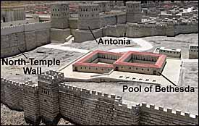
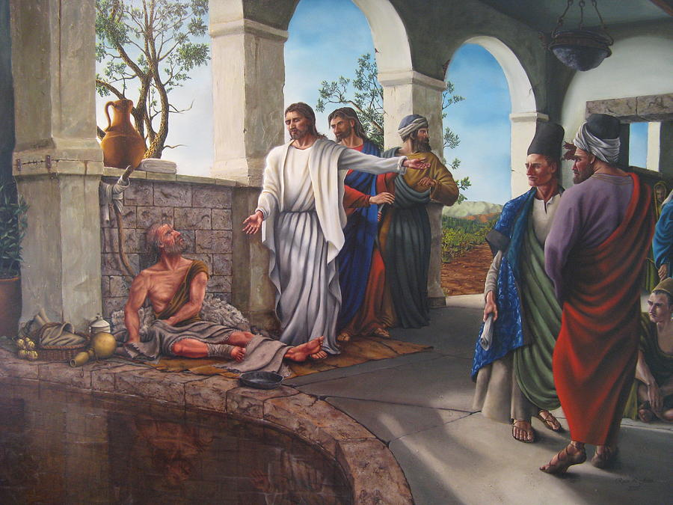
The healing of a lame man at the pool
of Bethesda.

Slide 8
1) He is the SON of God – He is God.
[16] And this was why the Jews were persecuting Jesus, because he was doing these things on the Sabbath. [17] But Jesus answered them, “My Father is working until now, and I am working.” [18] This was why the Jews were seeking all the more to kill him, because not only was he breaking the Sabbath, but he was even calling God his own Father, making himself equal with God. [19] So Jesus said to them, “Truly, truly, I say to you, the Son can do nothing of his own accord, but only what he sees the Father doing. For whatever the Father does, that the Son does likewise. [20] For the Father loves the Son and shows him all that he himself is doing. And greater works than these will he show him, so that you may marvel.”
John 5:16-20 (NIV)

Slide 9
1) He is the SON of God – He is God.
Just as the Father continually works for that which is good, so does Jesus.
b) Jesus claims a unique relationship with God.
c) The Jewish leaders considered his claim as blasphemy.

Slide 10
2. He is the Messiah (SAVIOUR)
[21] “For as the Father raises the dead and gives them life, so also the Son gives life to whom he will. [22] The Father judges no one, but has given all judgment to the Son, [23] that all may honour the Son, just as they honour the Father. Whoever does not honour the Son does not honour the Father who sent him. [24] Truly, truly, I say to you, whoever hears my word and believes him who sent me has eternal life. He does not come into judgment, but has passed from death to life.”
John 5:21-24 (NIV)

Slide 11
Jesus graciously bestows life.
In John 5:21 Jesus asserted his life-giving power.
“…the Son gives life to whom he will….”
When we hear and believe,
a new quality of life comes our way.

Slide 12
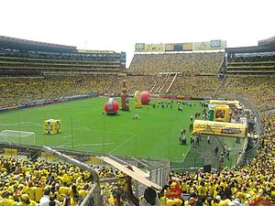

“The referee replied;
‘Maybe so, but mine is the only opinion that counts.’”

Slide 13
3) He is the great Judge
[25] “Truly, truly, I say to you, an hour is coming, and is now here, when the dead will hear the voice of the Son of God, and those who hear will live. [26] For as the Father has life in himself, so he has granted the Son also to have life in himself. [27] And he has given him authority to execute judgment, because he is the Son of Man. [28] Do not marvel at this, for an hour is coming when all who are in the tombs will hear his voice [29] and come out, those who have done good to the resurrection of life, and those who have done evil to the resurrection of judgment. [30] I can do nothing on my own. As I hear, I judge, and my judgment is just, because I seek not my own will but the will of him who sent me.” John 5:25-30 (NIV)

Slide 14
3) He is the great Judge
a) Jesus is the final judge of human destiny.
Jesus judges the morality of the works
of each person.
He is the giver of life in time (John 5:24 – 26).
He is the giver of life in eternity (John 5:28 – 29).

Slide 15
Were these claims true?
The claims of Jesus were verified by the witness of John the Baptist (John 5:33).
“You have sent to John and he has testified to the truth.
The claims of Jesus were verified by the witness of the heavenly Father (John 5:37).
“And the Father who sent me has himself testified concerning me. You have never heard his voice nor seen his form,”

Slide 16
The claims of Jesus were verified by his miraculous works
(John 5:36).
“I have testimony weightier than that of John. For the works that
the Father has given me to finish—the very works that I am doing
—testify that the Father has sent me.
The claims of Jesus were verified by the teachings of the Old Testament (John 5:39).
“You study the Scriptures diligently because you think that in them you have eternal life. These are the very Scriptures that testify about me,”

Slide 17
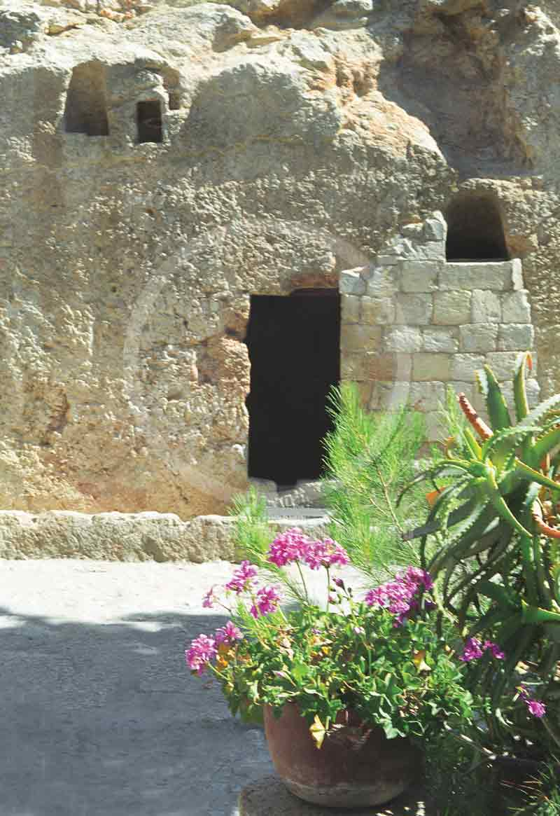
The claims of Jesus were verified by the changes wrought in the lives of those who trusted him as Lord and Master.
The claims of Christ were verified most dramatically by his victorious resurrection from the dead.

Slide 18
Responses to the claims of Christ.
Some responded with idle indifference and unconcern.
Some responded with doubts and unbelief.
Some responded with intense jealousy and hatred as a result of pride, selfishness, and prejudice.
Some received Jesus, believed in him, and followed him with a deathless loyalty.

Slide 19
CS Lewis quote: Mere Christianity
“(Many) people say about Him (Jesus): "I’m ready to accept Jesus as a great moral teacher but I don’t accept His claim to be God." That is the one thing we must not say. A man who was merely a man and said the sort of things Jesus said would not be a great moral teacher. He would either be a lunatic on a level with the man who says he is a poached egg or else he would be the Devil of Hell. You must make your choice. Either this man was, and is, the Son of God: or else a madman or something worse. You can shut Him up for a fool, you can spit at Him and kill Him as a demon; or you can fall at His feet and call Him Lord and God. But let us not come with any patronizing nonsense about His being a great human teacher. He has not left that open to us. He did not intend to.”
What will you do with Jesus?

Slide 20

What will be your response to the claims of Jesus Christ concerning his own unique purpose?

Slide 21
“I tell you the truth, whoever hears my word and believes him who sent me has eternal life and will not be condemned, he has crossed over from death to life”
(John 5:24 NIV).
What will you do with Jesus?

