Slide 1



Slide 2

But what about Spiritual Life?

Slide 3
“Jesus replied ‘I am the way to God the Father, I am the truth and the life, no one comes to the Father but through Me’ ”.
John 14:6.
Let’s Pray…

Slide 4
Jesus is your Way
The Lord warns us in the Bible
This is what the LORD says: "Cursed is the person who trusts in mankind, who makes flesh his strength, and whose heart turns away from the LORD.
Jeremiah 17:5 (ISV)
This is the consequence of having no spiritual life.

Slide 5


Why do we resist?
Human pride.

Slide 6
An example of faith.
Genesis 12
I. There is a calling to come to know the living God.
Idolatry has spread in the earth.
Joshua said to all the people, “This is what the Lord, the God of Israel, says: ‘Long ago your ancestors, including Terah the father of Abraham and Nahor, lived beyond the Euphrates River and worshipped other gods.
Joshua 24:2 (NIV)

Slide 7
God comes to those today who are willing to listen and respond.
The Lord had said to Abram, “Go from your country, your people and your father’s household to the land I will show you.
Genesis 12:1 (NIV)

Slide 8
II. There are promises.
“I will make you into a great nation,
and I will bless you; I will make your name great, and you will be a blessing.
Genesis 12:2 (NIV)
I will bless those who bless you, and whoever curses you I will curse; and all peoples on earth will be blessed through you.”
Genesis 12:3 (NIV)

Slide 9
There are promises.
Matthew 16:18-19
¹⁸ And I tell you that you are Peter, and on this rock I will build my church, and the gates of Hades will not overcome it. ¹⁹ I will give you the keys of the kingdom of heaven; whatever you bind on earth will be bound in heaven, and whatever you loose on earth will be loosed in heaven.”

Slide 10
There are promises.
Matthew 18:18-20
¹⁸ “Truly I tell you, whatever you bind on earth will be bound in heaven, and whatever you loose on earth will be loosed in heaven.
¹⁹ “Again, truly I tell you that if two of you on earth agree about anything they ask for, it will be done for them by my Father in heaven. ²⁰ For where two or three gather in my name, there am I with them.”

Slide 11
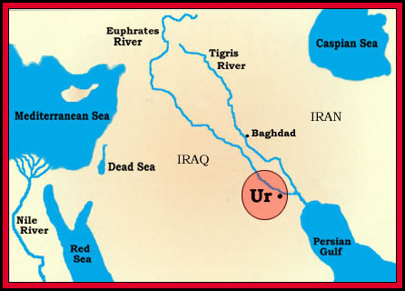
III. Obedience is required.
So Abram went, as the Lord had told him;…
Genesis 12:4 (NIV)

Slide 12
⁷ The Lord appeared to Abram…
So he built an altar there to the Lord, who had appeared to him.
“Instead, they were longing for a better country—a heavenly one.”
Hebrews 11:16 (NIV)

Slide 13
IV. There will be challenges on the way.
¹⁰ Now there was a famine in the land…
¹¹ As he was about to enter Egypt, he said to his wife Sarai, “I know what a beautiful woman you are. ¹² When the Egyptians see you, they will say, ‘This is his wife.’ Then they will kill me but will let you live. ¹³ Say you are my sister, so that I will be treated well for your sake and my life will be spared because of you.”

Slide 14
¹⁷ But the Lord inflicted serious diseases on Pharaoh and his household because of Abram’s wife Sarai.
¹⁸ So Pharaoh summoned Abram. “What have you done to me?” he said. “Why didn’t you tell me she was your wife? ¹⁹ Why did you say, ‘She is my sister,’ so that I took her to be my wife? Now then, here is your wife. Take her and go!” ²⁰ Then Pharaoh gave orders about Abram to his men, and they sent him on his way, with his wife and everything he had.

Slide 15
This is a declaration that is exclusive.
“I am the way and the truth and the life. No one comes to the Father except through me.”
“Salvation is found in no one else, for there is no other name under heaven given to mankind by which we must be saved.”
Acts 4:12 (NIV)

Slide 16
F.F. Bruce writes;
‘He [Jesus] is, in fact, the only way by which men and women may come to the Father; there is no other way. If this seems offensively exclusive, let it be borne in mind that the one who makes the claim is the incarnate Word, the revealer of the Father. If God has no avenue of communication with mankind apart from his Word…mankind has not avenue of approach to God apart from the same Word, who became flesh and dwelt among us in order to supply such an avenue of approach.
MacArthur New Testament Commentary, John 12-21,Moody Publishers, Chicago, 2008, p103

Slide 17
Now this is eternal life: that they know you, the only true God, and Jesus Christ, whom you have sent.
John 17:2 (NIV)
Are you willing to accept His calling this morning?

