Slide 1
Essentials to grow in the spiritual life #8:
God’s promised blessing
Psalm 24

Slide 2
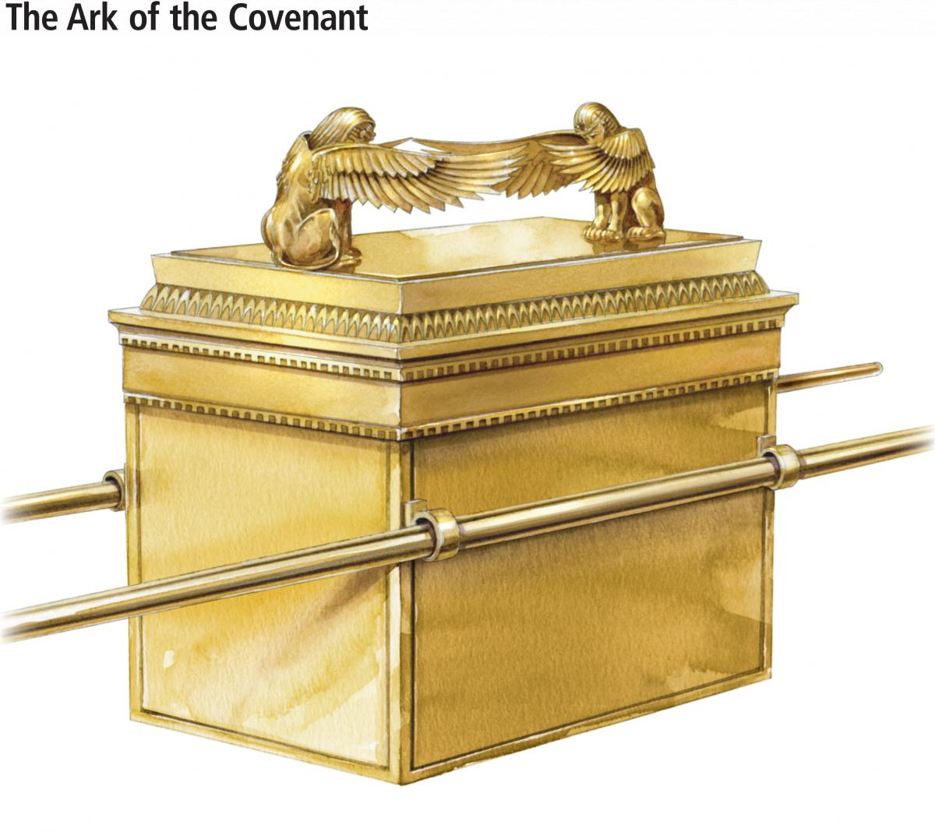
GOD’S PROMISED BLESSING

Slide 3
Psalm 24
A Psalm Of David.
¹ The earth is the Lord’s, and everything in it, the world, and all who live in it; ² for he founded it on the seas and established it on the waters.
³ Who may ascend the mountain of the Lord? Who may stand in his holy place? ⁴ The one who has clean hands and a pure heart, who does not trust in an idol or swear by a false god.
⁵ They will receive blessing from the Lord and vindication from God their Saviour. ⁶ Such is the generation of those who seek him, who seek your face, God of Jacob.
Selah

Slide 4
Psalm 24
A Psalm Of David.
⁷ Lift up your heads, you gates; be lifted up, you ancient doors, that the King of glory may come in. ⁸ Who is this King of glory? The Lord strong and mighty, the Lord mighty in battle. ⁹ Lift up your heads, you gates; lift them up, you ancient doors, that the King of glory may come in. ¹⁰ Who is he, this King of glory? The Lord Almighty— he is the King of glory.
Selah

Slide 5
^{Let’s Pray……}

Slide 6
God is the Lord of the universe…God is Mighty.
“The earth is the Lord’s, and everything in it, the world, and all who live in it;…”
The nation of Israel historically had a problem. As God’s chosen people, they let themselves become prideful and exclusive…
God is the Lord of the universe.
God is not a nationalistic God who is biased against…
Who are you biased against?

Slide 7
II. How to be right to enjoy the presence of the Holy God .
Verse 3: “Who shall ascend the hill of the LORD? / And who shall stand in His holy place?”
So the hill of the LORD is synonymous with God’s holy place
– it’s talking about His Presence,
where His worshipping people appear before Him.
What type of person is David interested in here ?

Slide 8
Sincere worshippers can go up to the ‘holy place’ but
there are here four conditions; admission depends on their:
(a) ‘clean hands’
(b) Purity - ‘pure heart’
(c) Commitment - no idolaters admitted
(d) Integrity.
“Such is the generation of those who seek him, who seek your face, God of Jacob.”
Psalm 24:6 (NIV)

Slide 9
JACOB
²⁵ Then he said, “My son, bring me some of your game to eat, so that I may give you my blessing.”
Jacob brought it to him and he ate; and he brought some wine and he drank. ²⁶ Then his father Isaac said to him, “Come here, my son, and kiss me.” ²⁷ So he went to him and kissed him. When Isaac caught the smell of his clothes, he blessed him and said,
“Ah, the smell of my son is like the smell of a field that the Lord has blessed.
Genesis 27:25-27 (NIV)

Slide 10
Sincere worshippers can go up to the ‘holy place’ but
there are here four conditions; admission depends on their:
(a) ‘Clean hands’ - Jacob’s practice in this matter was ugly and perverse He did not have ‘clean hands’
(b) Purity - His moral purity in family life was not what it ought to have been- He did not have ‘pure heart’
Commitment - Jacob’s spiritual allegiance was in question.
He worshipped what have been called ‘idols of the heart’ - possessions, things, prestige and privilege.
(d) Integrity - Jacob lacked integrity.

Slide 11
III. The Loving and Generous God
“Such is the generation of those who seek him, who seek your face, God of Jacob.”
Psalm 24:6 (NIV)
This psalm says that the ideal worshipper ‘will receive blessing from the Lord’ (verse 5).
David is here convinced that this ‘blessing’ is the gift of his Mighty,
Holy, Generous and Loving God.

Slide 12
This ‘blessing’ of ‘righteousness’ is a gift that depends entirely on our seeking and receiving.
Not on our striving or achieving on the basis of our religious works or moral effort.
Striving or achieving = Religion
Seeking and receiving
=
Personal relation with God

Slide 14
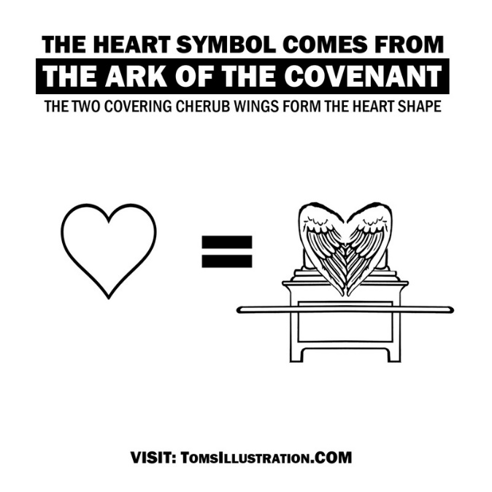
Romans 3:23-25 (NIV)
“for all have sinned and fall short of the glory of God, and are justified freely by his grace through the redemption that came by Christ Jesus. God presented him as a sacrifice of atonement, through faith in his blood. He did this to demonstrate his justice, because in his forbearance he had left the sins committed beforehand unpunished”.
For the Good News to be good news for me, it requires my Commitment.

Slide 15
Mark 1.14-15 (NIV)
After John was put in prison, Jesus went into Galilee, proclaiming the good news
of God. "The time has come," he said. "The kingdom of God is near.
Repent and believe the good news!".
“Then the man said, “Let me go, for it is daybreak.” But Jacob replied, “I will not let you go unless you bless me.”
Genesis 32:26 (NIV)

Slide 16
Blessing is a gift that depends entirely on our seeking and receiving, not on our striving or achieving on the basis of our religious works
or moral effort.
They will receive blessing from the Lord and vindication from God their Saviour.
Psalm 24:5 (NIV)

Slide 17
Will the gates of your heart be opened for Him?
“The King of glory came and will come again”.
Are you seeking Him?
Have you received Him and welcomed Him into your life?

Slide 18
Essentials to grow in the spiritual life #8:
God’s promised blessing
Psalm 24

