Slide 1
Jonah 4
But to Jonah this seemed very wrong, and he became angry. ² He prayed to the Lord, “Isn’t this what I said, Lord, when I was still at home? That is what I tried to forestall by fleeing to Tarshish. I knew that you are a gracious and compassionate God, slow to anger and abounding in love, a God who relents from sending calamity. ³ Now, Lord, take away my life, for it is better for me to die than to live.” ⁴ But the Lord replied, “Is it right for you to be angry?” ⁵ Jonah had gone out and sat down at a place east of the city. There he made himself a shelter, sat in its shade and waited to see what would happen to the city. ⁶ Then the Lord God provided a leafy plant and made it grow up over Jonah to give shade for his head to ease his discomfort, and Jonah was very happy about the plant.

Slide 2
Jonah 4
⁷ But at dawn the next day God provided a worm, which chewed the plant so that it withered. ⁸ When the sun rose, God provided a scorching east wind, and the sun blazed on Jonah’s head so that he grew faint. He wanted to die, and said, “It would be better for me to die than to live.”
⁹ But God said to Jonah, “Is it right for you to be angry about the plant?”
“It is,” he said. “And I’m so angry I wish I were dead.”
¹⁰ But the Lord said, “You have been concerned about this plant, though you did not tend it or make it grow. It sprang up overnight and died overnight. ¹¹ And should I not have concern for the great city of Nineveh, in which there are more than a hundred and twenty thousand people who cannot tell their right hand from their left—and also many animals?”

Slide 3
Let’s pray…

Slide 4
When we don’t understand events in our lives
But to Jonah this seemed very wrong, and he became angry.

Slide 5
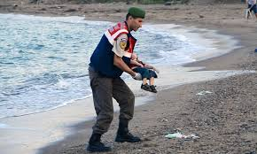
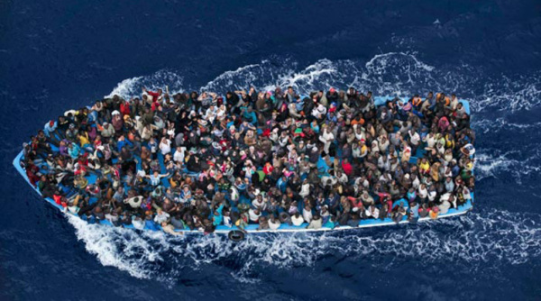
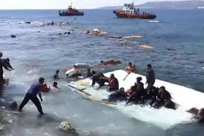
The images of children being washed up on the seashores of Europe

Slide 6
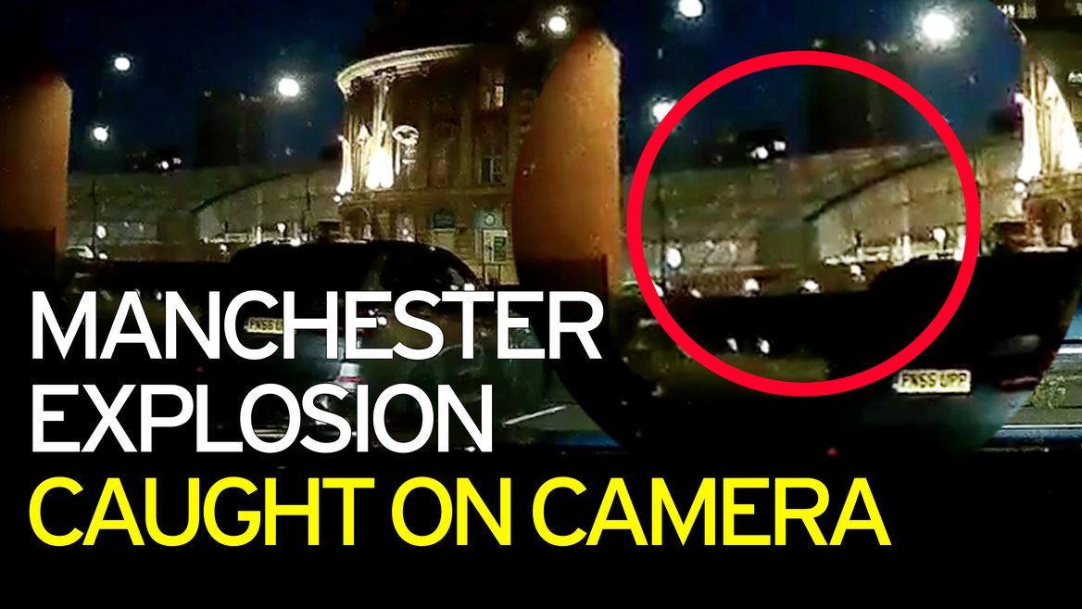
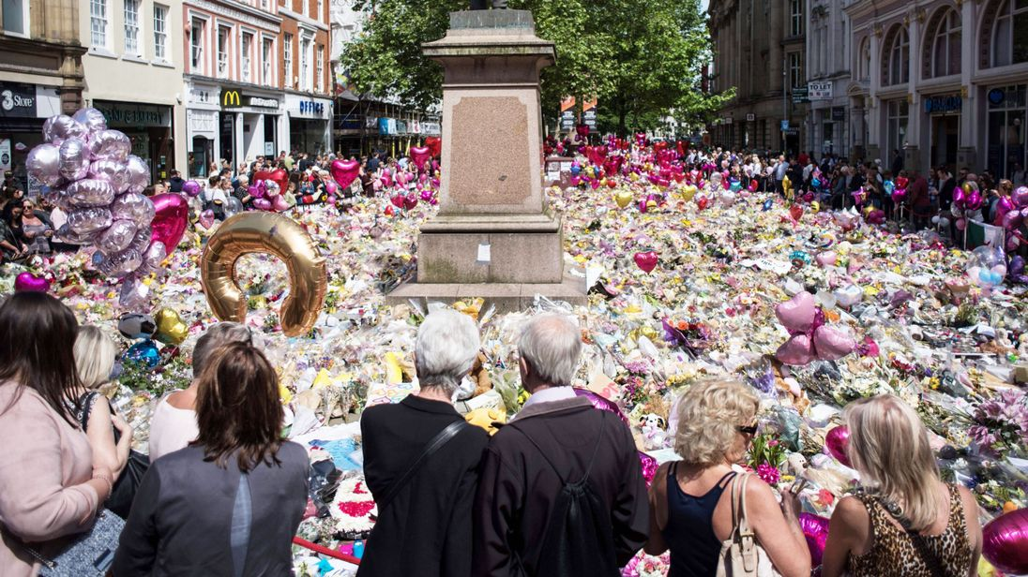

Slide 7
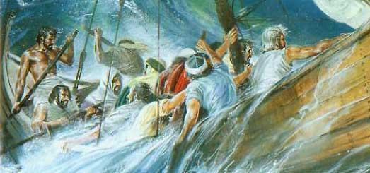
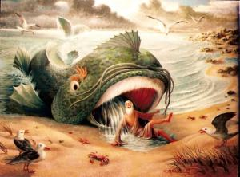
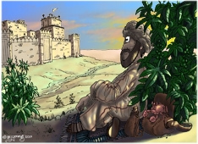
When we don’t understand events in our lives.
I. We tend to question and argue with God

Slide 8
⁹ But God said to Jonah, “Is it right for you to be angry about the plant?”
“It is,” he said. “And I’m so angry I wish I were dead.”
¹⁰ But the Lord said, “You have been concerned about this plant, though you did not tend it or make it grow. It sprang up overnight and died overnight.

Slide 9
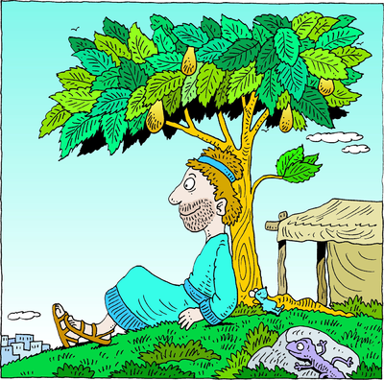
What happens when God sovereignly removes His blessings from us?

Slide 10
II. We show what is inside our hearts
Jonah is angry because he’s finally seeing himself for the first time.
God has shown him what he really is.
“You care about a plant… shouldn’t I care about 120,000 people who don’t even know their right hand from their left?”

Slide 11
II. We show what is inside our hearts
Theologian Henri Nouwen describes human nature as
“A clenched fist”
The dictionary defines ‘hostility’ as
a state of enmity or warfare.
For he himself is our peace, who has made the two groups one and has destroyed the barrier, the dividing wall of hostility,
Ephesians 2:14 (NIV)

Slide 12
“For it is by grace you have been saved, through faith—and this is not from yourselves, it is the gift of God.”
Ephesians 2:8 (NIV)

Slide 13
III. God’s mercy and grace are always available
¹¹ And should I not have concern for the great city of Nineveh,
in which there are more than a hundred and twenty thousand people
who cannot tell their right hand from their left—and also many animals?”
The writer Dorothy Sayer once said:
“Hell is the enjoyment of one’s own way for ever”
C.S Lewis put it even more powerfully when he said that there are two classes of people in the universe:
“Those who say to God, “Thy will be done” – the saints. And those to whom God says, “Thy will be done” – the sinners”.

Slide 14
THY HAND, O GOD, HAS GUIDED
Thy mercy will not fail us, Nor leave Thy work undone; With Thy right hand to help us, The victory shall be won; And then, by men and angels, Thy name shall be adored, And this shall be their anthem,
One church, one faith, one Lord.

Slide 15
⁴⁶ He told them, “This is what is written: The Messiah will suffer and rise from the dead on the third day, ⁴⁷ and repentance for the forgiveness of sins will be preached in his name to all nations, beginning at Jerusalem.
Luke 24:46-47 (NIV)

Slide 16
1 – Has God spoken to you, today?
2 – Has God spoken to us as a Church?
3 – What has He called us to do?
4 – Who has God called you to go to?

