Slide 1
Essentials to grow in the spiritual life #7:
The All-Knowing God
Psalm 139

Slide 2
“Before a word is on my tongue you know it completely, O Lord”
Psalm 139:4.
Let’s Pray…

Slide 3
Psalm 139
We need then to be reminded of our resources.
Like David we must have a big picture of God so that we can realise afresh all that he longs to give to us and do for us.
“who alone is immortal and who lives in unapproachable light, whom no one has seen or can see. To him be honour and might forever. Amen.”
1 Tim.6:16.

Slide 4
The All-Knowing God
I. OUR ALL-KNOWING LORD
¹ You have searched me, Lord, and you know me. ² You know when I sit and when I rise; you perceive my thoughts from afar. ³ You discern my going out and my lying down; you are familiar with all my ways. ⁴ Before a word is on my tongue you, Lord, know it completely.

Slide 5
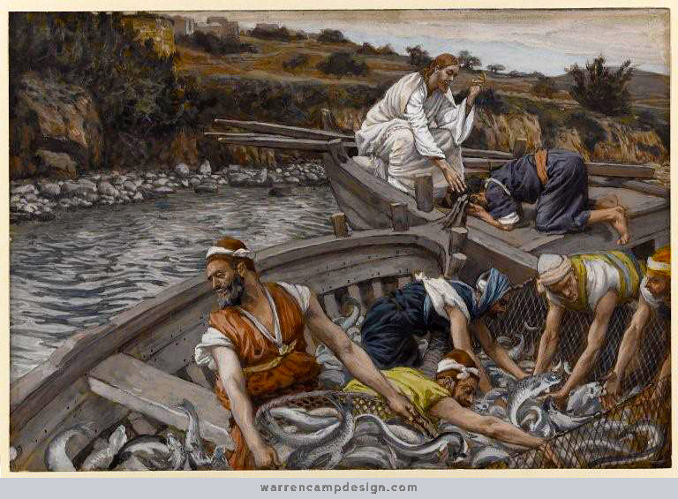
Luke 5:1-11
⁸ When Simon Peter saw this, he fell at Jesus’ knees and said, “Go away from me, Lord; I am a sinful man!”

Slide 6
II. OUR EVER-PRESENT GUIDE
⁵ You hem me in behind and before, and you lay your hand upon me.
⁶ Such knowledge is too wonderful for me, too lofty for me to attain.
⁷ Where can I go from your Spirit? Where can I flee from your presence?

Slide 7
⁸ If I go up to the heavens, you are there; if I make my bed in the depths, you are there. ⁹ If I rise on the wings of the dawn, if I settle on the far side of the sea, ¹⁰ even there your hand will guide me, your right hand will hold me fast.

Slide 8
III. OUR LOVING CREATOR
¹³ For you created my inmost being; you knit me together in my mother’s womb. ¹⁴ I praise you because I am fearfully and wonderfully made; your works are wonderful, I know that full well.
Psalm 139:13-14

Slide 9
III. OUR LOVING CREATOR
¹⁵ My frame was not hidden from you when I was made in the secret place, when I was woven together in the depths of the earth.
Psalm 139:15
David is overwhelmed at the distinctive masterpiece of every human life, the majestic thought of human uniqueness.

Slide 10
IV. OUR INCOMPARABLE TEACHER
¹⁷ How precious to me are your thoughts, God! How vast is the sum of them!
¹⁸ Were I to count them, they would outnumber the grains of sand when I awake, I am still with you.

Slide 11
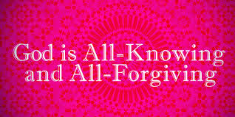
V. OUR RIGHTEOUS JUDGE
²³ Search me, God, and know my heart; test me and know my anxious thoughts. ²⁴ See if there is any offensive way in me, and lead me in the way everlasting.

Slide 12
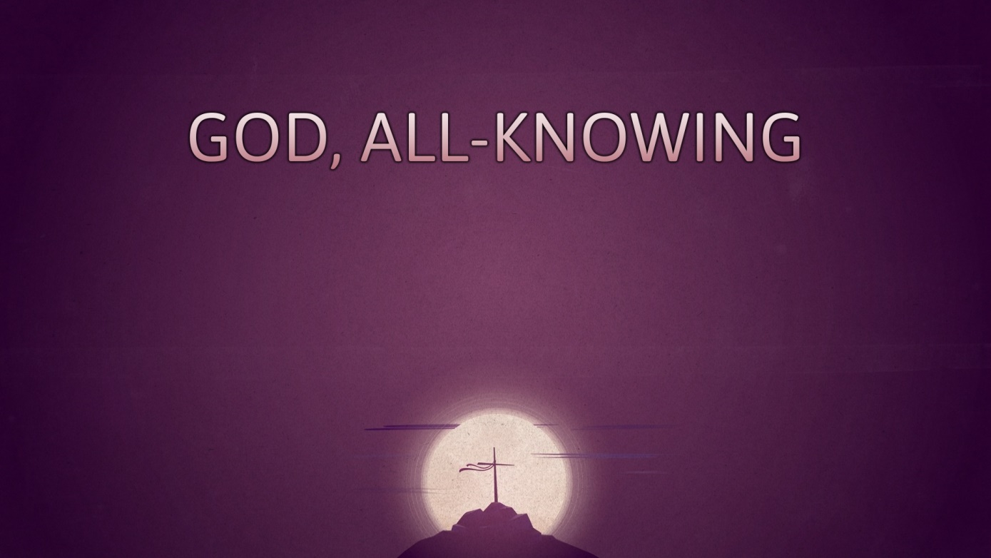
Essentials to grow in the spiritual life #7:
The All-Knowing God
Psalm 139

