Slide 1
“When the day of Pentecost came, they were all together in one place. ² Suddenly a sound like the blowing of a violent wind came from heaven and filled the whole house where they were sitting. ³ They saw what seemed to be tongues of fire that separated and came to rest on each of them. ⁴ All of them were filled with the Holy Spirit and began to speak in other tongues as the Spirit enabled them.”
(Acts 2:1 – 4) NIV.

Slide 2
^{Isaiah 4:2-4 (NIV)}
² In that day the Branch of the Lord will be beautiful and glorious, and the fruit of the land will be the pride and glory of the survivors in Israel. ³ Those who are left in Zion, who remain in Jerusalem, will be called holy, all who are recorded among the living in Jerusalem. ⁴ The Lord will wash away the filth of the women of Zion; he will cleanse the bloodstains from Jerusalem by a spirit of judgment and a spirit of fire.

Slide 3
Let’s Pray…

Slide 4
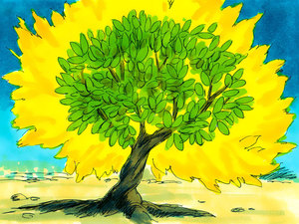
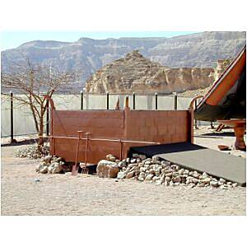
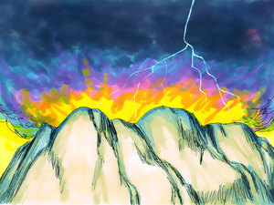
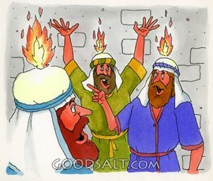
The burning bush
The brazen altar of the tabernacle
Mount Carmel
Pentecost people

Slide 5
The Holy Spirit as a Fire
² Suddenly a sound like the blowing of a violent wind came from heaven and filled the whole house where they were sitting. ³ They saw what seemed to be tongues of fire that separated and came to rest on each of them.
the KJV says; “And there appeared unto them cloven tongues like as of fire”

Slide 6
Matthew 3:11 John the Baptist said about Jesus:
“I baptize you with water for repentance. But He that comes after me is mightier than I, whose shoes I am not worthy to carry. He will baptize you with the Holy Spirit and with fire.”
¹² Whose fan is in his hand, and he will throughly purge his floor, and gather his wheat into the garner; but he will burn up the chaff with unquenchable fire.

Slide 7
I. Fire reveals and consumes.
The first thing that the Bible says that fire does is,
fire reveals.
In 1 Corinthians 3:13, we read:
“Their work will be shown for what it is, because the Day will bring it to light. It will be revealed with fire, and the fire will test the quality of each person’s work.”

Slide 8
²³ Search me, God, and know my heart; test me and know my anxious thoughts. ²⁴ See if there is any offensive way in me, and lead me in the way
everlasting.
Psalm 139:23-24 NIV.

Slide 9
Fire consumes what is not necessary
“But be assured today that the Lord your God is the one who goes across ahead of you like a devouring fire. He will destroy them; he will subdue them before you. And you will drive them out and annihilate them quickly, as the Lord has promised you.”
(Deuteronomy 9:3) NIV.

Slide 10
II. Fire purifies.
The Fire of the Holy Spirit brings to light the dross (filthiness) of our soul and causes us to repent of the sin in our lives
At the sound of their voices the doorposts and thresholds shook and the temple was filled with smoke. ⁵ “Woe to me!” I cried. “I am ruined! For I am a man of unclean lips, and I live among a people of unclean lips, and my eyes have seen the King, the Lord Almighty.” ⁶ Then one of the seraphim flew to me with a live coal in his hand, which he had taken with tongs from the altar. ⁷ With it he touched my mouth and said, “See, this has touched your lips; your guilt is taken away and your sin atoned for.”
(Isaiah 6:4-7) NIV.

Slide 11
III. Fire softens and unites.
All of them were filled with the Holy Spirit…
Ephesians 5:18
¹⁸ Do not get drunk on wine, which leads to debauchery. Instead, be filled with the Spirit,
Why?
Because the FIRE of the Holy Spirit Softens
and Unites.

Slide 12
Fire softens and unites.
The Holy Spirit softens the heart of the sinner. He makes people responsive. He prepares them to be remoulded, remade, regenerated.

Slide 13
IV. Fire empowers.
We are powerless because we are flameless
⁸ But you will receive power when the Holy Spirit comes on you; and you will be my witnesses in Jerusalem, and in all Judea and Samaria, and to the ends of the earth.”
(Acts 1:8) NIV.

Slide 14
IV. Fire empowers.
”they will pick up snakes with their hands; and when they drink deadly poison, it will not hurt them at all; they will place their hands on sick people, and they will get well.” (Mark 16:18) NIV
We don’t put ourselves in a place for these kinds of things to happen.

Slide 15
The consuming, purifying, softening, uniting, and
empowering of the Holy Fire can be ours.
Speaking to a large audience, D.L. Moody held up a glass and asked, "How can I get the air out of this glass?" One man shouted, "Suck it out with a pump!" Moody replied, "That would create a vacuum and shatter the glass." After numerous other suggestions Moody smiled, picked up a pitcher of water, and filled the glass. "There," he said, "all the air is now removed." He then went on to explain that victory in the Christian life is not accomplished by "sucking out a sin here and there," but by being filled with the Holy Spirit.
Today in the Word, September, 1991, p. 30.

Slide 16
WE NEED TO BE REFILLED; WE NEED TO BE FULL TO OVERFLOWING, AND IMMERSED IN THE HOLY SPIRIT!
First, we must be saved. Repent of those things that have kept us from experiencing God’s Best in our lives.
Second, we must be obedient to the leading of the Holy Spirit within us to do the work of the Kingdom.
Third, we must be hungry for the bread of life and thirsty for the Word of God that fills the void within each of us.

Slide 17
Finally, we must surrender our will to Jesus and allow the Holy Spirit to come.
D.L Moody said, "I believe firmly that the moment our hearts are emptied of pride and selfishness and ambition and everything that is contrary to God's law, the Holy Spirit will fill every corner of our hearts. But if we are full of pride and conceit and ambition and the world, there is no room for the Spirit of God. We must be emptied before we can be filled."
J. Kuhatschek, Taking The Guesswork Out of Applying The Bible, IVP, p. 153ff.

